Slide 1
Overview of the situation in the EU: results of an ongoing study on the Impact of
Re-use of Public Data Resources
Màrta NAGY-ROTHENGASS
Head of Unit "Data Value Chain"
DG CONNECT – European Commission

Slide 2
The policy context
2011
  Communication on Open Data (COM(2011)882)
  Update of the Commission's decision on re-use (2011/833/EU)
2012
  Launch of the EU Institutions' portal www.open-data.europa.eu
2013
  Adoption of the Directive (2013/37/EU) amending the PSI Directive
2014
  Commission Notice: guidelines on PSI re-use (2014/C 240/01)
  Commission Communication 'Towards a thriving Data-Driven Economy'
2015
  Adoption of DSM Strategy: April 2015
  Launch of the pan-European Open Data portal: November 2015
  Review of the Commission's decision on re-use

Slide 3
Open Data and the Digital Single Market Strategy (I)
In line with the strategy presented in the 2014 Big Data Communication, Open Data is part of the Data Economy
Pillar III: Maximising the growth potential of the digital economy
Building a data economy – Free flow of data initiative
Commission to focus on:
  Tackling data location restrictions
  Clarifying emerging issues of data ownership, access and liability
  Launching a European Cloud initiative
  Encouraging access to public data

Slide 4
Open Data and the Digital Single Market Strategy (II)
Next steps:
  Launch of public DSM consultation on 'platforms, online intermediaries, data and cloud computing and the collaborative economy'
    https://ec.europa.eu/eusurvey/runner/Platforms/
    Includes a question on PSI re-use
  Closes end 2015
  Results available in February-March 2016

Slide 5
Open Data and the Digital Single Market Strategy (III)
In the field of Open Data, the consultation is intended primarily as 'taking the pulse' exercise rather than preparation for a new policy initiative
New initiatives can be expected in the 'emerging' fields of data localisation, data ownership and access
Policy choices to be decided upon in the second half of 2016

Slide 6
Towards an infrastructure for (open) data (I)
The Connecting Europe Facility (CEF) programme 2014-2020:
"Access to digital service infrastructures are the elementary units of a digital single market, allowing
communication, services and business to grow
allowing areas such as e-commerce and
e-government to exploit their full potential"

Slide 7
Towards an infrastructure for (open) data (II)
Digital Service Infrastructures (DSIs) are deployed to deliver networked cross-border services for citizens, businesses and public administrations.
Supported projects are to contribute to:
Improvements in the competitiveness of the European economy;
Promotion of the interconnection and interoperability of national, regional and local networks;
Access to such networks, thus supporting the development of a Digital Single Market.

Slide 8
Towards an infrastructure for (open) data (III)
The overall objective of the Open Data service infrastructure is to help boost the development of information products and services based on the re-use and combination of open public data, across the EU.
The Open Data infrastructure, through its pan-European portal, provides an interface for accessing infrastructures distributed over a huge number of EU and MSs data repositories. The infrastructure as such provides a technical platform for data discovery and access, together with tools facilitating data transformation and exploitation.

Slide 9
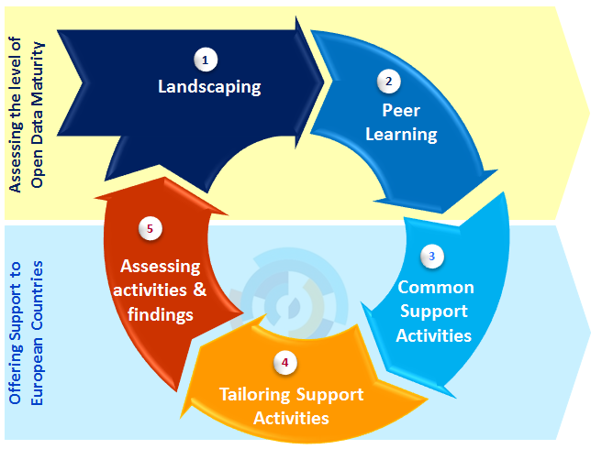
Towards an infrastructure for (open) data (IV)
Already launched actions are not limited to the portal. A series of support activities take place to support EU Countries publishing more data
The objective is to provide common and tailored support to countries to accelerate the release of public data at national and local levels

Slide 10
Fostering the reuse of public data resources
Four complementary work streams are focused on reuse:
Leveraging community engagement to make the most out of Open Data
Communicating and raising awareness about the Portal
Preparing for the future and working on the sustainability
Studying the economic impact of the reuse of public data resources
Economic Benefits of Open Data
Metrics to measure economic impact
Market Size
Jobs Created
Cost Savings
Efficiency Gains

Slide 11
Economic analysis – core study
Four indicators have been measured:
Market Size and value added as percentage of GDP: the market size is defined through the market volume (realized sales volume ) and the market potential.
Number of Jobs Created: number of additional jobs (in persons) created directly related to Open Data for the private sector.
Cost Savings for the public sector: savings include time saved for public administrators by using Open Data, eliminated transaction costs for providing data, realizing more transparency.
Efficiency Gains or productivity gains: qualitative assessment of indirect benefits for citizens. This can be in terms of time saved, lives saved, productivity gains.

Slide 12
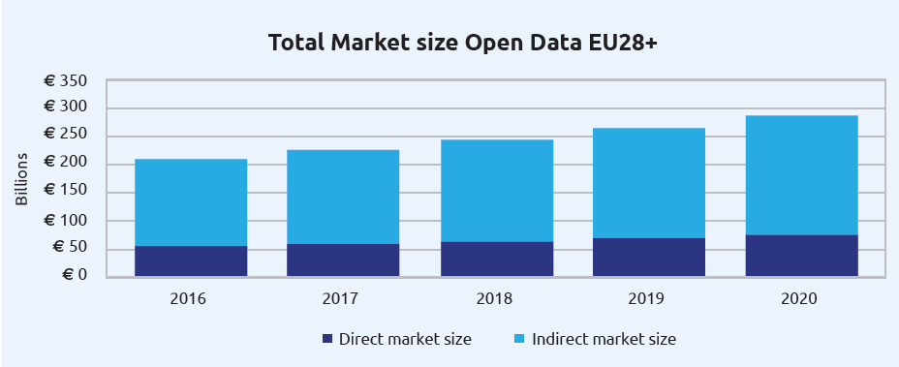
Economic analysis – main results (I)
For 2016, the direct market size of Open Data is expected to be 55.3 bn EUR for the EU 28+.
Between 2016 and 2020, the market size is expected to increase by 36.9%, to a value of 75.7 bn EUR in 2020.
The total market value of Open Data is estimated between 193 bn EUR and 209 bn EUR for 2016 with an estimated projection of 265-286 bn EUR for 2020

Slide 13
Economic analysis – main results (II)
The forecasted total number of direct Open Data jobs in 2016 has an upper bound of 75,000 jobs.
By 2020, the upper bound provides a forecast of just under 100,000 direct jobs directly related to Open Data jobs. This equals a growth of 32% over a 5-year period.
Per year, the increase in number of jobs is forecasted to grow at an average rate of 7.3%.
Thus, in the period 2016-2020, almost 25,000 direct Open Data jobs should be created

Slide 14
Economic analysis – main results (III)
Based on the forecasted EU28+ GDP for 2020, whilst taking into account the countries’ respective government expenditure averages, the cost savings per country have been assessed.
The accumulated cost savings for the EU28+ in 2020 are forecasted to equal 1.7 bn EUR.

Slide 15
Economic analysis – main results (IV)
The metric efficiency gains has a more qualitative approach compared to the other three metrics. It offers a combination of the insights around the efficiency gains of Open Data and real-life examples. Three indicators are assessed in more detail: contribution to life saving, to time saving and to environmental benefits.
The study evaluated that:
Open Data has the potential of saving 1,425 lives a year (i.e. 5,5% of the European road fatalities).
Applying Open Data in traffic can save 629 million hours of unnecessary waiting time on the road in the EU

Slide 16
Economic analysis – conclusions and recommendations
The costs and benefits of releasing data should be further detailed
A marginal or free cost model for Open Data is needed
Government Portals should maintain site analytics in order to obtain important information on who uses the websites, which data sets are being downloaded and how many downloads take place
On Open Data portals, feedback mechanisms should be created
Governments should conduct surveys into the re-use of Open Data in the private sector
The work force should be empowered to make the most of Open Data

Slide 17
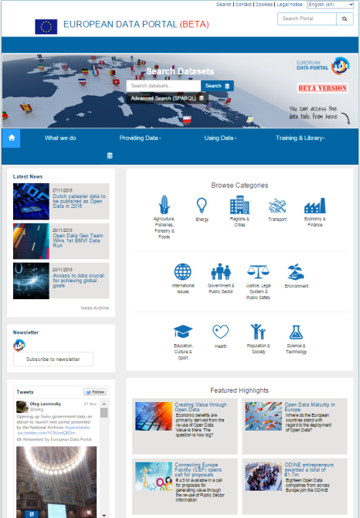
Thank you for your attention
Creating Value through Open Data:
http://www.europeandataportal.eu/en/content/creating-value-through-open-data
European Data Portal:
http://www.europeandataportal.eu/
...and more:
https://ec.europa.eu/digital-agenda/en/content-and-media/data
Contact us at: cnect-G3@ec.europa.eu
Follow us on Twitter: @EUDataEcosystem

