Slide 1
The German eID and eIDAS
Jens Bender Federal Office for Information Security

Slide 2
Electronic Identification @ eIDAS
Notification of (existing) national eID schemes
No „EU-eID“, but mutual recognition of national eIDs
Notification is not mandatory
Recognition of notified eIDs is mandatory
eID schemes are only affected if notified
eServices are always affected
→ „Interoperability“ instead of „harmonisation“

Slide 3
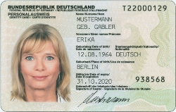
The German eID
Governmental ID Card
Integrated (contactless) chip since 2010
~ 40 Mill. issued
Electronic functions
Travel similar to ePassport
Identification/authentication
Qualified Signature

Slide 4
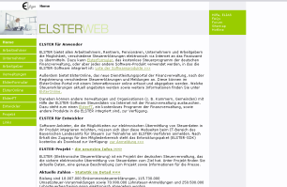
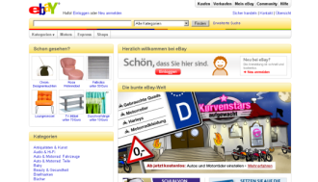
The German eID
Citizen:
Can the service provider prove its identity?
Service Provider:
Is the citizen able to prove his/her identity?
Service provider proves identity using its access certifcate
Both, the citizen and the service provider, have reliable proof of the identity of the other party
Citizen uses eID to prove identity

Slide 5
The German eID
Based on secure channel citizen ↔ SP
As opposed to “document oriented” signatures
Only valid in the moment of authentication
Offline capable
Citizen
Service Provider
Web Browser
Web Site
eID-Client
Background Infrastructure
eID-Server
Card Reader

Slide 6
The German eID
No traditional “ID-Provider”
No central IT security hot spot
No central entitiy which could track citizens → privacy
No Service Level Agreements necessary
Citizen
Service Provider
Web Browser
Web Site
eID-Client
Background Infrastructure
eID-Server
Card Reader

Slide 7
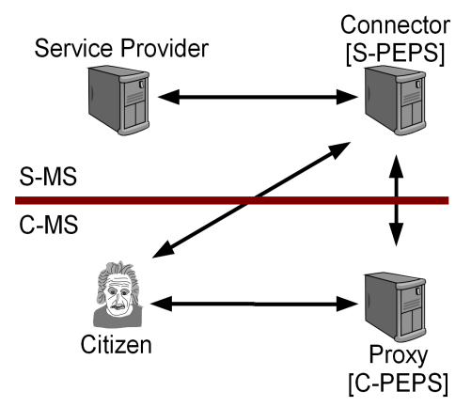
European Interoperability
Many different eID schemes
Smartcard based, TAN based, server based, …
Based on signature or secure channel or …
Operated by government or private sector (or both)
Interop. framework must deal with all of them

Slide 8
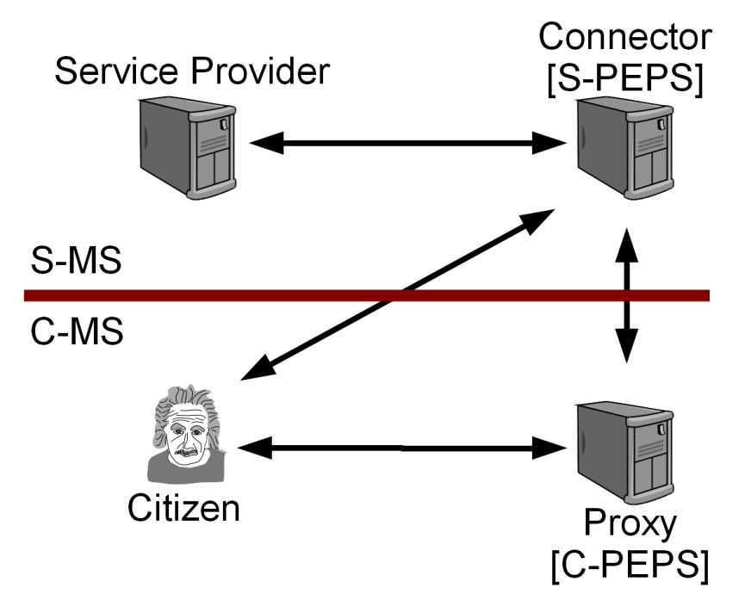
Proxy based
eID scheme provides central “Proxy” all SPs can connect to
Well suited for eID schemes already having a central entity
Pro
SPs needs to implement only a single interface
Con
No end-to-end relationship between citizen and SP
Which law to use? Who is the data controller?
The proxy knows everything → Tracking
Single Point of Failure → Availability?

Slide 9
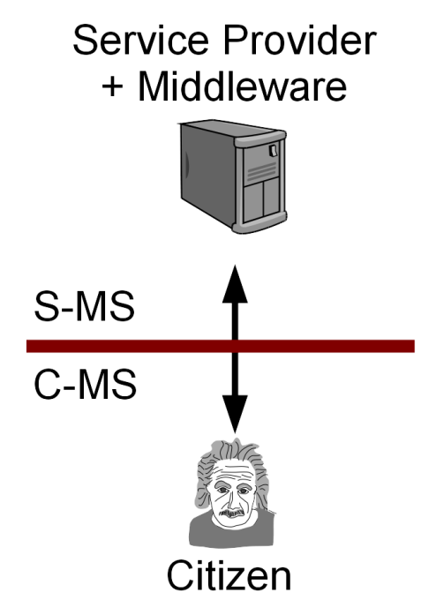
Pure Middleware based
eID scheme provides middleware to SPs
Well suited for eID schemes having no central entity
Pro
End-to-end relationship (allows mutual auth.)
No central component
Con
Service provider needs to deploy middleware

Slide 10
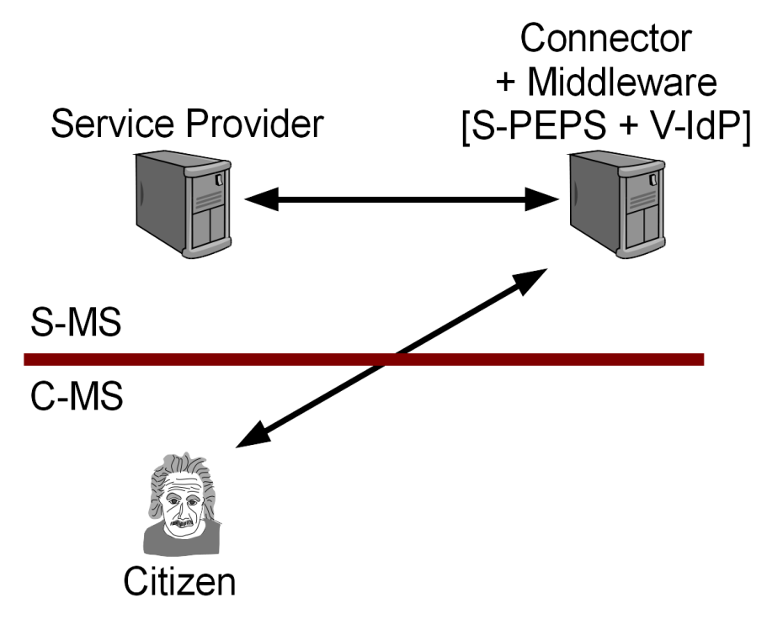
“Hybrid”
Middleware based eID
No central component in eID scheme necessary
Central deployment at receiving MS
As single interface towards Service Provider
SP does not need to know if the citizen uses a MW or Proxy based scheme

Slide 11
Interoperability Framework
Defines common interface for Proxy and Middleware
Notifying MS decides on Proxy- or Middleware based notification
Receiving MS decides on centralized/decentralized deployment
Also “semi decentralized”, e.g. one Connector per sector, is possible
Criteria
Does a central entity already exists
What fits into security/data protection “philosophy”
Scalability
National eID scheme
Proxy
eIDAS Connector
Service Provider(s)
MW 1
National eID scheme
MW 2

Slide 12
DE & eIDAS : eID scheme
German eID is middleware based
Fits into the framework
Middleware to be provided to other MSs under development/testing
eIDAS only deals with “unique identification”
No pseudonymous identification, age verification, …
No authentication of SP
→ only part of the German eID scheme is covered

Slide 13
DE & eIDAS : Service Providers
Decentralized deployment for Service Providers
SPs already operate “eID-Server” for German eID
To be extended by Connector to eIDAS Interoperability Framework
Less data available via eIDAS than from German eID
Not all MSs deliver name at birth, place of birth expected by eGov
Many processes require address not available from all MSs
Service Provider need to understand concept of LoA
→ Adaption of business processes necessary!

Slide 14
Current Status / Way forward
Implementing Act for Interoperability Framework published in Official Journal
Technical Specifications
Drafted by Technical Subgroup of the Expert Group
Opinion of the Cooperation Network and adoption
Testing and Integration
Sample Implementation by DIGIT under CEF
Pilots …
Support for MSs for (technical) integration via CEF calls
Which Member State will notify first?

Slide 15
Long-term Hypothesis
Currently: many different national eID schemes
Every MS does his own thing
„Enforced“ interoperability via eIDAS regulation
→ Hypothesis: Convergence of eID schemes will happen Due to economic, not regulatory, pressure
Common standard(s)
Common data model(s) and „direct“ interoperability
Cost and time-to-market reduction for industry and MS

Slide 16
! – ?

