Slide 1
Opening Data in a Social Way
The case of www.data.gouv.fr
Claire-Marie Foulquier-Gazagnes @Etalab @_cmfg

Slide 2
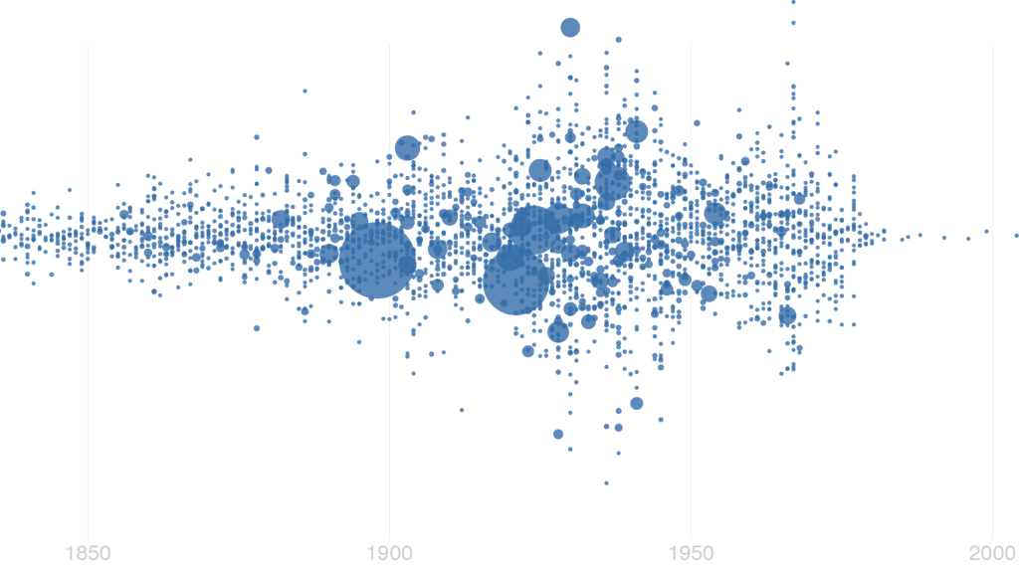
Vision

Slide 3
Access to Data is a right of the Society
Notes:
« Society has the right to require of every public agent an account of its administration »

Slide 4
Data only takes value when reused

Slide 5
Data is a social construct
Notes:
The illusion of raw data / The Hawthorne effect http://psych.hanover.edu/vygotsky/smagor.html

Slide 6
Co-construction

Slide 7
Meet users, test & learn

Slide 8
Develop in the Open

Slide 9
Iterate, Iterate, Iterate…

Slide 10
Execution

Slide 11
Open Data Reuses: Front and Center
On the Homepage
On datasets’s webpages

Slide 12
Citizen’s contribution: Allowed!
Open Data from CSOs
Open Data from corporations

Slide 13
Social Web: use its code & tools
Notes:
10775 users

Slide 14
Iterations

Slide 15
Ongoing conversations
On Twitter
On Data.gouv.fr

Slide 16
Inspiration: renewed
adresse.data.gouv.fr
mes-aides.gouv.fr

Slide 17
KPIs: make them social!

Slide 18
Thank you!
Questions? @Etalab @_cmfg

