Slide 1
ISA²
"A programme on interoperability solutions and common frameworks for European public administrations, businesses and citizens as a means for modernising the public sector"
Promoting Interoperability in Europe
eGovernment
Luxembourg, December 2015
Margarida Abecasis Margarida.abecasis@ec.europa.eu
DG for Informatics
European Commission

Slide 2
ISA Interoperability Solutions for European public Administrations
Objectives
European public
administrations
Flexible and
interlinked
Efficient
… and effective electronic
cross-border and cross-sector
interaction between European
public administrations.
… share and re-use existing successful or new
Interoperability solutions, common services and generic tools.
…IT systems allow smooth implementation of Community policies and activities.
2

Slide 3
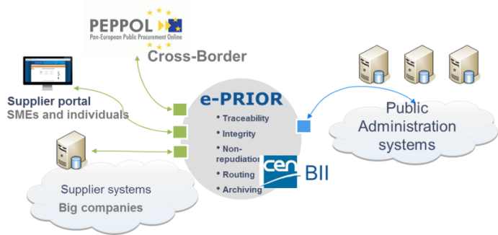


ISA² in brief
Extended scope
Programme on interoperability solutions and common frameworks for European public administrations, businesses and citizens as a means for modernising the public sector
Administration to:
Administrations
Citizens
Businesses
Proposals from Member States and Commission services
~131M Euros
2016-2020
Execution by
the European Commission
3

Slide 4






Updated focus
    Updated approach
    Scope extension
    Modernise PA at all levels
    Links with other EU initiatives
    Holistic approach
    Global picture on IOP in Europe
    Instruments
      Strategy
      Framework
      Architecture
      Cartography
    Legislation Gaps
    Business
    Citizens
    Identify, collect and respond to user needs
    EU and national level
    Drill down to regional and local
    Connecting Europe facility
    Horizon2020
    Structural Funds
    Monitoring
    Communication
    User satisfaction
    Quantification of benefits
    Disseminate
    Engage
4

Slide 5
ISA² updated focus
Objectives
Develop, maintain promote a holistic approach to IOP
Implement the EIF
Monitor EIF's implementation
IOP cross-border or cross-sector
Administrations, businesses and citizens
Go down to regional and local administrations
Identify, create and operate IOP solutions to support EU policies
Facilitate re-use of IOP solutions by the EU public administrations
5

Slide 6
ISA² updated focus
Activities (1/2)
Build new interoperability services and tools
Maintain and operate existing ones
Maintain, update, promote and monitor implementation of the EIS, the EIF and the EIRA
Put in place a European Interoperability cartography (EIC) based on a European Interoperability Reference Architecture (EIRA) to ease reuse and identify gaps
Monitor and evaluate progress
Assess, update and promote existing common specifications and standards
Develop new common & open specifications
Collaborate with European and international standardisation bodies
6

Slide 7
ISA² updated focus
Activities (2/2)
Assess the ICT implications of existing and proposed EU legislation
Identify legislation gaps hampering interoperability
Develop a mechanism to measure and quantify the costs and benefits of interoperability
Identify and promote best practises, develop guidelines to coordination on interoperability and facilitate community building
Put in place a platform to disseminate interoperability solutions, allow exchange of best practises and raise awareness
Develop a communication strategy to raise awareness targeting businesses, SMEs and citizens
7

Slide 8
ISA² updated focus
Chosen actions shall …
    be guided by principles:
    be based on utility and driven by identified needs and programme objectives
subsidiarity & proportionality;
user-centricity;
inclusion and accessibility;
prevent digital divide;
security, privacy & data protection;
multilingualism;
administrative simplification and modernisation;
transparency;
preservation of information;
openness;
re-usability and avoidance of duplication;
technological neutrality, solutions which, insofar as possible, are future-proof, and adaptability;
effectiveness and efficiency;
be flexible, extensible and applicable to other business or policy areas;
demonstrate financial, organisational and technical sustainability
8

Slide 9

ISA² updated focus
Prioritisation
Link with other EU initiatives
Contribution to IOP landscape
Criteria are of equal value
Actions fulfilling more criteria are given higher priority
Reusability
Priority check
Scope of action
Geographical reach
Urgency
9

Slide 10
ISA² updated focus
Implementation rules
Include IOP solutions in the EIC
In the implementation of the programme, give due consideration to the
EIS and the EIF
Implementation
Rules
To establish and improve IOP solutions, build on exchange of views, sharing of experience and best practises
Give due consideration to the EIRA
Organise conferences, workshops and the like
10

Slide 11
ISA² updated focus
Monitoring and Evaluation (1/2)
Run an interim and a Final Evaluation
"The Commission shall monitor regularly the implementation and re-use of interoperability solutions across the Union"
What to check
Relevance (also for local and regional administrations)
Effectiveness
Efficiency
Utility including business & citizens satisfaction
Sustainability
Coherence
Coherence and synergies with other initiatives, i.e. CEF
Benefits of actions to advancing the EU policies
11

Slide 12
ISA² updated focus
Monitoring and Evaluation (2/2)
How to check
The achievement of the objectives shall be measured in particular in terms of the number of key interoperability enablers and through the number of supporting instruments delivered to and used by European public administrations
Evaluation should contain
1. Quantifiable and qualifiable benefits that the interoperability solutions deliver by linking ICT with the needs of end-users;
2. the quantifiable and qualifiable impact of the interoperable ICT-based solutions.
Completed or suspended actions shall remain subject to the overall programme evaluation and evaluated in terms of user uptake, utilisation and re-usability.
12

Slide 13
Updated focus
    Updated approach
    Scope extension
    Modernise PA at all levels
    Links with other EU initiatives
    Holistic approach
    Global picture on IOP in Europe
    Instruments
      Strategy
      Framework
      Architecture
      Cartography
    Legislation Gaps
    Business
    Citizens
    Identify, collect and respond to user needs
    EU and national level
    Drill down to regional and local
    Connecting Europe facility
    Horizon2020
    Structural Funds
    Monitoring
    Communication
    User satisfaction
    Quantification of benefits
    Disseminate
    Engage
13

Slide 14

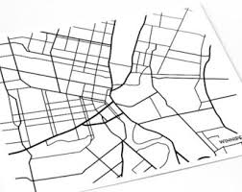

Work under ISA
European IOP Strategy & Framework (EIS and EIF)
European Interoperability Reference Architecture – EIRA
European IOP Cartography – EIC
ICT impact of EU legislation ("Digital check")
Share and reuse framework
1
Supporting instruments ("City planning")
Key interoperability enablers ("City utilities")
2
3
Support EU legislation and initiatives
Data exchange
eID – eSignature
Data semantics
Base registries
Catalogue of Services
Digital Single Market
INSPIRE
14

Slide 15
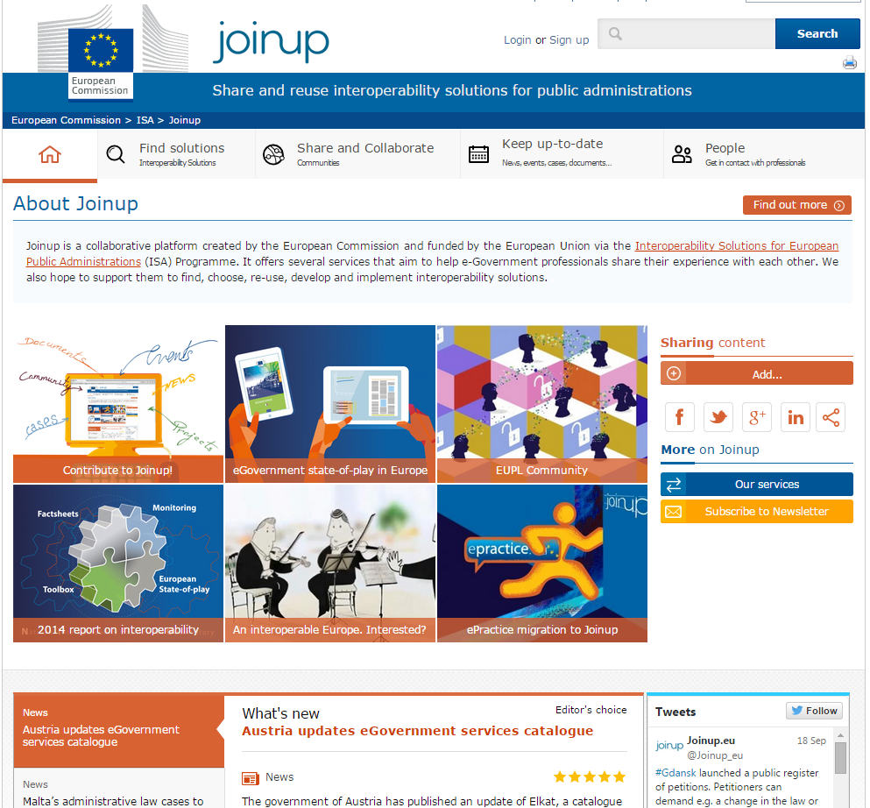
Work under ISA
https://joinup.ec.europa.eu/
15

Slide 16
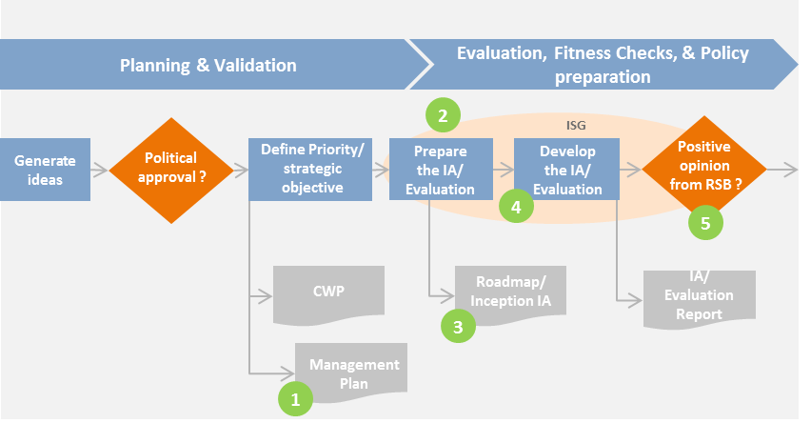
Work under ISA
Start early + Control mechanisms + Integrate with IT Governance
ICT tool #23
ISA method
Collect early
feedback
Screen Roadmaps
and notify ICT Governance
check and notify
ICT Governance
16

Slide 17
Work under ISA
ISA monitoring framework
Evaluation Criteria | Meaning (*) | Frequency | Method | ISA Dasboard
Efficiency | The extent the desired effects are achieved at a reasonable cost | Monthly | Action reporting | Y (action & program level)
Effectiveness | The extent to which action objectives set are achieved | Monthly, quarterly or yearly | Action reporting | Y
Availability | Ability of a service to perform its agreed fucntion when required | monthly | Action reporting | Y
Utility | The extent to which action effects corresponded with the needs to be addressed | Interim / final evaluation | Survey/Interviews | On-going
Perceived Quality | Extent to which action effects satisfies expectations of direct beneficiaries? | Interim / final evaluation | Survey | Y
Coherence | Links between actions/other EU initiatives | Yearly with revision work program | Report | N
Relevance | The extent to which an actions’ objectives are pertinent to needs to be addressed | Interim and final evaluation | Survey/Interviews | Y (Program level)
17

Slide 18


Work under ISA
Time
Savings
Cost savings for users
Owner time savings
Financial
Benefits
Increased revenue for owners
User time savings
Reduced operational costs for owners
Vendor lock-in avoidance for owners
Facilitate reuse, sharing and adoption
of future solutions
Higher services satisfaction for users
Improved
Service Quality
Improved compliance for owners
Better data quality for owners
Better data availability for users
Foster innovation
Improved security for owners
Increase transparency
Spill-over
effects
Impact on growth and competitiveness
Protection of fundamental rights for users and society
Reduced CO₂ emissions
Better decision making
Furthering public and private policy goals
18

Slide 19
Challenges and Opportunities
    Updated approach
    Scope extension
    Modernise PA at all levels
    Links with other EU initiatives
    Holistic approach
    Global picture on IOP in Europe
    Instruments
      Strategy
      Framework
      Architecture
      Cartography
    Legislation Gaps
    Business
    Citizens
    Identify, collect and respond to user needs
    EU and national level
    Drill down to regional and local
    Connecting Europe facility
    Horizon2020
    Structural Funds
    Monitoring
    Communication
    User satisfaction
    Quantification of benefits
    Disseminate
    Engage
19

Slide 20



Q & A
Thank you !
Join ISA initiatives at: http://ec.europa.eu/isa/index_en.htm
and @ http://joinup.ec.europa.eu
http://goo.gl/eK1EY
@SEMICeu
http://joinup.ec.europa.eu
20

