Slide 1
The “Once Only Principle” and reuse of data in Luxembourg
Gilles Feith
Director, Government IT Centre

Slide 2
Agenda
Key findings and conclusions of the European study on the “Once Only” principle conducted in the context of EUPAN
Core eGovernment principles adopted by the Luxembourg Government Council and their implementation on the MyGuichet platform

Slide 3
Agenda
Key findings and conclusions of the European study on the “Once Only” principle conducted in the context of EUPAN
Core eGovernment principles adopted by the Luxembourg Government Council and their implementation on the MyGuichet platform
Notes:
The study took place between July and October 2015.
It was done in the context of EUPAN, more specifically for the IPSG meeting in mid-October
Online questionnaire
Desk research
Case studies
Paper version of the study is available at the registration desk. It was also sent to the participants of the conference last week.

Slide 4
Has your country started to implement the OOP?
IS*
    Out of a total of 33 European countries, 25 countries have started to implement the OOP at national level.
    7 of these 25 countries have started implementing it on both regional and local levels.
FI*
NO
EE
SE
LV
DK*
LT*
IE
UK*
NL
DE*
PL*
BE
LU
CZ
SK
FR*
LI
AT
HU
CH
SI
RO
HR
IT
BG
MK
TR
Implementing OOP
PT
ES
GR
Not implementing OOP
CY
MT

Slide 5
Is there a strategy/initiative for implementing the OOP in your country?
IS
    Out of a total of 25 European countries:
    16 have both a strategy & initiatives in place;
    2 have only a strategy in place; and
    7 have only initiatives in place.
FI
NO
EE
SE
LV
DK
LT*
IE
UK
NL
DE
PL
BE
LU
CZ
SK
LI
AT
HU
Both a strategy & initiative(s) exist
FR*
CH
SI
RO
Only a strategy exists
HR
IT
BG
Only initiative(s) exist(s)
MK
TR
PT
ES
GR
No data available
CY
MT

Slide 6
Is there legislation that supports the implementation of the OOP in your country?
IS
    Out of a total of 25 European countries, 13 have legislation supporting the implementation of the ‘Once-only’ principle in place.
FI
NO
EE
SE
LV
DK
LT
IE
UK
NL
DE
PL
BE
LU
CZ
SK
FR
LI
AT
HU
CH
SI
RO
HR
IT
BG
A piece of legislation exists
MK
TR
PT
ES
GR
No specific legislation
No data available
CY
MT

Slide 7
Is there a law establishing authentic sources in your country?
    For each type of data, the establishment of related authentic sources is widely supported by a specific law.
Number of answers
12
10
8
Yes
6
No
Don’t know/No opinion
4
No answer
2
Note:
An authentic source is a high quality database, accompanied by explicit guarantees ensuring its quality and that contains essential and/or frequently used data pertaining to persons, institutions, issues, activities or occurrences.
Personal data related to citizens
Identification data related to businesses
Geographic (including address) data
Fiscal/Financial data
Health data
8

Slide 8
How does your country implement the consent of “data subjects”?
IS
    Out of a total of 25 European countries,
    10 countries apply the principle that explicit consent has to be given by the ‘data subjects’ before their data can be processed, whereas this processing is set by default by law in 6 other countries. Depending on the type of data, 4 additional EU countries require the explicit consent of ‘data subjects’ if the processing of those data is not imposed by law.
Explicit consent to be given
FI
By law, no explicit consent needed
NO
Explicit consent to be given or imposed by law
EE
SE
LV
No answer
DK
LT
IE
UK
NL
DE
PL
BE
LU
CZ
SK
FR
LI
AT
HU
CH
SI
RO
HR
IT
BG
MK
TR
PT
ES
GR
CY
MT
Source: Online questionnaire (KURT SALMON 2015), n=25

Slide 9
What are the main barriers to overcome in order to ensure the implementation of the OOP?
Organisational barriers (21)
Semantic barriers (16)
Legal barriers (13)
Technical barriers (9)
    Lack of resources
    Lack of willingness to share data with other administrations
    Lack of harmonisation of processes
    Inconsistencies in data elements definition
    Different data models
    Specific provisions related to the processing of personal data
    Legacy systems
Main barriers encountered
    Identification of information ownership
    Common strategy coordinated by one entity
    Establishment and promotion of common vocabularies
    No measures mentioned
    No measures mentioned
Measures proposed
Other barriers mentioned: implementation costs related to the OOP and lack of budget.
Source: Online questionnaire (KURT SALMON 2015), n=25
9

Slide 10
What approach is currently used by your country to implement the OOP?
Front-office
integration
Combination of both
Front & Back-office
integration
Combination
IS
1
(5%)
Back-office integration
FI
Front-office integration
Don’t know/
No opinion
3
(16%)
11
(58%)
N/A
NO
EE
SE
LV
1
(5%)
DK
LT
Other
IE
3
(16%)
UK
NL
DE
PL
Back-office
integration
BE
CZ
LU
SK
    A combination of both Front and Back-office integration is used by a vast majority of countries to implement the OOP. In fact, this approach facilitates the different applications and related processes used to implement the OOP.
FR
LI
AT
HU
CH
SI
RO
HR
IT
BG
MK
TR
PT
ES
GR
CY
MT

Slide 11
Agenda
Key findings and conclusions of the European study on the “Once Only” principle conducted in the context of EUPAN
Core eGovernment principles adopted by the Luxembourg Government Council and implementation on the MyGuichet platform

Slide 12

Towards a highly performant eAdministration
Fundamental principles adopted in July 2015 by the Luxembourg Government Council:
  Digital by Default
  Transparency
  « Once Only » principle
Right balance has to be found between administrative simplification and modernisation and data protection
→ Trust is key!

Slide 13




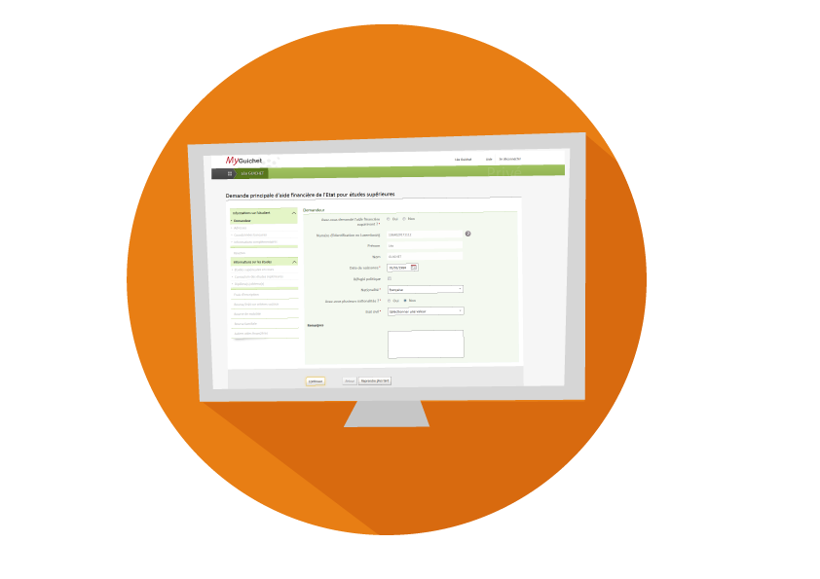





MyGuichet platform
Eco friendly
Tracking
Security
Tailored dialog
Time gain
Supporting document management
High availability
Notes:
Starting at 1 o’clock: Security, time gain, availability 24h/24h , 7d/7d, Supporting document management, tailored dialog, tracking, ecoFriendly

Slide 14




MyGuichet workflow
Front Office
Back Office
Security
Strong authentication
Once Only
(front office)
Citizens & Businesses
Personal data consultation
Administrative task
Pre filling
Once Only
(back office)
Data entry
Authentic sources
Correction request
eSign
User consent
Processing
Additional documents
Admission
Transmission
Administrative request
Transparency
User consent
Tracking
Response
Notes:
Animation
Step 1 : Users log in to perform Administrative task or consult personal Data
Step 2 : MyGuichet general process : Data entry, eSign, Transmission and processing by ADM
Step 3 : Once only (FRONT Office) based on authentic sources used to prefill forms
Step 4 : once only (BACK Office) : Administrations have an access to Authentic sources with the consent of the users
Key benefits :
compliant with data protection
no need for requester to provide supporting document
Also doing the loop with the IPSG study → combination of once only front-office integration and back-office

Slide 15

MyGuichet platform
  More APIs for databases or registers containing authentic sources will be implemented over time.
Citizens & Businesses
Security
Data compartment
VAT balance sheet
Taxi waiting list
National Register
Driving license
Tax credit
…
Private Space
Professional Spaces
Data compartment
Front Office
eForms
eForms
Authentic
sources
Data consultation
Data consultation
Data compartment
Tracking
Tracking
Data compartment
Data compartment
Authentic
sources
Back
Office
Back Office
Security
Administrations
Notes:
Step 1
Global architecture of MyGuichet
Front Office dedicated to Citizen and Businesses
Back office dedicated to Administrations
Front office provides: personal spaces that allow to
perform administrative task + tracking
access authentic sources
Step 2
Many authentic sources are available
In order to comply with data protection legislation, data provided by the authentic sources are compartmentalized in semantic units

Slide 16
Authentic sources - the main engine for OOP
No need for users to provide supporting documents
Compliant with data protection
  Users can access their data
  Data are compartmentalized in semantic units
Users have the possibility to correct data that concerns them
  Increases the quality of government data

Slide 17
Thank you very much
?

