Slide 1
Once Only, Only Once?
Guus Bronkhorst
The Netherlands

Slide 2
Topics
Once only in the Netherlands
  System of base registries – law and system
  Standard business reporting – framework pp
  Once only in the social sector - law
Policy goals and principles
Datafication, data management
Information society and role of citizens

Slide 3
Once only
What kind of data?
How and who to collect?
How to store, distribute and re-use?
Personal data and privacy
Is once only always only once?

Slide 4
System of base registries

Slide 5
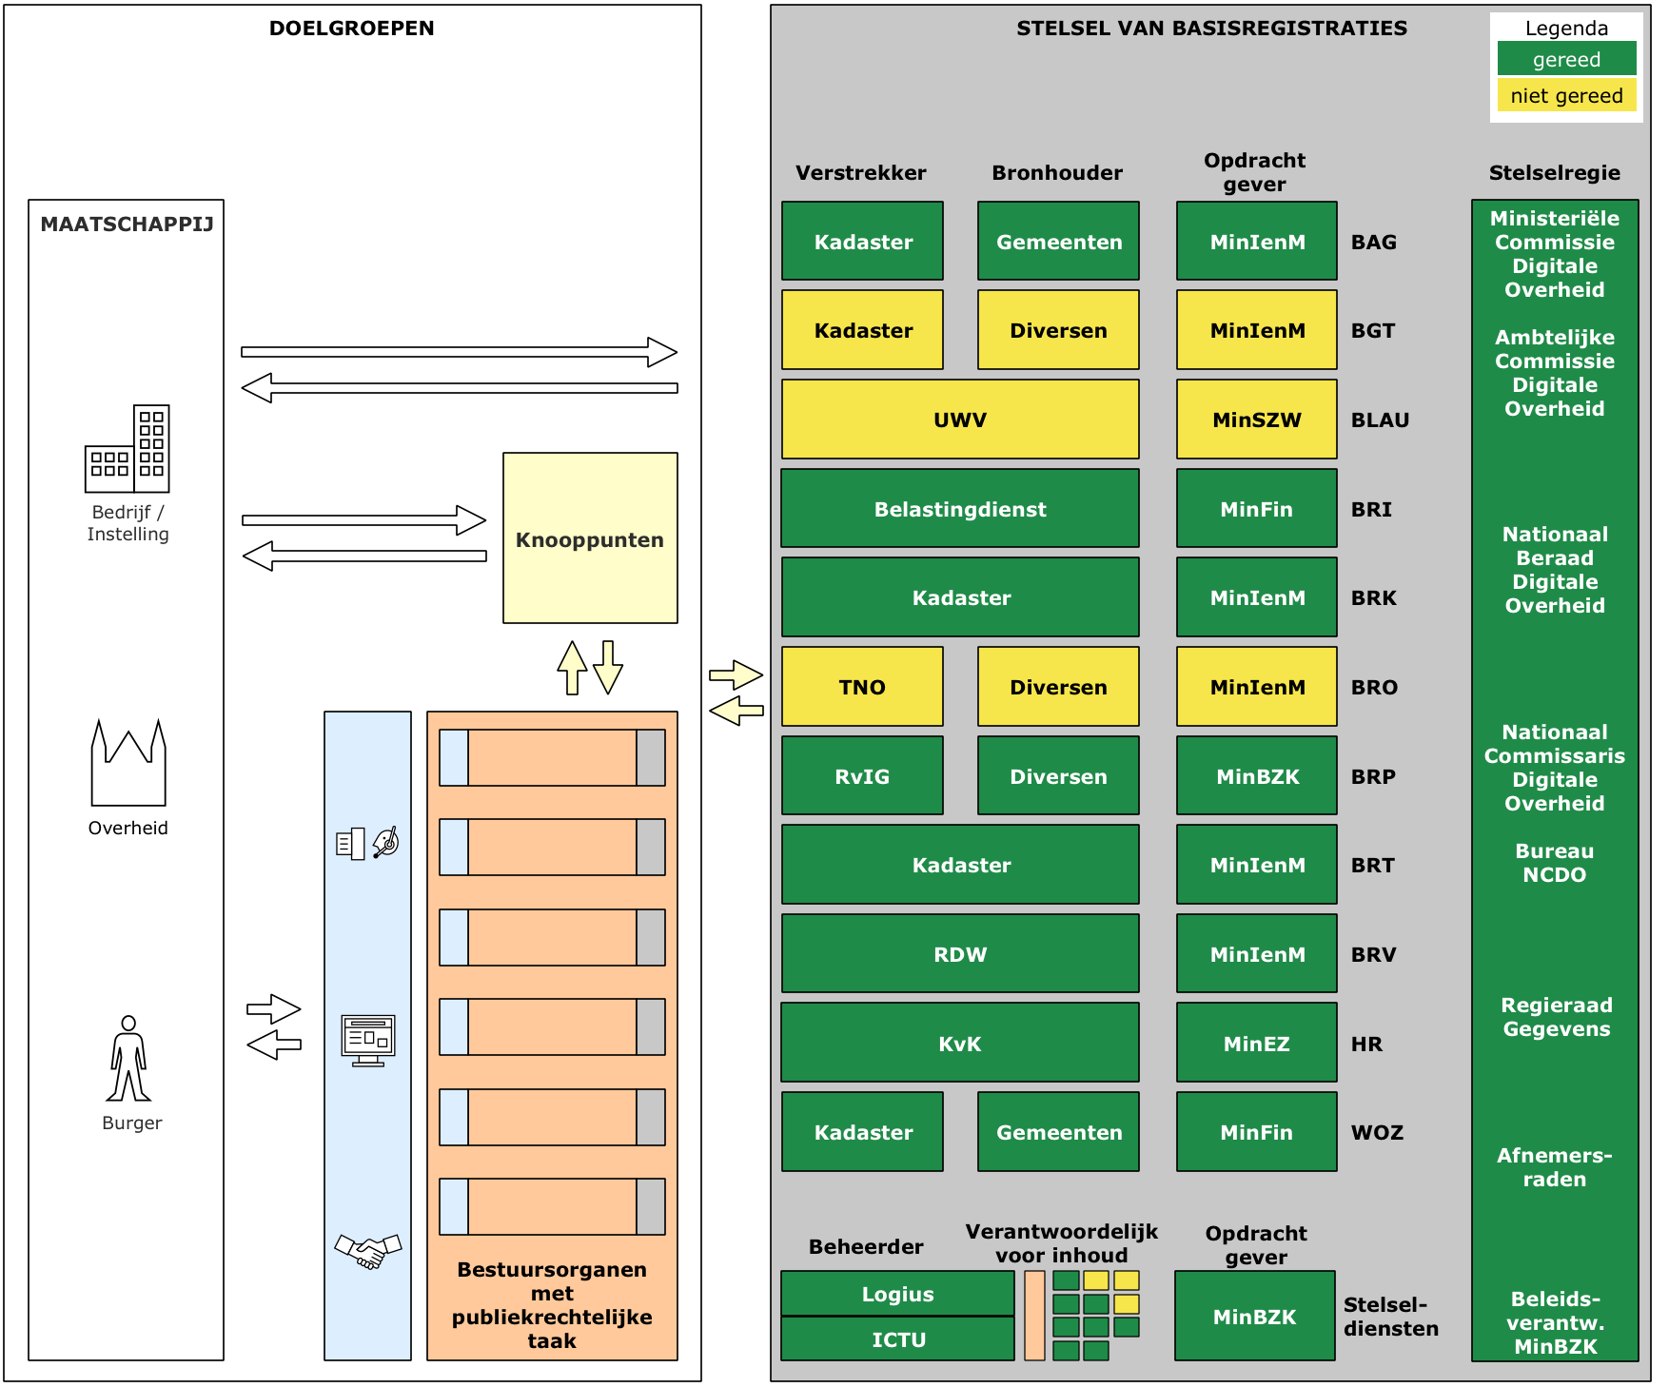
Base Registries

Slide 6
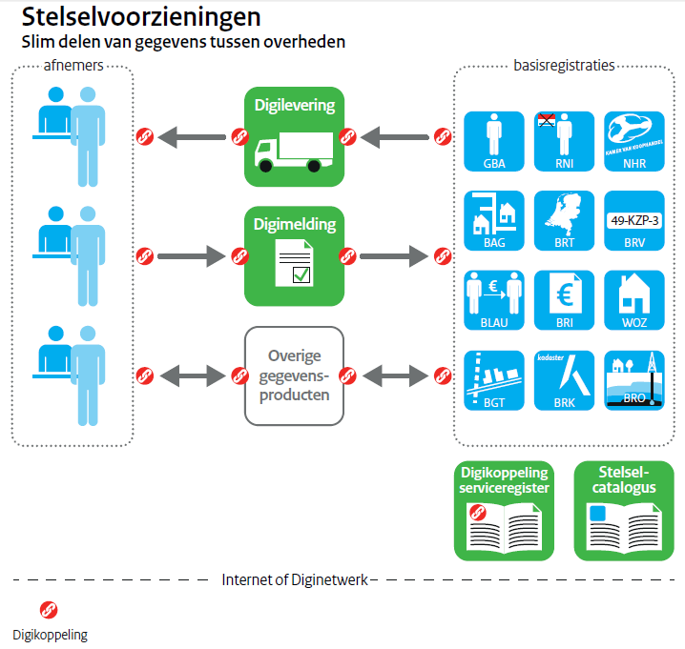
Base Registries

Slide 7
Standard business reporting
Once only delivery of financial data
Standardisation in data, processes and technology
Framework agreement between government and businesses
Use of XBRL, taxonomy, DIGIGate

Slide 8
Social sector
Law once only delivery
Government should use
  Base registries
  Once only on all other information from citizens
Re-use through the chain: agencies, municipalities

Slide 9
Principles of NL information Policy
A public sector that:
• provides answers to questions of the public
• does not require information that is already available
• cannot be fooled
• knows what it is talking about
• can be relied on.

Slide 10
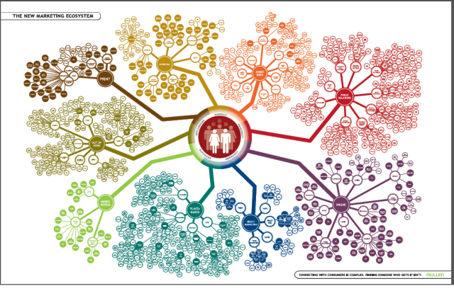
Datafication

Slide 11
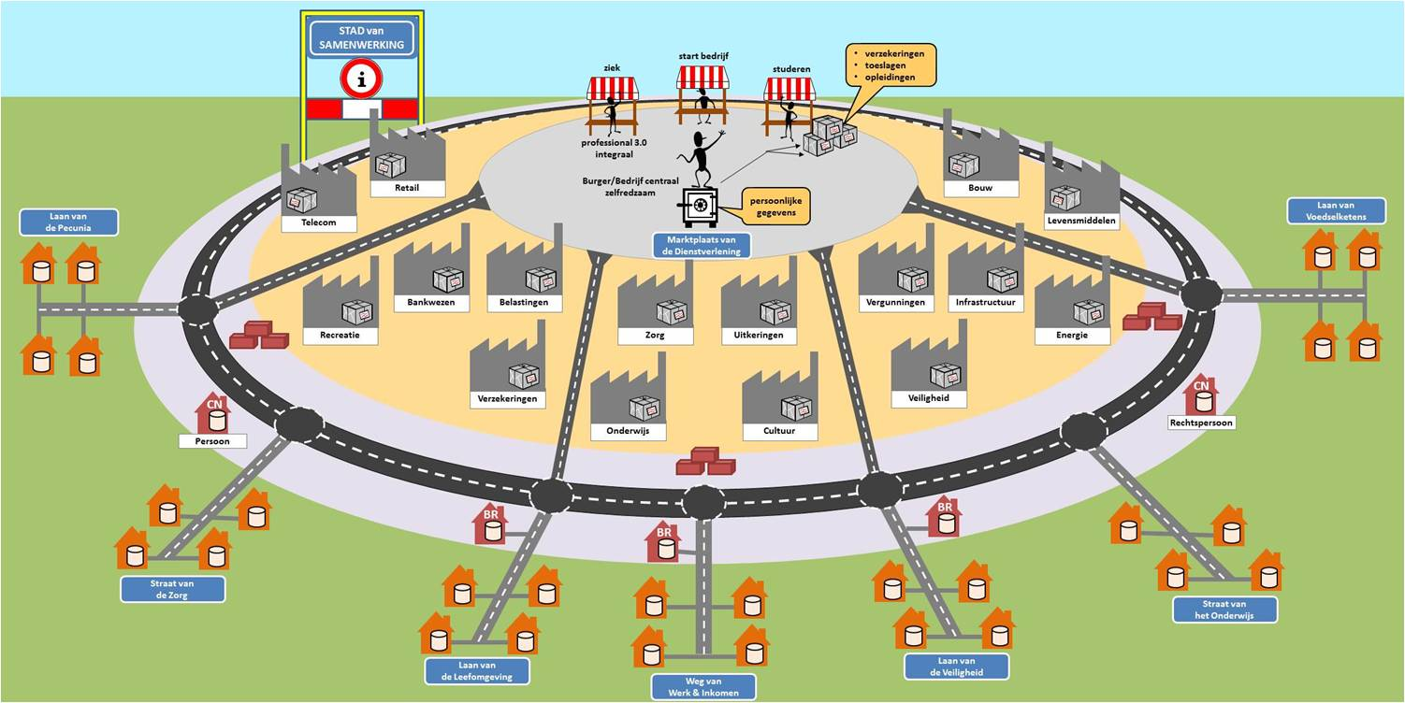
System of government data

Slide 12
Network society
Explosion of data
Sharing of data
Role government
Personal data management
Trusted frameworks and citizens in control
Do they always want once only?

