Slide 1
Data protection as an integral part of OOP implementations: The Austrian approach
Peter Kustor

Slide 2
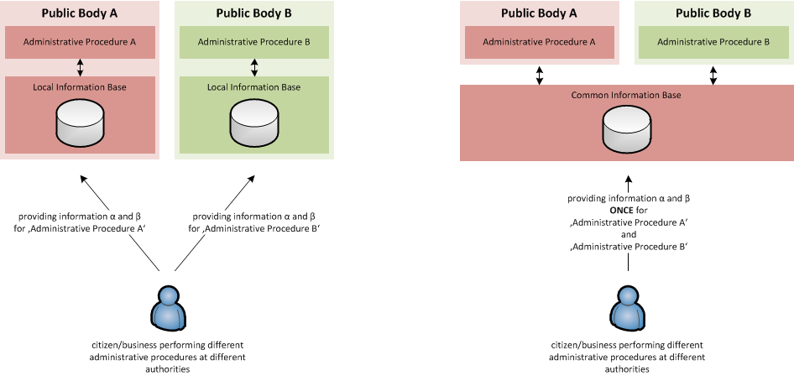
OOP – What‘s behind?
without OOP
with OOP

Slide 3
OOP – some benefits
Reduction of administrative burden
Cost reductions for the administration
Improved quality of service and of data
  Improved administrative efficiency and effectiveness
  Implementation supports one-stop/no-stop solutions
Improved mobility – if practised cross-border …
Notes:
Reduction of administrative burden
For citizens and businesses, information has to be provided only once for a large number of administrative procedures – easier and faster interaction
Cost reductions for the administration
Cost savings for public authorities through improved information management
Improved quality of service and of data
Implementation supports existing one-stop/no-stop strategies
administrative efficiency
Improved mobility
Information provided in a certain EU Member State are available in other EU Member States as well

Slide 4
OOP on the political agenda
European Council Conclusions 24/25 Oct. 2013, Para 9:
“[…] EU legislation should be designed to facilitate digital interaction between citizens and businesses and the public authorities. Efforts should be made to apply the principle that information is collected from citizens only once, in due respect of data protection rules.”

Slide 5
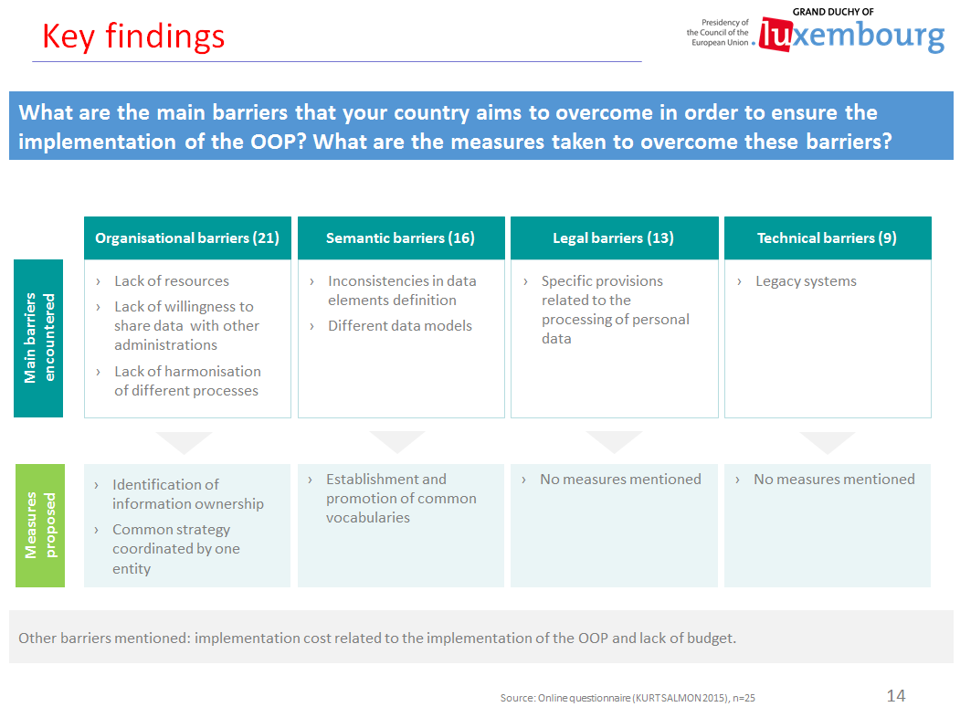
OOP and data protection?
„Main barriers“
„Measures to overcome these barriers“
Legal barriers:
Data protection?!

Slide 6
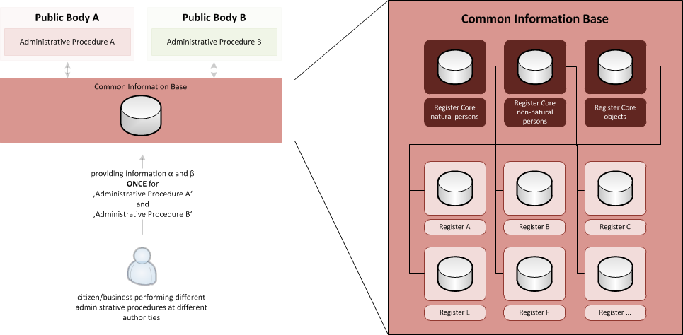
OOP: The Austrian Approach
Conceptual Model
Interconnected base registers serve as a common information base for different public bodies…

Slide 7
Organisational aspects (1/2)
Central coordination
The Austrian Federal Chancellery coordinates the national implementation of the OOP
Involvement of concerned parties
Citizen‘s/businesses‘ consent is required for using data held within registers in the sense of the OOP – unless explicitly foreseen by law
Back-office-approach
Information provided by citizens/businesses once is (where this is lawful) shared within the public administration without requiring additional front-side-interaction
[Front-office-approach
electronically signed documents/ register extracts are widely available in AT and may also be used in procedures (where the back-office-approach is not used/preferred)]

Slide 8
Organisational aspects (2/2)
Decentralized architecture
No central storage in „the one super-register“, but interconnected base registers as a common information base for implementation of the OOP
Trigger for one-stop/no-stop-government strategy
Information provided at a certain point can potentially initiate processes within different administrative areas
(e.g. informing a public body about a name change)

Slide 9
Legal Framework – Data Protection Law (1/2)
§ 1 (Constitutional Provision) - Fundamental Right to Data Protection
§ 6. (1) Data shall only
  be used fairly and lawfully;
  be collected for specific, explicit and legitimate purposes and not further processed in a way incompatible with those purposes; […]
  be used insofar as they are essential for the purpose of the data application and are not excessive in relation to the purpose;
  be used so that the results are factually correct with regard to the purpose of the application, and the data must be kept up to date when necessary;
  be kept in a form which permits identification of data subjects as long as this is necessary for the purpose for which the data were collected; a longer period of storage may be laid down in specific laws, particularly laws concerning archives.
Notes:
§ 1. (1) Everybody shall have the right to secrecy for the personal data concerning him, especially with regard to his private and family life, insofar as he has an interest deserving such protection. Such an interest is precluded when data cannot be subject to the right to secrecy due to their general availability or because they cannot be traced back to the data subject.
§1 (2) Insofar personal data is not used in the vital interest of the data subject or with his consent, restrictions to the right to secrecy are only permitted to safeguard overriding legitimate interests of another, namely in case of an intervention by a public authority the restriction shall only be permitted based on laws necessary for the reasons stated in Art. 8, para. 2 of the European Convention for the Protection of Human Rights and Fundamental Freedoms (Federal Law Gazette No. 210/1958). Such laws may provide for the use of data that deserve special protection only in order to safeguard substantial public interests and shall provide suitable safeguards for the protection of the data subjects’ interest in secrecy. Even in the case of permitted restrictions the intervention with the fundamental right shall be carried out using only the least intrusive of all effective methods.

Slide 10
Legal Framework – Data Protection Law (2/2)
§ 8. (1) […] no infringement […] if
  an explicit legal authorisation or obligation to use the data exists; or
  the data subject has given his consent, which can be revoked at any time, the revocation making any further use of the data illegal; or
  vital interests of the data subject require the use; or
  over-riding legitimate interests pursued by the controller or by a third party require the use of data.
Notes:
§ 1. (1) Everybody shall have the right to secrecy for the personal data concerning him, especially with regard to his private and family life, insofar as he has an interest deserving such protection. Such an interest is precluded when data cannot be subject to the right to secrecy due to their general availability or because they cannot be traced back to the data subject.
§1 (2) Insofar personal data is not used in the vital interest of the data subject or with his consent, restrictions to the right to secrecy are only permitted to safeguard overriding legitimate interests of another, namely in case of an intervention by a public authority the restriction shall only be permitted based on laws necessary for the reasons stated in Art. 8, para. 2 of the European Convention for the Protection of Human Rights and Fundamental Freedoms (Federal Law Gazette No. 210/1958). Such laws may provide for the use of data that deserve special protection only in order to safeguard substantial public interests and shall provide suitable safeguards for the protection of the data subjects’ interest in secrecy. Even in the case of permitted restrictions the intervention with the fundamental right shall be carried out using only the least intrusive of all effective methods.

Slide 11
Legal Framework – E-Government Act § 17 (2)
If:
preliminary question in a procedure
data contained in a public electronic register
  data subject has consented to the acquisition of the data OR
  that such acquisition through official channels is authorised by law
Then: The authorities shall acquire the data themselves via electronic communications to the extent this is necessary
  The authorities shall advise the data subject of the possibility of consenting
  Data acquisition shall replace the presentation of proof of the data by the parties or persons involved.
Notes:
§17 (2): "If, as a preliminary question in a procedure, authorities must determine the accuracy of data contained in a public electronic register and provided that the data subject has consented to the acquisition of the data or that such acquisition through official channels is authorised by statute, they shall acquire the data themselves via electronic communications, to the extent this is necessary. The authorities shall advise the data subject of the possibility of consenting to the data acquisition. Data acquisition shall replace the presentation of proof of the data by the parties or persons involved. […]"

Slide 12
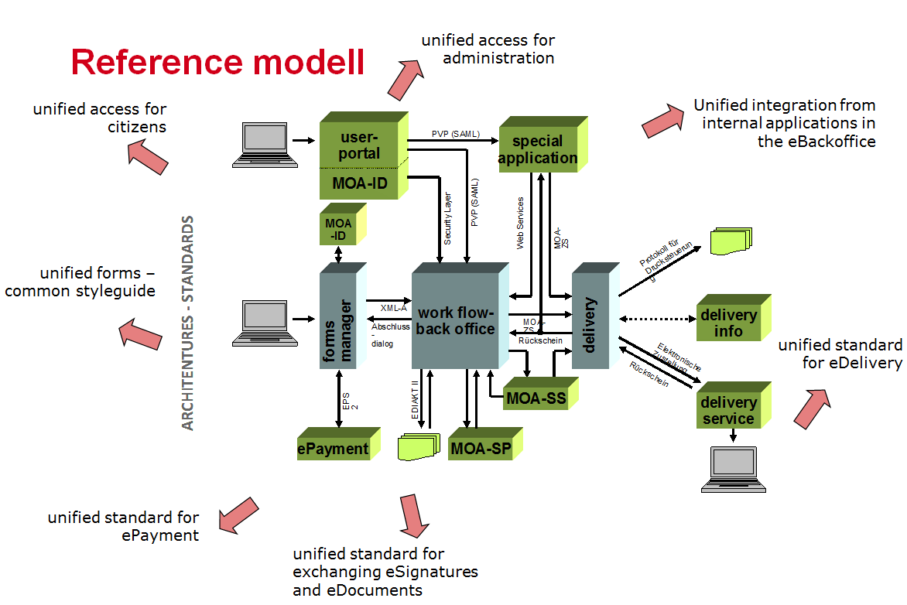
Technical concept – the „big picture“
Common eGovernment building blocks as a basis
essential component of Austria‘s national eGovernment strategy
common solutions for data exchange, identity management, authorization, etc.
field-tested and open source modules (via joinup.eu)

Slide 13
Interconnected base registers
based on common Austrian eGovernment building blocks
operated by different public bodies
holding (person-related) data from different administrative sectors
data exchange based on common interfaces and specifications
security and data protection ‚by design‘ (data exchange powered by sector-specific identifiers (ssPIN))
authentication & authorization at the back-office interaction powered by federation of portals-concept (PVP)
Notes:
(based on XML, WSDL, SOAP, XMLDSig, etc.)
Federated identity management
>> based on the Austrian federation of portals, ensuring state-of-the-art access control (PVP, SAML-based)

Slide 14
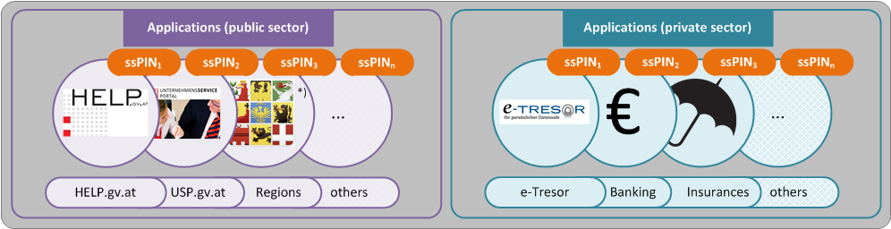
Identity Management 1/3 – the aim
Unique identifiers based on core registers
Conformance with data protection - privacy friendly: Sector specific derivations (ssPIN) in electronic services/ applications
Reliable, high quality information

Slide 15
ssPIN: Generation
Source PIN
irreversible
derivation
ssPIN a
ssPIN b
e.g. taxes & duties
e.g. constructing & living
Conversion impossible!
If person-related data (lawfully) is transmitted across sectors, encrypted ssPINs have to be used thus avoiding the easy creation of comprehensive citizen profiles.

Slide 16
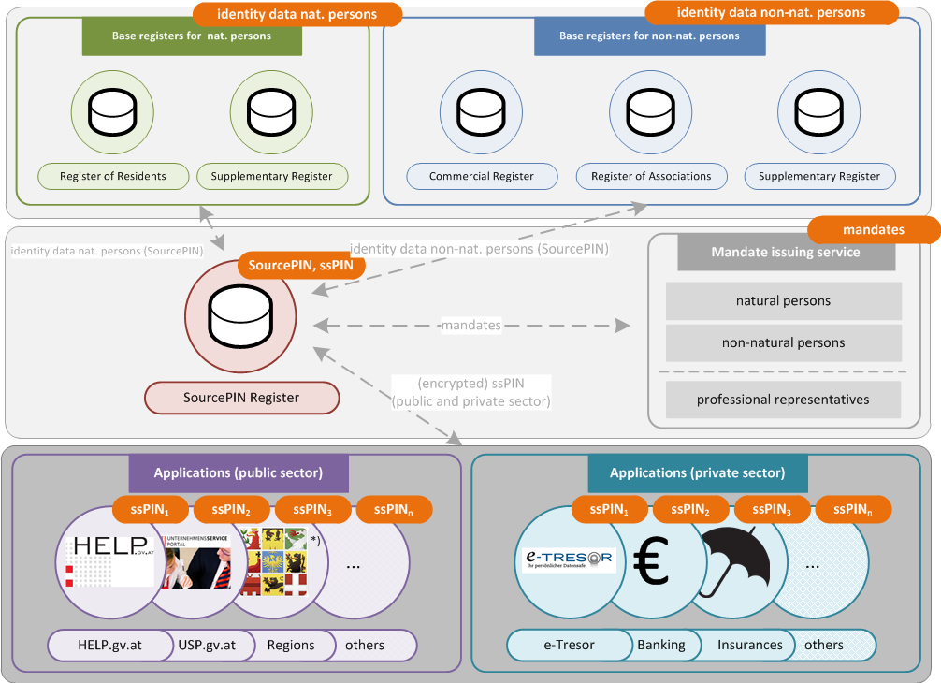
Identity Management 2/3 – „provisioning“

Slide 17
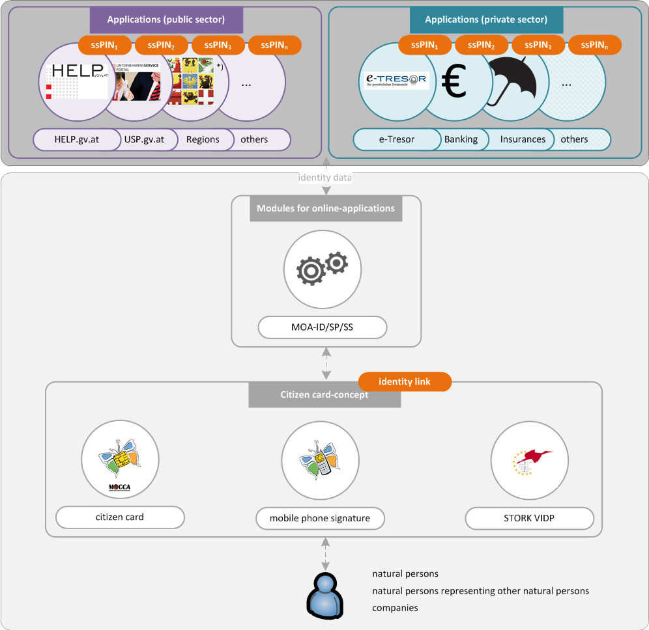
Identity Management 3/3 – „Access“

Slide 18
Best Practices
Implementation examples

Slide 19
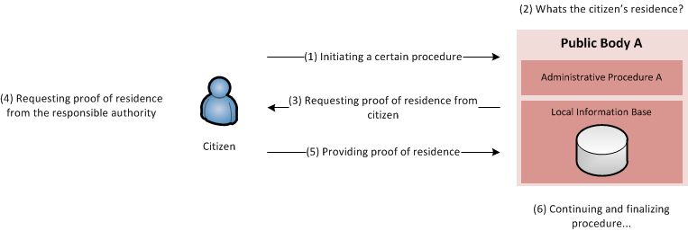
Best Practices - Providing proof of residence (1)
without OOP

Slide 20
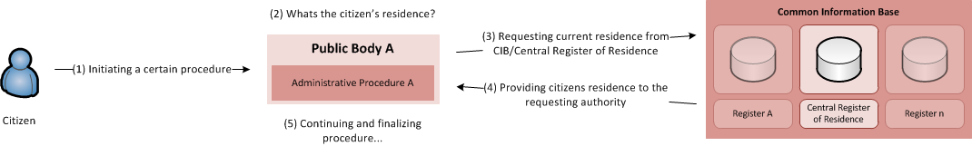
Best Practices - Providing proof of residence (2)
with OOP

Slide 21
Best Practices - the Business Service Portal
One-stop-shop for businesses – the Business Service Portal (BSP)
  Initiative „Reducing Admin Burden for Businesses“
  Launched in 2006
  230,000,000 times a year Austrian companies comply with information obligations to public authorities or a third person
  5,700 information obligations cause administrative burden of 4.3 billion Euro a year (1.6 % of GDP, measured in 2007)
  target: reduce burden by 25 % or more than 1 billion Euro by 2012
  Flagship-project: Austrian Business Service Portal (BSP)
  One-stop-shop for businesses

Slide 22
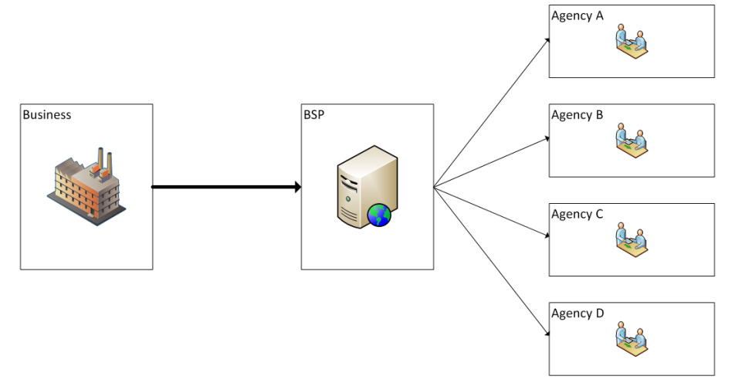
Best Practices - the Business Service Portal
Businesses must report the same or similar information to different authorities
  The BSP provides a single distribution point for those information
  BSP provides an electronic interface for automated data transmission from business software systems to public authorities
  Eases fulfilment of reporting obligations
  Heavily relies upon Austrian business register

Slide 23
Best Practices – life-situation birth
Birth related administrative processes
  Aim: reducing administrative burden in the context of birth
  Mainly achieved through automated triggering of specific procedures via the Austrian central register of civil status
  Including inter-authority exchange of required information
  Examples for triggered/one-stop procedures
  Report of the place of residence
  Notification of social insurance
  Issuance of proof of citizenship
  Initialization of family allowance → No-Stop-Procedure…

Slide 24
Thank you!
Peter.Kustor@bka.gv.at

