Slide 1
How digital technology will change the way we live, work and govern
Government of the Future
Dr Sergey Filippov Associate Director, the Lisbon Council

Slide 2
European Digital Forum
A think tank dedicated to growing Europe’s digital economy and empowering tech entrepreneurs
Proposed in Startup Manifesto in October 2013, launched in January 2014 at the World Economic Forum
Led by the Lisbon Council and Nesta, in collaboration with the European Commission’s Startup Europe initiative

Slide 3
Opening Remarks
Paul Hofheinz
President and Co-Founder, the Lisbon Council
Director, European Digital Forum

Slide 4
Imagine the future

Slide 5
Tuesday, 01 January 2030
What if
today’s emerging technologies had been massively rolled out and adopted?
Technology
would transform our economy and society
But it is only a smart tool
to reengineer government, redefine its role, to make it more client-oriented and user-centric
to develop and deepen democracy, to provide better, more advanced public services
In the end
it is a political, not technical paradigm shift

Slide 6
Fast forward: analogue >> digital
 | Analogue | Digital
Democracy | Political life structured around political parties Voters cast their ballot at polling station, over regular intervals of time | Ad-hoc social groups, parties, citizens interact and collaborate Voting takes place online, citizens participate in political life in between general elections
Legislation | Governing parties, members of parliament produce legislation | Political parties are facilitators, citizens co-legislate
Public services | Government is the principal provider of public services – uniform public services by “siloed” departments | Government facilitates and commissions public services – tailor-made public services offered on eGov platforms

Slide 7
Public services in the digital age
Today
many public-sector organisations already blend cyber and physical systems
generic services for mass consumption
Tomorrow
intelligent public services – “living public services”
Insight-driven, leveraging the power of data analytics, wrapping around us, learning and adapting
personalisation, automation, context-awareness

Slide 8
Living public services
Analytical and customised
Powered by data analytics for decision-making in real time, predicting the user’s needs, voice-operated
Mobile
Apps on mobile devices, “streamed” to user, relying on cloud infrastructure
Offered on platform
Hosted on a cross-agency plug-and-play platform, uniting users and service providers in a safe, secure and easy-to-access environment

Slide 9
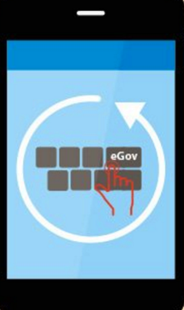
Public services digital typology
Digitally-supported:
humans provide the service, technology supports it (law enforcement, justice)
Digitally-enabled:
humans make value- and judgement-based decisions, technology enables the service (healthcare, education)
Digitally-driven:
technology generates and provides the service, humans intervene if necessary (“background task” – licences, permits)
Artificial intelligence-led:
technology makes decisions and acts upon them, humans create framework conditions

Slide 10
Key principles
Digital by default
User friendliness and inclusiveness
Once-only
No legacy
24/7
Single point of entry
Omni-channel services
Open standards

Slide 11
Collaborative public services
Citizens demand more digital
Citizens embrace a digital future. Consumers’ expectations became “liquid,” comparing with “best-in-class.” People demand more from public services
Collaboration and co-creation
Citizen engagement: Citizens wish to be co-creators and shapers of tailor-made public services, not passive consumers of generic ones
Government as a platform: Government shifts away from being a producer, to becoming a broker and a facilitator

Slide 12
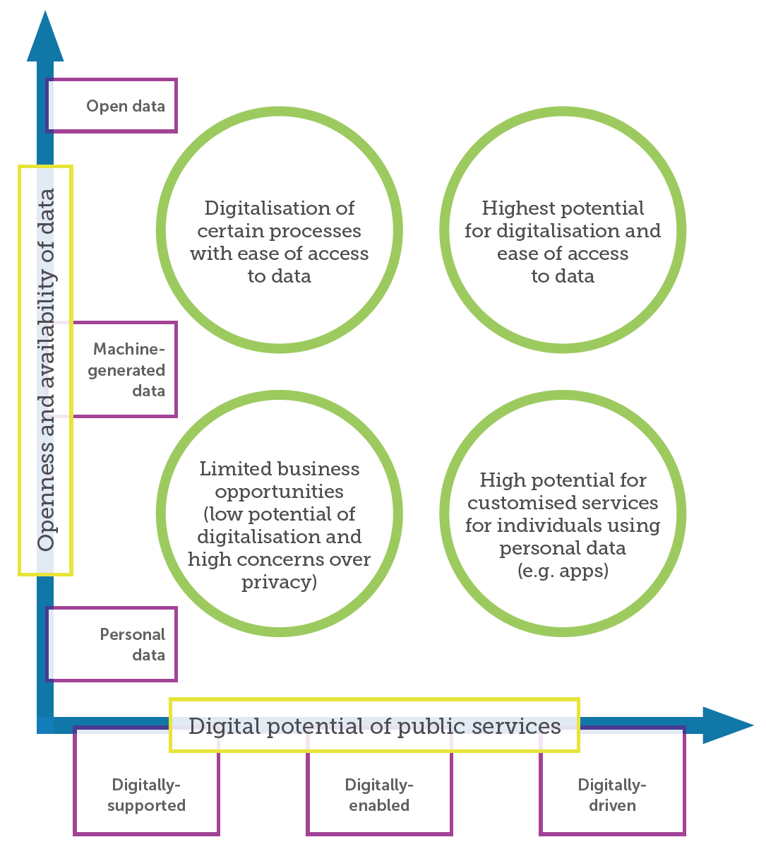
Openness and availability of data vs Digital potential of public services
Huge potential for involvement of tech entrepreneurs and digital startups in co-design and delivery of public services
Especially, digitally-driven services using open data
Procurement of innovative digital services

Slide 13
Time for action!
Strategic, regulatory, technical
European, national, local level
Civil society, (small) businesses
Ambitious vision in eGovernment Action Plan 2016-2020

Slide 14
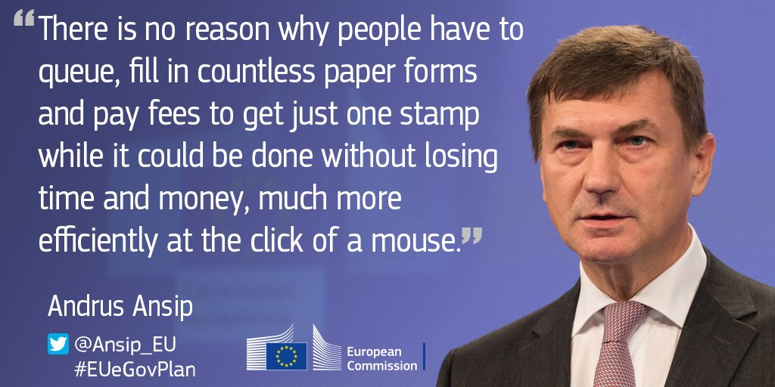

Slide 15
Strategic action
Build trust, public participation and collaboration
Change the mindset, embrace digital future, showcase best practice
Reengineer internal administrative processes
It is a complete overhaul of public services, not a digital front-end to existing ones
Prepare the digitally-savvy public service workforce
Digital skills and entrepreneurship among public servants, who are moving from performing routine tasks to face-to-face advice

Slide 16
Regulatory action
Reliable electronic identification (eID)
Interoperability across services and EU member states
Pan-European cloud computing solutions
Interoperable cloud computing at EU scale
Enabling regulatory regime for data analytics
Sufficient flexibility in data protection to unleash data analytics
Cybersecurity
Overall resilience to cyber attacks is essential; flexible and adaptable regulation

Slide 17
Technical action
Common standards for a GovOS platform
Standard building blocks can be reassembled locally
Open-source basic architecture – customised for specific needs
Potential of peer-to-peer technologies
Blockchain technology underpinning virtual currencies
Decentralised technologies complementing centralisation
Government as pioneer in use of new technologies

Slide 19
Tuesday, 01 January 2030
e-Residency platforms
Personalised way of doing business and new occupations
Sharing economy
Information-driven world: on screens of wearables and portables
Text and data mining, and data analytics
Technology in medicine and healthcare

Slide 20
Thank you for your attention!
www.europeandigitalforum.eu
Twitter: @edf_eu

Slide 21
Closing Remarks
Bernard Le Masson
Global Managing Director for Public Service
Accenture

