Slide 1

How citizens and civil society can contribute to the delivery of more and better digital public services
Francisco GARCIA MORAN
Chief IT Advisor
European Commission

Slide 2

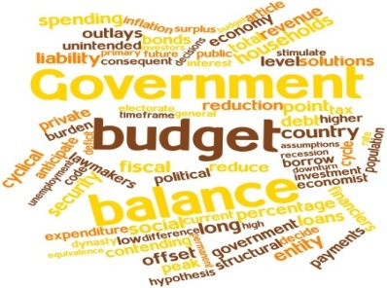




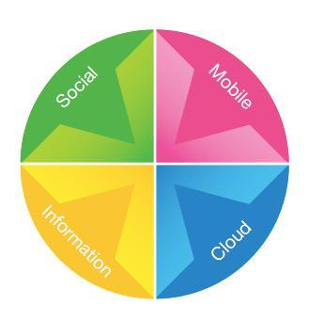
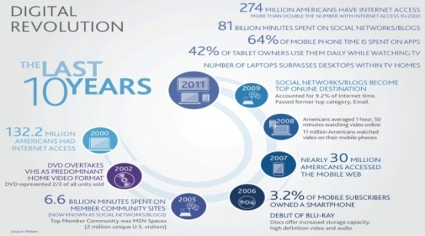
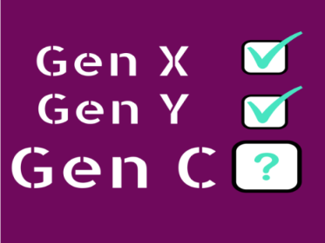
Context
Notes:
Thanks to technological transformation, we live in an environment which allows for increased (and easier) interaction between institutions, citizens and public and private organizations. This is particularly true for Generation-C (C stands for connection, creation, community), a demographic group where 65% is under 35,which is leading the way towards a "sharing society", characterized by blurred boundaries between collaborative production and consumption, that is likely to end up impacting the way public services are delivered.

Slide 3
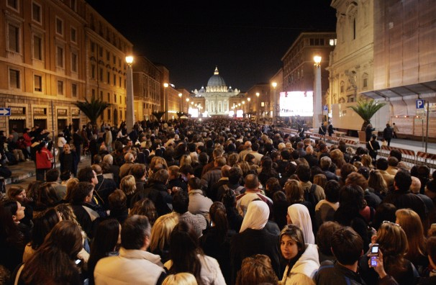
Proclamation of pope Benedict
2005

Slide 4
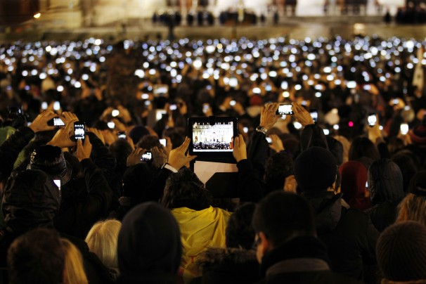
Proclamation of pope Francis
2013

Slide 5

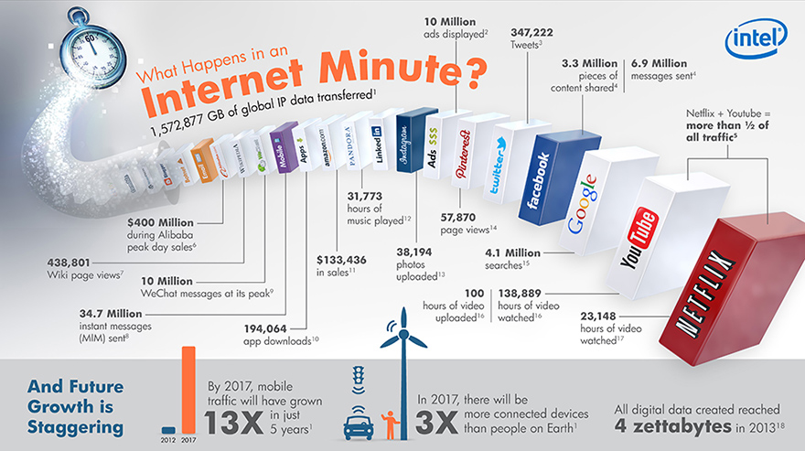

Slide 6

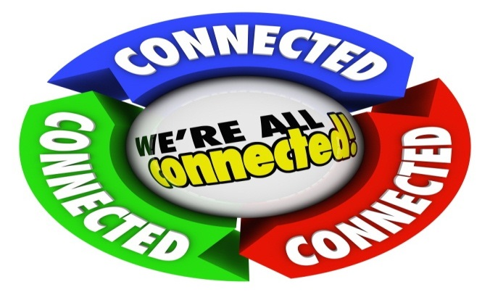


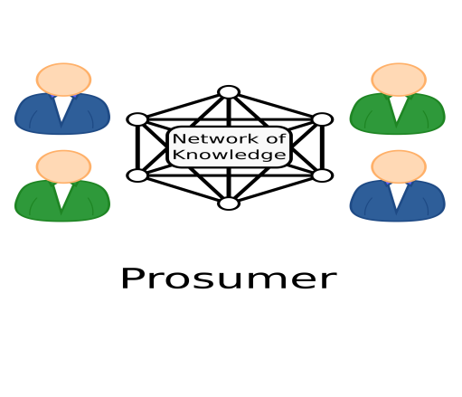
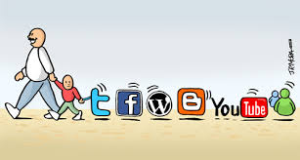
Context

Slide 7


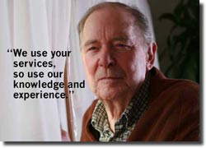
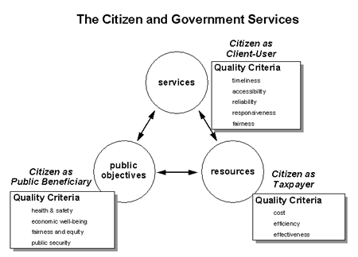
Government = Vending Machine?
Notes:
Donald Kettl: Vending Machine Government: Wepay our taxes, we expect services. When we do not get what we expect our "participation is limited to protest- esentially kicking the vending machine". Collective action has been watered down to collective complain.

Slide 8
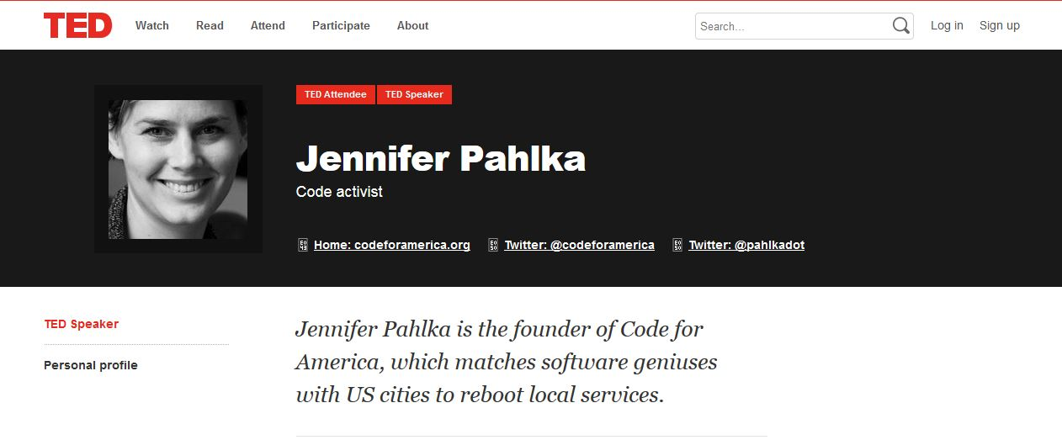

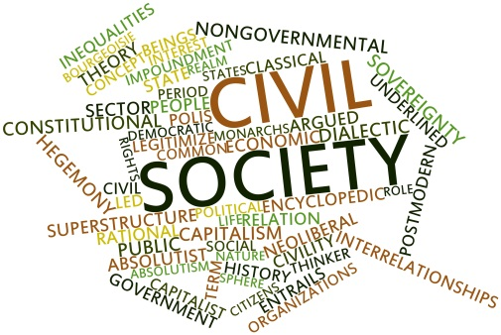

Governement, Citizens & Civil Society
I created Code for America to get the rock stars of design and coding in America “to work in an environment that represents everything that we are supposed to HATE….., to work in Government” …

Slide 9
African proverb
“ When the music changes, so does the dance”
If we fail to listen we will be out of step!
(Denise Lievesley)

Slide 10
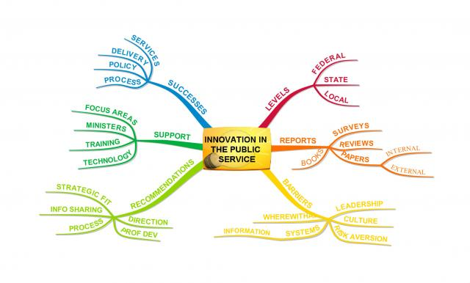



The Public Sector Transformation
Public sector in the EU: 50% of EU GDP, 17% of Employment, 20% of Purchasing Power, Largest Purchaser of IT, Great Influence on Market Dynamics
Notes:
As stated in EU 2020 initiative, Europe needs to mobilize innovation in its public sector to remain internationally competitive. The Government sector represents almost 50% of the EU GDP and 17% of total employment. Addressing its problems is therefore an important factor of fiscal consolidation and economic growth and also leads to considerable public savings.
The challenges mentioned at the begining, within the current financial crisis, have created a renewed momentum for the modernization of public administration very much in line with one of the priorities identified in the Annual Growth Survey 2013. As a consequence, public services need to become more efficient and effective; governments have to consider their transformation using innovative new ways of developing and organizing the public sector for creating public value and the way it is achieved Europe 2020 is the European Union’s ten-year growth and jobs strategy that was launched in 2010. It is more than just overcoming the crisis; it is also about addressing the shortcomings of EU's growth model and creating the conditions for a smart, sustainable and inclusive growth.
The Annual Growth Survey (AGS) takes stock of the economic and social situation in Europe and sets out broad policy priorities for the EU as a whole for the coming year. Modernising public administration is , for three years in a row, one of the five priorities identified by the EU Institutions and Member States.

Slide 11
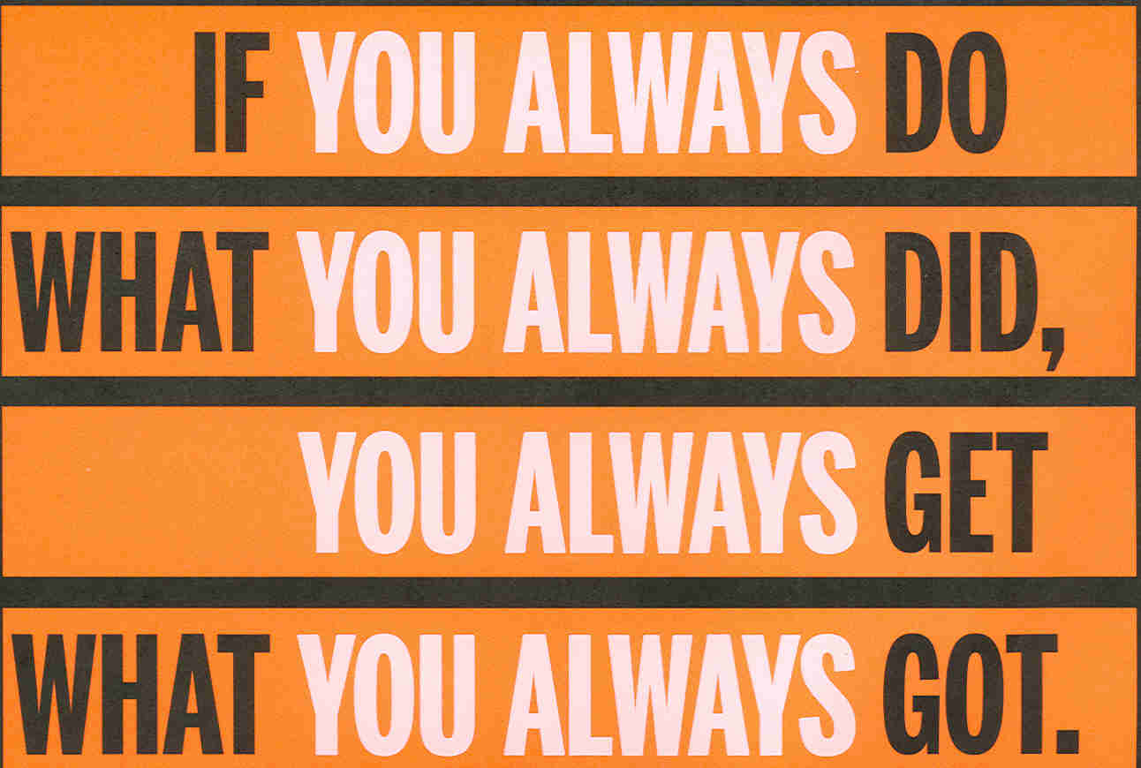
Change management

Slide 12

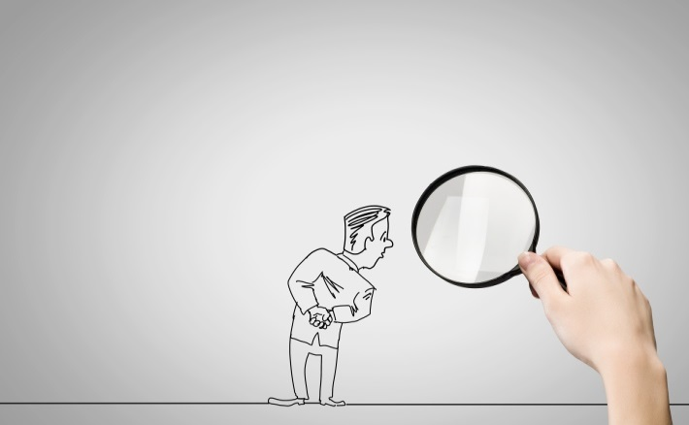


Slide 13
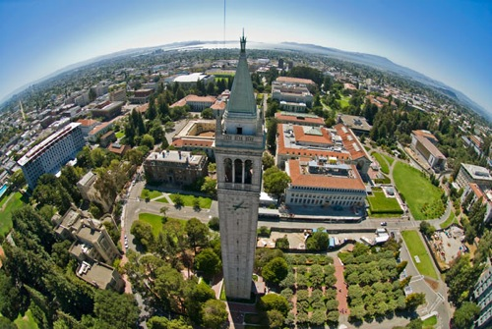




EC Fellowship @ UC Berkeley

Slide 14
Objectives
Feasibility of collaborative digital services ?
What governance? Role of Civil Servants?
Platforms?
ICT Management for collaborative services?

Slide 15

Background
Ostrom became the first woman to receive the prestigious Nobel Memorial Prize in Economic Sciences "for her analysis of economic governance", saying her work had demonstrated how common property could be successfully managed by groups using it

Slide 16
Co-production (with digital)
"Coproduction is a way of planning, designing, delivering, monitoring and evaluating digital public services which, with the help of technology, draws on direct input and domain skills and experiences from citizens, service users, civil society organizations and social enterprises to produce agreed outcomes and increase public and/or social value".

Slide 17
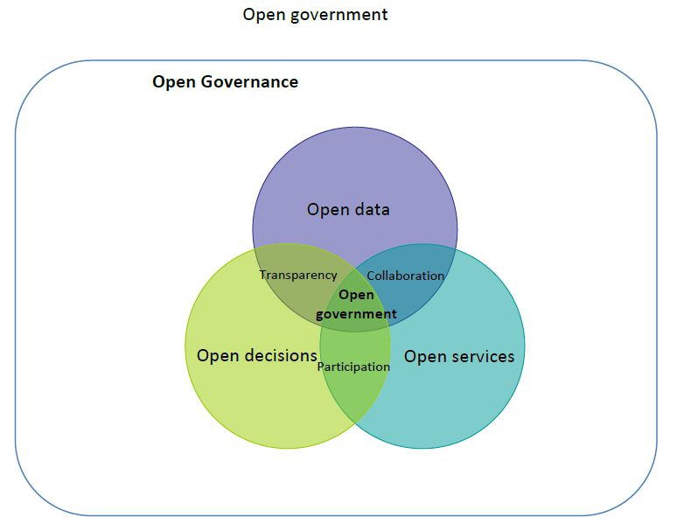

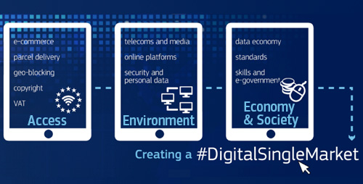
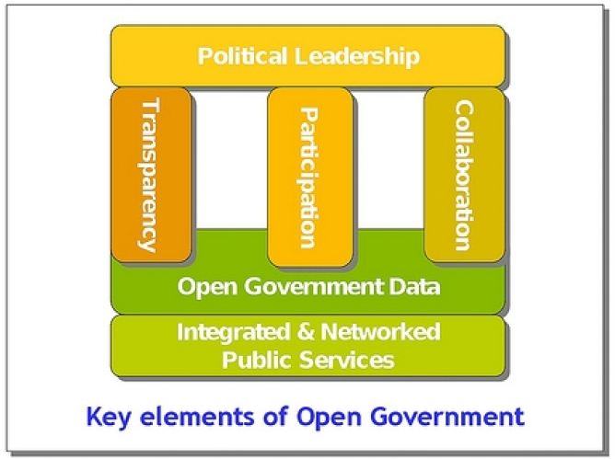
Co-production needs : Open and Collaborative Government
Notes:
Engaging with the wider public can help meet the challenge of rising expectations. It will make the services more user-friendly and effective, improve the quality of decision-making, promote greater trust in public institutions and thus enhance public value [13].
This approach, driven by opening up and sharing assets - making data, services and decisions open - enables collaboration and increases bottom-up, participative forms of service design, production and delivery. The kind of public sector organisation that is at the heart of this transformation is open government, based on the principles of collaboration, transparency and participation and functioning within an open governance framework

Slide 18

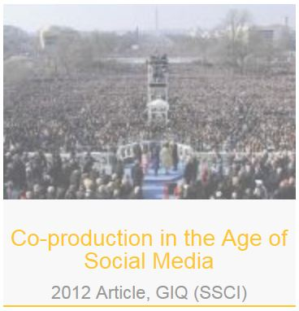
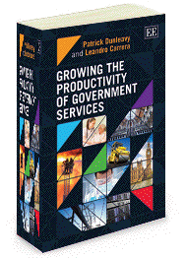

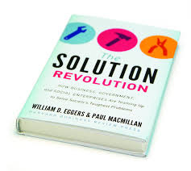

Background Information….

Slide 19
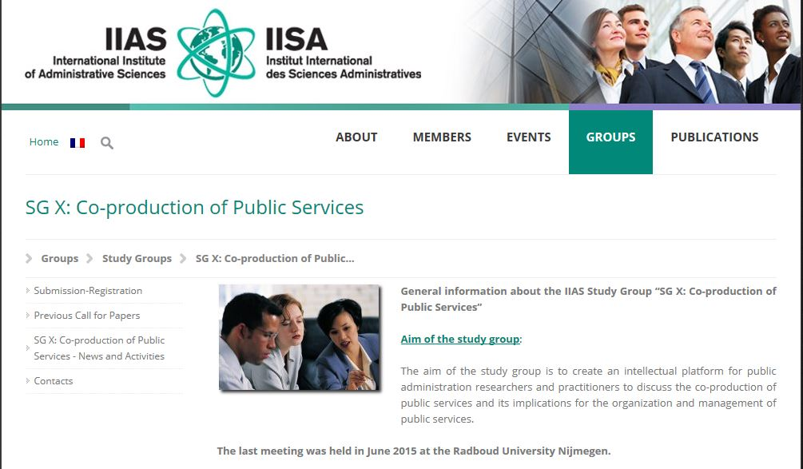
Academy

Slide 20
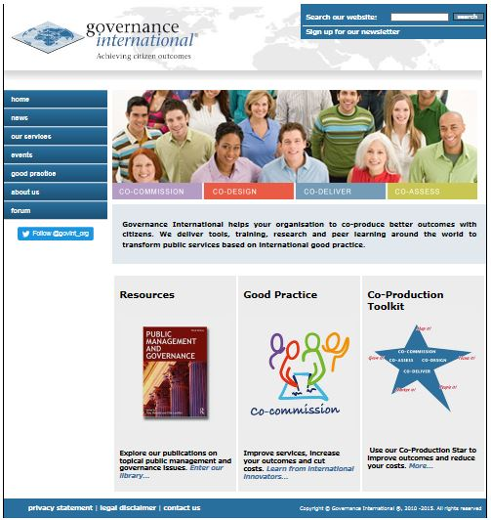
Resources

Slide 21
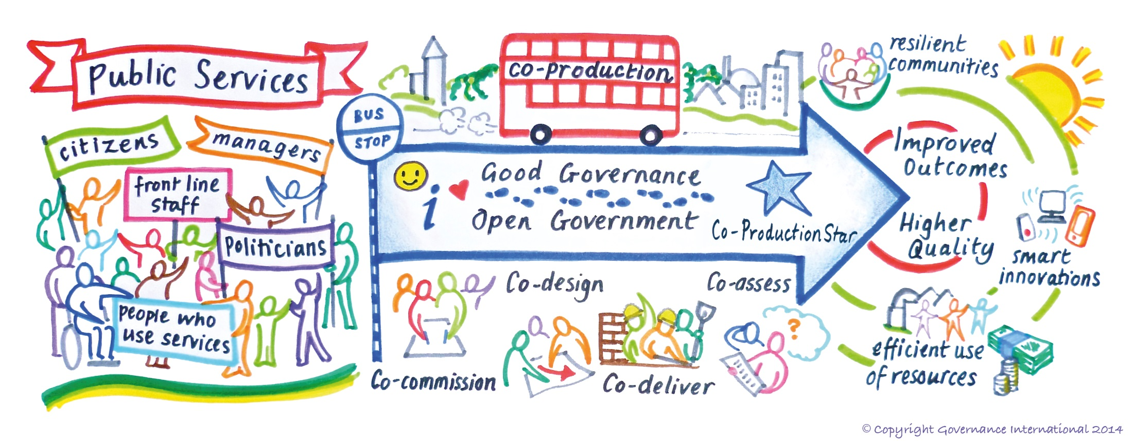
The Big Picture
http://www.govint.org/

Slide 22
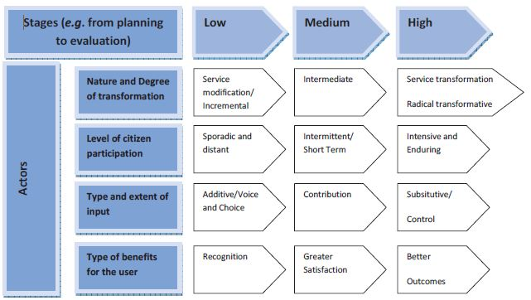
Summary of play and players
Source: OECD

Slide 23



On going …….
Australian Declaration of Open Government, enshrines the principle of collaboration with citizens on policy and service delivery
Government, citizens, CSOs, private businesses, and other parties will work collaboratively to play an active role in providing services for everyday life
Big Society: Increased role of citizens and civil society organisations in public service delivery

Slide 24


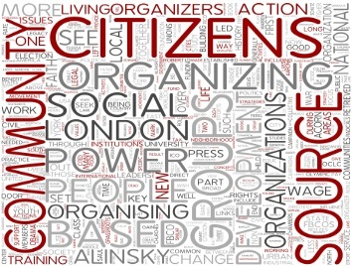






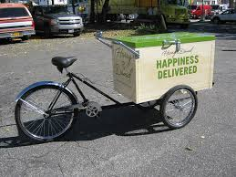

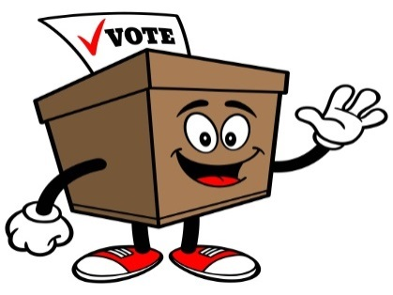
Participatory Budgeting

Slide 25
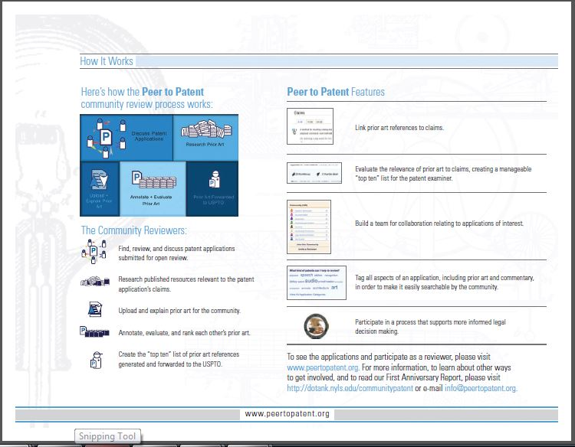



Peer-to-Patent

Slide 26
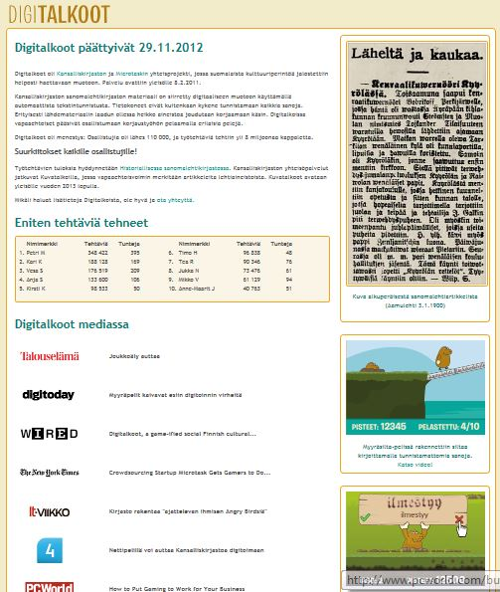
Crowdsourcing for common good

Slide 27

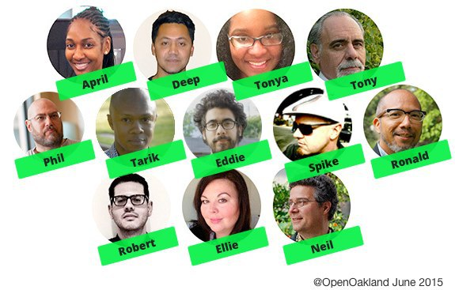
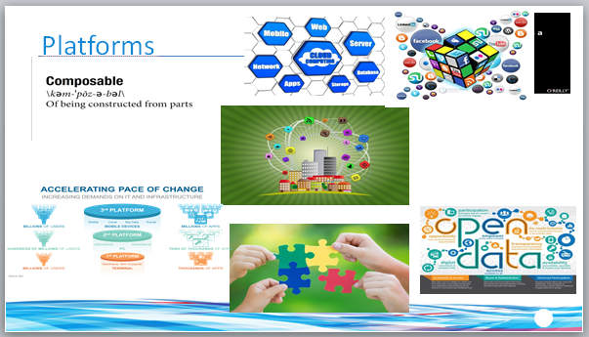



Code for ………

Slide 28
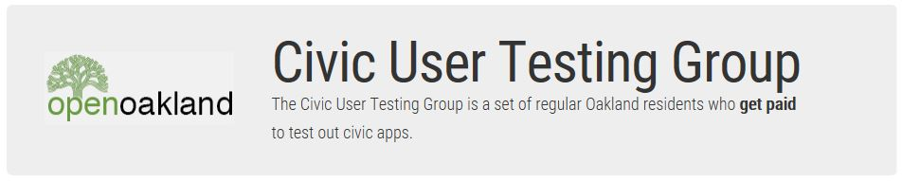


Civic User Testing

Slide 29

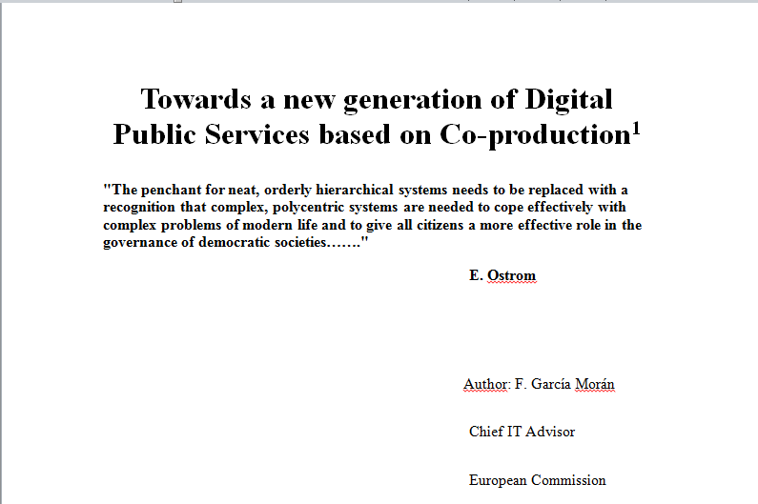
Study & Use Cases Database

Slide 30

This Conference…..
“Simple, secure and transparent public services”
“Simple, secure, open, collaborative and digital public services”

Slide 31

THANK YOU !!!!
francisco.garcia-moran@ec.europa.eu

