Slide 1

The European Citizens’ Initiative (ECI) and the promise of digital democracy
Carsten Berg
The ECI Campaign

Slide 2
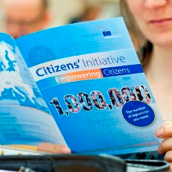
What is the ECI?
Participatory democracy
  Stronger than e-petition
  Weaker than national citizens’ initiative
Invites the Commission to submit a proposal
  Hearing in Parliament
  Commission response
  No obligation to act

Slide 3
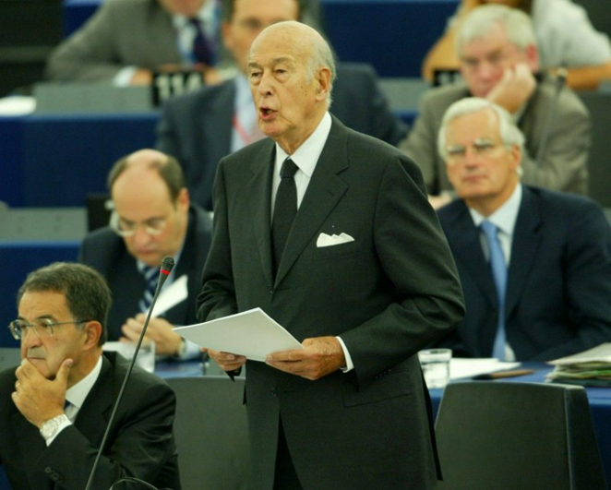
Why a Citizens’ Initiative for the EU?
CSOs/parliamentarians = “more democracy”
Small EU citizen toolbox
  EP elections = platform
  EP Petitions and EU Ombudsman = complaint
  ECI = new proposal

Slide 4



ECI’s FORMAL impact
49 ECIs proposed
29 ECIs registered
6 million citizens
3 ECIs succeeded
0 new legislation
Between 1.4.12 – 1.12.15
1.9 Million
1.9 Million
1.3 Million

Slide 5
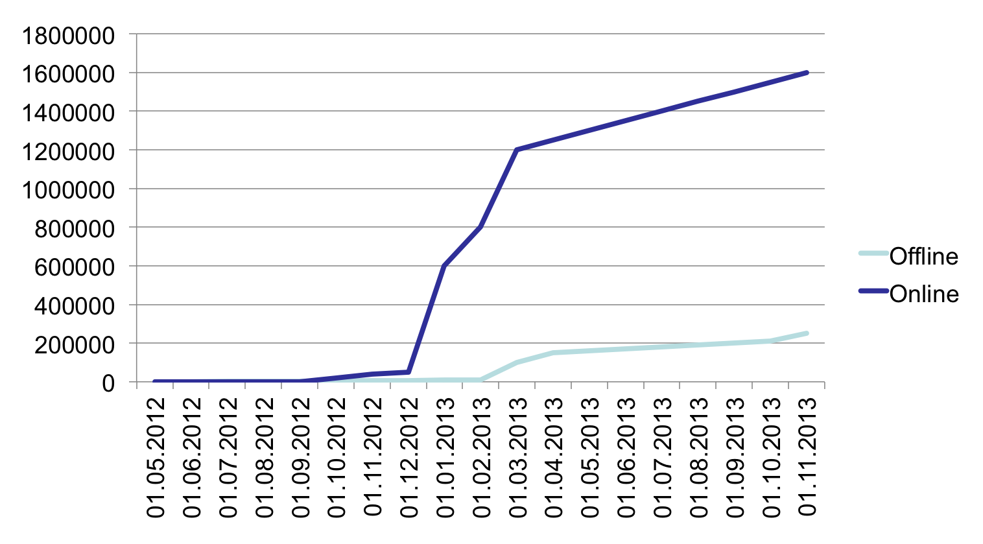
Right2Water: Offline/Online Support

Slide 6


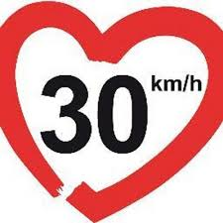






ECI’s INFORMAL impact
Platform for Brussels’ “outsiders”
  New issues to EU level
  New associations
  New cross-border cooperation
  New local laws

Slide 7
ECI use crashes in 2014

Slide 8
Number of Signatures 2012 - 2015

Slide 9
Just 3 ECIs now open
For a Socially Fair Europe (until 12/15)
  EU cooperation to end poverty
  No online collection
Fair Transport Europe (until 9/16)
  Equal treatment of transportation workers
  Online open
Stop Plastic in the Sea (until 10/16)
  Online not ready

Slide 10

Learning from 20+ ECI Campaigns
ECI is too hard to use!!!
  Personal data excessive
  Online system flawed
  Registration too strict
  Response inadequate
  Insufficient time
  Unknown to public
  Resource-intensive
www.ecithatworks.org

Slide 11
ECI Campaign = 12 Ways to Fix ECI
MORE IMPACTFUL
Less restrictive registration
Allow treaty amendments
Take successful ECIs seriously
MORE USABLE
4. Simplify and harmonise personal data required
5. Eliminate ID numbers
6. Improve online (OCS)
7. Collect emails
8. Choose start date
9. Allow 16 & 17 year olds
10. More practical support
11. Legal status for committees
12. Increase awareness

Slide 12
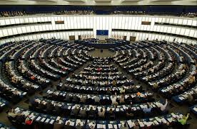
European Parliament: 28 October 2015
MORE IMPACTFUL
Less restrictive registration
Allow treaty am
Take successful ECIs seriously
MORE USABLE
4. Simplify & harmonise personal data required
5. Eliminate ID numbers
6. Improve online (OCS)
7. Collect email addresses
8. Choose own start date
9. Lower support age to 16
10. Offer practical support
11. Legal status to committees
12. Increase awareness

Slide 13
The ECI’s Digital Dimension
Online support is novel for citizens’ initiative
BUT
  Overly regulated
  No single site
  Flawed software
  Not user-friendly design

Slide 14
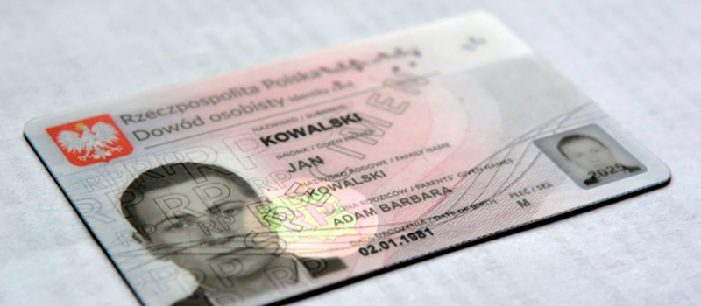
Regulatory Reform to Improve ECI’s Digital Dimension
Less Personal Data
4. Simplify & harmonise personal data required
5. Eliminate ID numbers
User-Friendly Design
6. Improve online collection
- Technical Regulation 2011/1179
7. Collect email addresses
Begin When Ready
8. Choose own start date

Slide 15
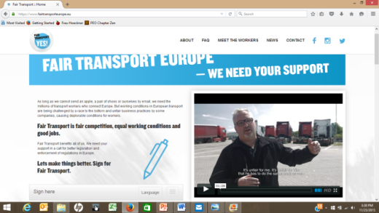

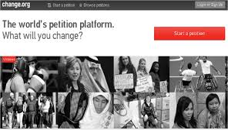
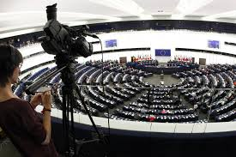
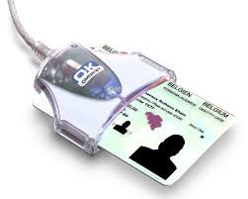


A Brighter Digital Future for the ECI?
Alternative OCS (Open ECI)
OCS connected to online platforms –
e.g., social media, petitions sites
Two-way communications – e.g.,
streaming hearings + chats
Room to innovate – flexible technical Regulation

