Slide 1
A national authority's perspective on the European Citizens' Initiative

Slide 2
Agenda
Overview and state of play
4 proposals to improve the ECI

Slide 3
Agenda
Overview and state of play
4 proposals to improve the ECI

Slide 4
What is an ECI ?
The European Citizens' Initiative (ECI)
is an invitation to the European Commission to propose legislation on matters where the EU has competence to legislate.
was introduced with the Treaty of Lisbon and has been in force since April 1st 2012.
is ruled by regulations (EU) 211/2011 and (EU) 1179/2011.
1 million signatures
1 year
7 Member States
Formal response from the Commission
+
Public hearing at the European Parliament

Slide 5
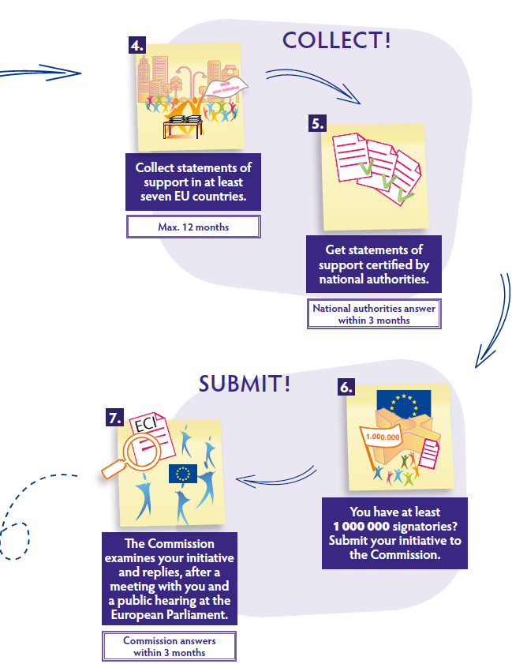
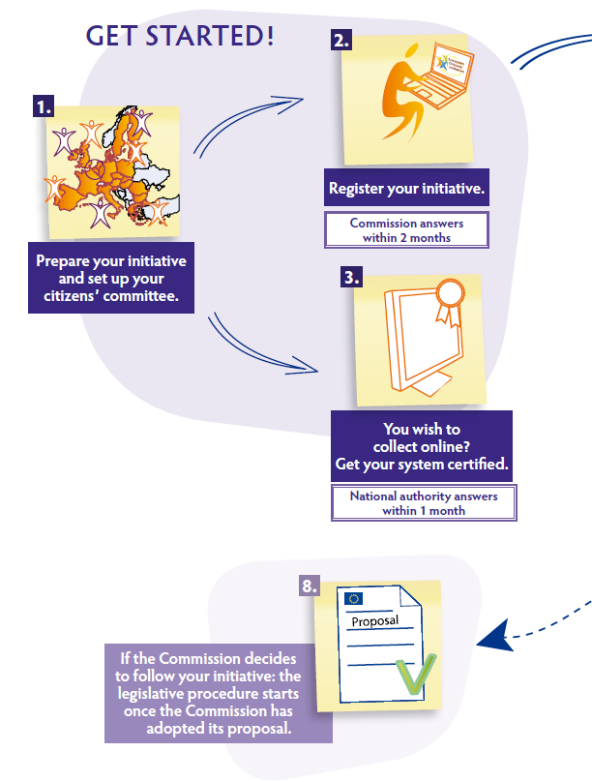
Process
Source: "Guide to the European citizens’ initiative"

Slide 6
Actors
Citizens: Organisers and signatories
EU Commission: SG (legal aspects, support, ECI Expert group)
DIGIT (OCS, hosting, training, support)
Europe Direct Contact Centre (support)
Member States: National authority for certification
National authority for validation ECI Expert group
EESC: Translation, events
NGOs: Support to organisers, improvement proposals

Slide 7
A rough start

Slide 8
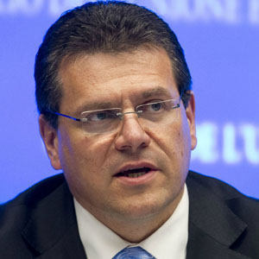
The hosting offer
"During these early stages of what is, after all, the biggest ever experiment in transnational participatory democracy, the Commission is absolutely determined to make sure that organisers of the first ECIs face no insurmountable stumbling blocks. Since some organisers struggled to find suitable host providers on the market for collecting signatures online, the Commission will offer its own servers to them as a hosting environment."
Commission Vice-President Maroš Šefčovič,
18/07/2012
But…. the Commission servers are located in Luxembourg
And… (EU) 211/2011 requires the Luxembourgish national authority to certify all online collection systems hosted in Luxembourg
So… we have to evaluate each ECI hosted on the Commission's servers versus the requirements of (EU) 1179/2011.

Slide 9
Outcome
Certification: custom auditing tools
(21) « smart » ISO 27001 electronic template documents
Linux Live CD for secure organiser environment
Validation: development of a new validation tool with:
(4)
Automated validation versus national population registry
Automated processing of paper statements of support (OCR)
Detection of duplicates
customisation for validation of national petitions

Slide 10
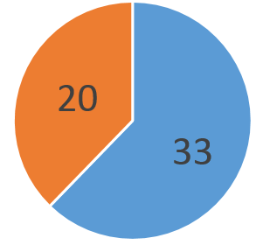
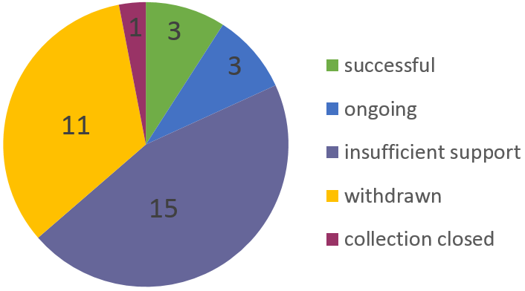
Current results
53 proposed ECIs
Formal responses from the Commission
Public hearings at the Parliament
Some actions taken (Right2Water)
No new legal act introduced

Slide 11
Agenda
Overview and state of play
4 proposals to improve the ECI

Slide 12
Review period
European Ombudsman's own-initiative inquiry (4 March 2015)
European Commission's application report (31 March 2015)
Latvian Presidency of the Council note (4 June 2015)
Committee of Regions' opinion (13 October 2015)
European Parliament's resolution (28 October 2015)
…
+ Lots of legal studies, PhD thesis, NGOs publications, etc.
Member States ?
National authorities ?

Slide 13
Proposals
1. Review the timeline of an ECI

Slide 14
Proposals
2. Review implementing regulation (EU) 1179/2011
Allow alternative approaches to the formal ISO/IEC 27k and SoGP while keeping a high level of security
Review requirements on version and patch management
Use a risk-based approach instead of detailed requirements
Make it easier for organisers and hosting entities

Slide 15
Proposals
3. Offer a free centralised platform
For organisers:
free
no need of IT/security experts
Findings of Commission's ICT study :
most overall cost effective approach
satisfaction of organisers with EC hosting and support
Let the organizers focus on their campaign

Slide 16
Proposals
4. Develop synergies with eIDAS
eIDAS regulation covers both online authentication and electronic signature
Some tools already exist (TSL, DS-DSS, ECAS)
Let's not reinvent a (broken) wheel…

Slide 17
Conclusion
3 questions about ECI
Does it work ?
What is the problem ?
Should it be revised ?

Slide 18
Thank you
Any question ?

