Slide 1



eIDAS: current state of play and the Luxembourgish approach

Slide 2

Agenda
  Overview, state of play, next steps
  The Luxembourgish approach for eIDAS deployment

Slide 3
Agenda
  Overview, state of play, next steps
  The Luxembourgish approach for eIDAS deployment

Slide 4
Before eIDAS…
  Electronic signatures (eSignature Directive (1999), Services Directive (2006))
  However:
      Different interpretations of SSCDs
      “Appropriate” supervision of TSPs
      No distinction between natural and legal persons
      Outdated technical standards
  Authentication ?
  Technical PoCs (STORK, …) and many national solutions
  Other Trust Services ?
    No legal basis
TOO SMALL
TOO WEAK
TOO OLD

Slide 5
The eIDAS regulation
Goal: strengthen EU Single Market by boosting trust and convenience in secure and seamless cross-border electronic transactions.
Too small
Too Weak
Too old
→ Larger scope to cover eID and all relevant trust services
→ Regulation directly enforceable in all MS
→ Some eSig "gray areas" have been clarified (Supervision, QSCD,…)
→ New use-cases and technologies have been taken into account
→ Technology-neutral and outcome-based approach

Slide 6
Scope
eIDAS Regulation
eID
Trust services
Mutual recognition
Notification process
eSignatures
eSeals
Time stamp
Website authen-tication
Electronic registered delivery
Trusted
lists
QSCD
Liability
TSP supervision
Trust mark
eSig/eSeals validation and preservation
Interoperability framework
Levels of Assurance
Breach notification
+ electronic
documents

Slide 7
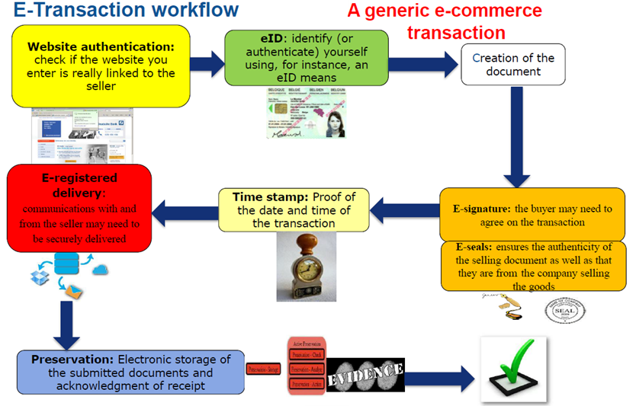
Scenario
Source:
European Commission

Slide 8
Legal framework
Legal act | Réf. | Entry in force
eIDAS regulation | (EU) 910/2014 | 17/09/2014
IA on cooperation | (EU) 2015/296 | 17/03/2015
IA on interoperability framework | (EU) 2015/1501 | 29/09/2015
IA on levels of assurance | (EU) 2015/1502 | 29/09/2015
IA on EU trust mark | (EU) 2015/806 | 12/06/2015
IA on trusted lists | (EU) 2015/1505 | 29/09/2015
IA on eSignatures / eSeals formats | (EU) 2015/1506 | 29/09/2015
IA on notification | (EU) 2015/1984 | 03/11/2015
IA on standards for QSCDs | ? | 04/2016 ?
eID
Trust services

Slide 9
Deployment
17/09/2014 entry in force of eIDAS regulation
29/09/2015
29/09/2018
eID
Voluntary recognition
Mandatory recognition
01/07/2016
Trust services
eSignature Directive regime
Transition
period
(QES TSPs)
eIDAS regime
2014 2015 2016 2017 2018 2019

Slide 10
Coming in 2016
            SLA for eIDAS node
            Guidelines on LoA, peer reviews and notification
            Deployment of interoperability infrastructure (CEF calls)
            First notifications and peer reviews ?
            Switch from eSig Directive regime to eIDAS
            Technical standards and implementing act on:
              QSCD
              IT security certification
              Prior Authorization of QTSPs
            Progress on eDelivery
eID
Trust services

Slide 11
Agenda
  Overview, state of play, next steps
  The Luxembourgish approach for eIDAS deployment

Slide 12

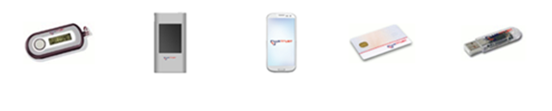

LuxTrust (2005 -)
National CA (public-private partnership)
Qualified Trust Service provider for:
    electronic signatures
    timestamps
Identity provider:
    OTP and chip-based solutions for
    authentication and signature
Other services:
    SSL and code-signing certificates
    Mass signing

Slide 13
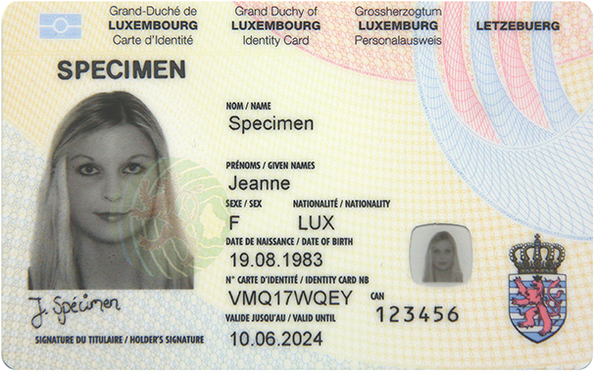
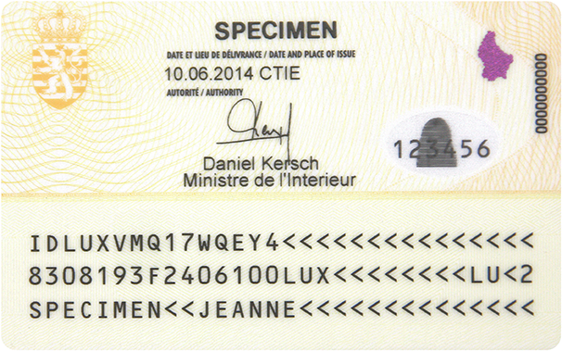
National eID card (2014 -)
ICAO-9303 compliant electronic
machine-readable travel document
+
Contactless smartcard with 2 certificates
(authentication + qualified eSignature)

Slide 14






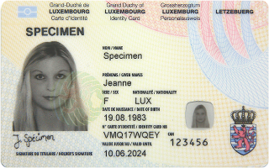
Service Providers
PUBLIC
PRIVATE
Services
eID

Slide 15
Trust services
eIDAS Regulation
eID
Trust services
Mutual recognition
Notification process
eSignatures
eSeals
Time stamp
Website authen-tication
Electronic registered delivery
Trusted
lists
QSCD
Liability
TSP supervision
Trust mark
eSig/eSeals validation and preservation
Interoperability framework
Levels of Assurance
Breach notification

Slide 16


MyGuichet
MyGuichet is the interactive platform of guichet.lu which allows administrative formalities to be carried out online with the competent administration.
Offers:
  45 services for citizens
  72 services for companies
Uses:
  strong authentication
  electronic signature
  trusted timestamps

Slide 17






Interoperability framework
Online
service
eIDAS Connector
Please go here
Sure, how do you want to authenticate?
1
I want to access your service
eIDAS !

Slide 18
Interoperability framework
Online
service
eIDAS Connector
eIDAS
Proxy Service
Where are you from ?
Please go here
2
Luxembourg

Slide 19



Interoperability framework
eIDAS
Proxy Service
Identity / Attribute provider
Online
service
eIDAS Connector
RNRPP
3
Select eID
Authenticate
Consent
PIN:
******

Slide 20
Interoperability framework
eIDAS
Proxy Service
Identity / Attribute provider
Online
service
eIDAS Connector
data
data
data
RNRPP
Access granted

Slide 21

Interoperability framework
Deployment:
eIDAS LU Proxy Service
eIDAS LU Connector
IdP/DBs connexions
LuxTrust support
Notification: LU eID card
Notification:
Some LuxTrust eIDs
Q1 Q2 Q3 Q4 Q1 Q2 Q3 Q4
2016
2017

Slide 22
Thank you
Any question ?

