Slide 1


Changing the way we do government
01 December 2015
Notes:
Ladies and gentlemen hello and welcome!

Slide 2

A little bit of history…
Notes:
Let me start with a little bit of history…

Slide 3


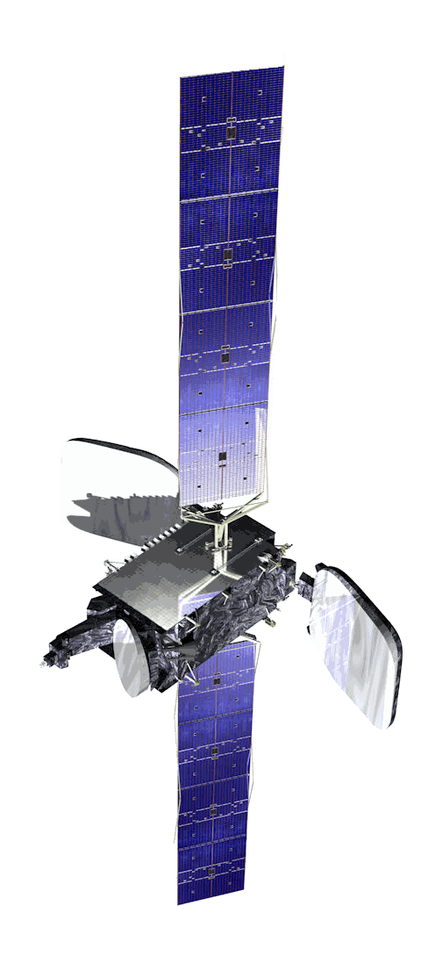




A long history: 1931 - ….
@
2000s
1990s
1980s
1950s
1930s
Notes:
Luxembourg has long been at the forefront of cross-border information technology services in Europe.

Slide 4
































































Notes:
With the internet revolution, things accelerated --- many, many actors joined us.

Slide 5
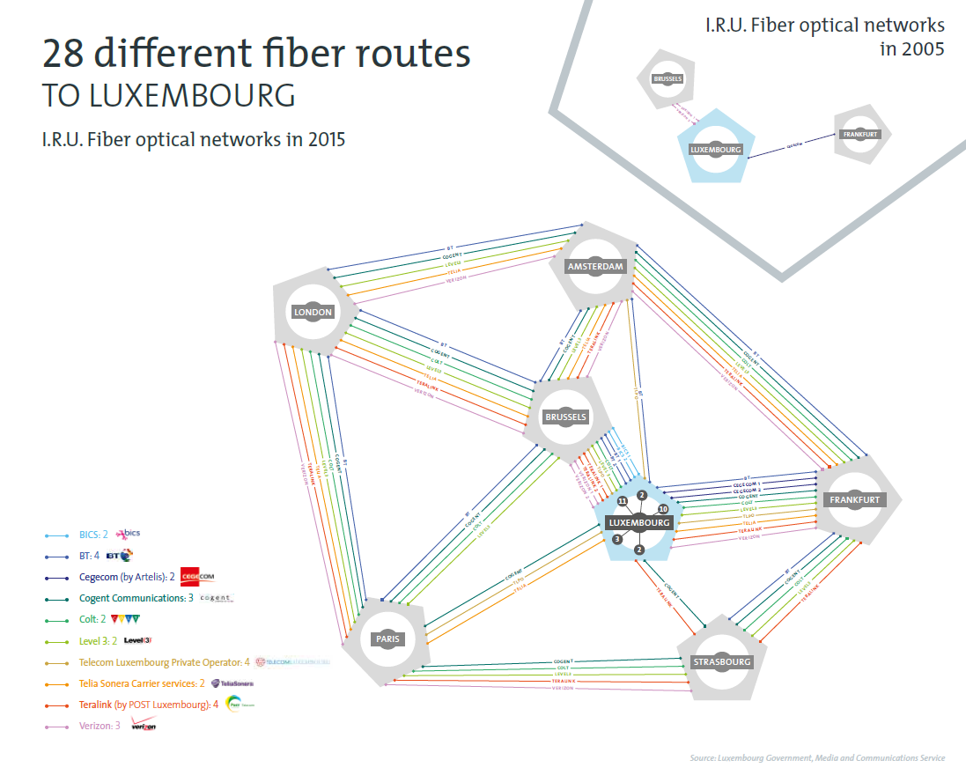
Infrastructures: connectivity
2005 vs 2015
Notes:
Digital transformation confronted us with a diversity of challenges. A lot of things had to be done to meet the needs of these companies:
Providing headquarter services meant we had to step-up our connectivity –which we did.
But also had to act on a whole range of other (seemingly unrelated) challenges, e.g: improve international schools offering, fast-track visas, better transportation…

Slide 6
« Action eats strategy for breakfast »
Inspired by Peter Drucker
Notes:
Most experts will say you need a detailed well-structured long term strategy. We initially started this way – experienced a couple of (failed) long term strategies. These always turned out to be ill-adapted to the fast pace of technology evolution.
So as we confronted the first challenges of the digital revolution we actively decided not to do a 10 year action plan – we focused on acting along the way of technological developments in response to the current and expected needs of our market ( in close concertation with industry).
Yet faced limitations: while action eats strategy for breakfast, the reach of ad-hoc action can only be limited.

Slide 7

Long term objectives
Accelerate Luxembourg’s Smart Nation transformation
Facilitate the life of citizens and companies
Ensure the long term competitivity of the country
Raise awareness abroad on this facet of Luxembourg
Notes:
Digital transformation confronted us with increasingly diverse and complex challenges, affecting a wide range of administrations, with many actions needed at the same time that need to be coordinated → needed more transversal approach.
We needed to improve our coordination to break outdated silos, but we also wanted to maintain the benefits of a less rigid approach. Knew that when choosing a methodology to address our long term objectives, keeping this flexibility and speed of action were key.

Slide 8

2014: Digital Lëtzebuerg is launched
Notes:
This is why we decided to launch the digital Lëtzebuerg initiative: an efficient methodology to rapidly execute.

Slide 9
Horizontal approach by design
The Governement
A cross-ministerial steering team
Public and private stakeholders as well as academia
Notes:
A crucial point is our horizontal structure: __(see slide)__.

Slide 10
Better coordinate our policies
Address cross-cutting issues related to new technologies
Identify and address orphan topics
Share knowledge and favour cooperation
Give visibility to our actions and ambitions
Notes:
DL allows us to: __(see slide)__.
From organizational requirements to problems convincing other administrations that their seemingly unrelated field of work is an important part of a wider whole/jigsaw
Digital Lëtzebuerg has provided us with a tag allowing to prioritise and accelerate projects / flag files.

Slide 11
A living strategy
Infrastructure
Tom Kettels, Service des médias et des communications, tom.kettels@smc.etat.lu
e-skills
Claudine Kariger, Service des médias et des communications, claudine.kariger@smc.etat.lu
Innovation support
Michele Gallo, ministère de l’Economie,
michele.gallo@eco.etat.lu
FinTech
Nicolas Mackel, Luxembourg for Finance,
nicolas.mackel@lff.lu
e-administration
Gilles Feith, ministère de la Fonction publique
et de la Réforme administrative, gilles.feith@ctie.public.lu
Promotion
Romain Fouarge, ministère de l’Economie,
romain.fouarge@eco.etat.lu
Notes:
Digital Lëtzebuerg – a living strategy: to date 6 themes, but not the only ones – others can and will be added as our needs evolve.

Slide 12
info@digital-letzebuerg.lu
Notes:
Thank you!

