Slide 1
European Interoperability Framework revision
Call for action!
The Digital Single Market
and the role of Interoperability
eGovernment
Luxembourg, December 2015
Stephen Quest
Director General
European Commission

Slide 2


Benefits of Interoperability
Time
Savings
Cost savings for users
Owner time savings
Financial
Benefits
Increased revenue for owners
User time savings
Reduced operational costs for owners
Vendor lock-in avoidance for owners
Facilitate reuse, sharing and adoption
of future solutions
Higher services satisfaction for users
Improved
Service Quality
Improved compliance for owners
Better data quality for owners
Better data availability for users
Foster innovation
Improved security for owners
Increase transparency
Spill-over
effects
Impact on growth and competitiveness
Protection of fundamental rights for users and society
Reduced CO₂ emissions
Better decision making
Furthering public and private policy goals
2

Slide 3

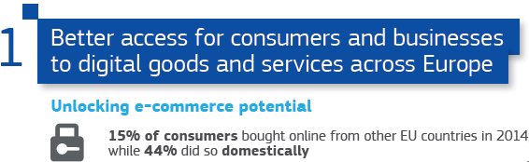
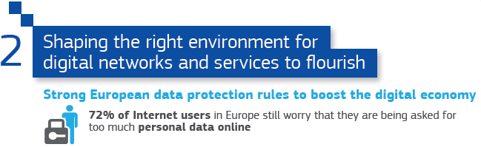
Digital Single Market - DSM
Interoperability
3

Slide 4
DSM - Interoperability and standards
Creating an European Digital Economy and society with growth potential
Cybersecurity
Cloud services
Data driven economy
E-Health
  Interoperability is strategic for
E-Business
Intelligent transport systems
Internet of Things
Global challenges require multidisciplinary approaches
4

Slide 5
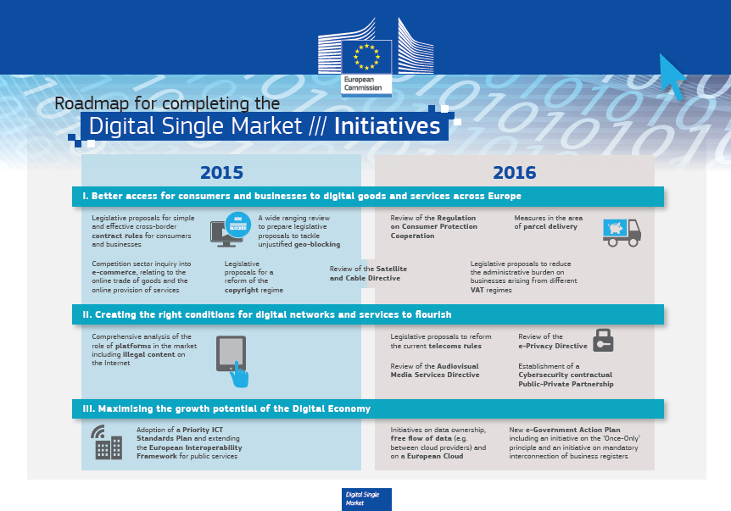

DSM Roadmap
Adoption of a Priority ICT Standards Plan and extending the European Interoperability Framework for public services
5

Slide 6
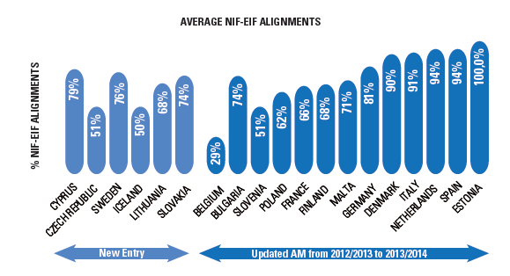

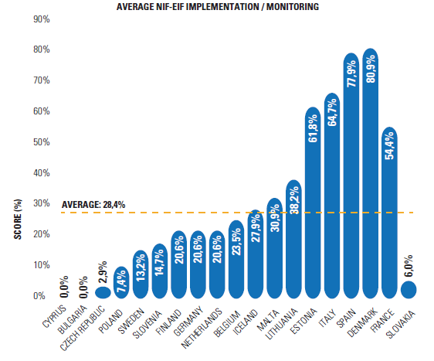
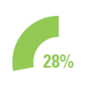
Current State-of-Play
The European Interoperability Framework - EIF
Well accepted as a framework by the MS
Still some way to go to have it implemented
6

Slide 7
European Interoperability Framework
Revision
Guidance
Support
Best practices
Avoiding the creation of new electronic barriers or silos when modernising public administrations in Europe
Facilitating the interconnection of public services for citizens and businesses at national and EU level
Improving quality of public services and transparency
Coherence of open data from various sectors and countries
7

Slide 8



European Interoperability Framework
Revision
Alignment with policy development
Extend and align with emerging trends
More focus on EIF implementation is needed
    Policies having a strong linkage with IOP have been either recently launched (e.g. DSM strategy) or revised (e.g. PSI Directive).
    Include the European Reference Interoperability Architecture (EIRA) and Cartography (EIC)
    ICT (e.g. Cloud)
    Information management (e.g. Big data, Open data)
    Security
    Organisational and governance structures
    NIFs aligned with EIF to a large extent (72%)
    Application (implementation and monitoring) of NIFs still lags behind (28%)
8

Slide 9
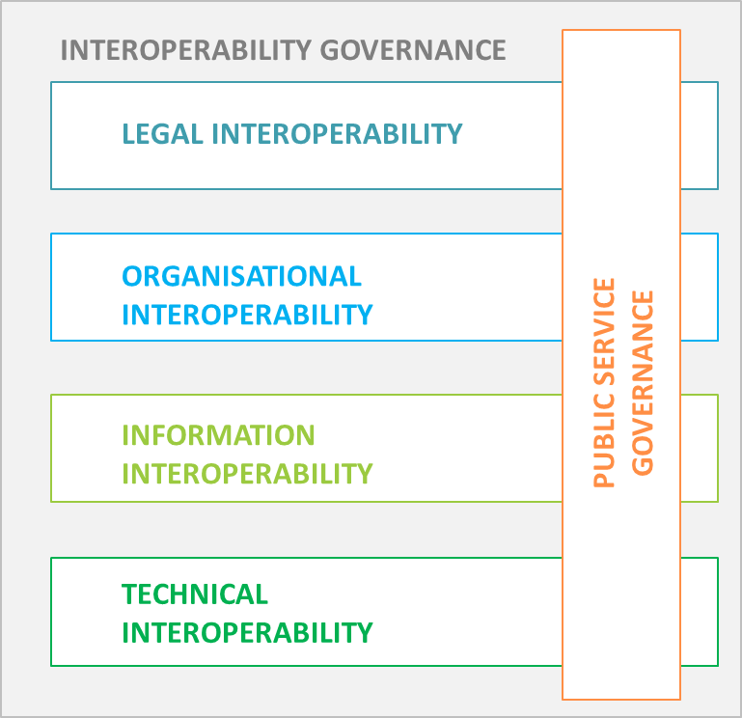
European Interoperability Framework
Revision
Updated Interoperability
PRINCIPLES
Updated Interoperability RECOMMENDATIONS
Updated Interoperability
MODELS
9

Slide 10


Strategy and Framework together
Strategy - EIS
Framework
EIF
Objectives
Vision
Principles
to guide
Recommendations
and
Conceptual models
Needs
to implement in
Roadmap
Financing
10

Slide 11

The European Interoperability
Strategy
Priorities
Move from alignement of national approaches with the EIF to real implementation
From political willingness on IOP to practical implementation
Put in place IOP Governance at EU level and nationally && ensure
coordination among various actors
Deal with legal barriers on iop through "impact assessments" and "digital checks"
Confronted challenges
Deal with the low uptake of digital public services including through a "user-centred" approach
Provide tools and guidance to overcome resources constraints
&&
deal with shortage of skills on IOP
11

Slide 12
EIS revision in practise
EIS should be more ‘’concrete’’ with a clear shift towards “implementation”.
Definitions, objectives and clusters of the EIS should be simplified and clarified.
1
2
Set up an implementation roadmap with milestones
and measurable goals
Revision guidelines
Plan and prioritise roadmap's activities
Monitor implementation (e.g. uptake and reuse) both, EIS and EIF
12

Slide 13
EIS Focus areas
Priorities for the period 2016 -2020
(work in progress)
FOCUS AREA N°1
Governance & Coordination
FOCUS AREA N°2
Organisational interoperability
FOCUS AREA N°3
Engagement/ Raising awareness
FOCUS AREA N°4
Key enablers
FOCUS AREA N°5
Supporting instruments
Governance structure for IOP coordination (EU, MS)
Put at place a monitoring of the EIS implementation (i.e. observatory) (EU, MS)
Identify and liaise with other relevant policies and their governance structures at EU and national level
Mechanism for measuring IOP benefits (EU, MS)
Identify organisational structures for digital public services (EU, MS)
Communication campaign promoting the importance and benefits of interoperability (EU)
GO LOCAL in MSs. Liaise with EU country desks for dissemination (EU, MS)
Platform (JOINUP) for best Practice Centre of Excellence (EU)
Platform for user engagement / community building (EU, MS)
Define common specifications on the terms and conditions to access base registries (EU, MS)
Data specifications to support the EU open data initiative (EU)
Make available catalogues of services across the EU (EU, MS)
Identify legislation that hampers IOP (including legal screening) / Perform digital check (EU, MS)
Develop and maintain EIRA and the cartography of solutions (EU)
Include actions coming from the ISA² legal basis
All actions should be user centered and needs driven
Proposed actions at both national and EU levels
13

Slide 14
Financial Instruments
Financial instruments to consider for the EIS/EIF
ISA²
Horizon 2020
Connecting Europe Facility
ESIF and SRSP
INTERREG Europe
    Facilitating efficient and effective electronic cross-border or cross-sector interactions
    Developing a EU holistic approach to IOP;
    Maintain and monitor implementation EIS/EIF/EIRA
    Contributing to the development of e-administration
    Developing IOP solutions
    Addressing innovative ways to use ICT in the public sector
    Supporting piloting activities on a large scale and several sectors addressing different technological areas
    Building on Member States’ initiatives.
    Supporting the deployment and operation of key cross-border digital services for businesses and citizens
    Electronic identification and procurement, interoperable health services….
    Supporting national, regional, local administrations in the implementation of their national operation and reform programmes
    Addressing ICT as a cross-cutting theme that links in with the other thematic objectives
14

Slide 15

Revision Process
How it is organised
    Consensus-building process with
    The Member States
    The concerned Commission Services
    The other European Institutions
Other stakeholders
Standardisation bodies
Industry representatives
Academia
Public consultation
From January to March 2016
Working with experts from the academia for the EIF
15

Slide 16

ISA² coming up !
(successor of the ISA programme)
Shall facilitate efficient & effective electronic cross-border or cross-sector interaction between European public administrations & between them, citizens & businesses.
Objective
Will run from 2016 until 2020, aligned with the Multi-annual Financial Framework (MFF)
Will have a financial envelope of approx. 131 M€
Will receive proposals from Member States and Commission services
Will be executed by the European Commission
16

Slide 17
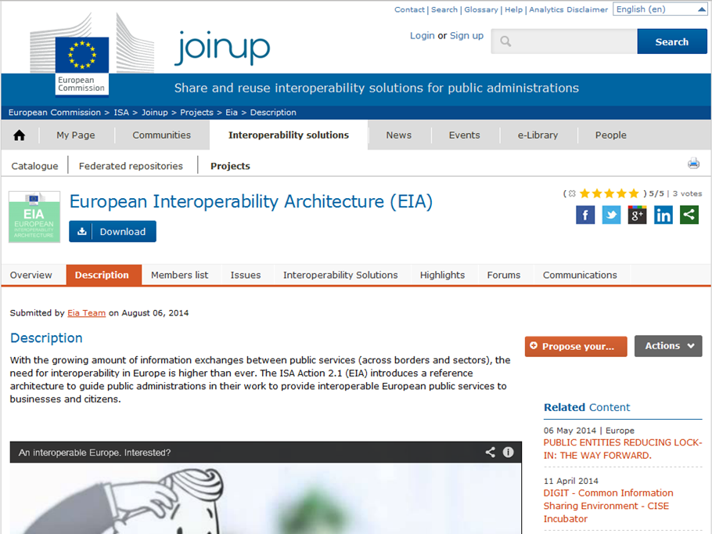



Q & A
Join ISA initiatives at: http://ec.europa.eu/isa/index_en.htm
and @ http://joinup.ec.europa.eu
http://goo.gl/eK1EY
@SEMICeu
http://joinup.ec.europa.eu
17

