Slide 1
Feeling Guide - an Electronic Tool for Improving Employee Well-Being
Head of Personnel Division Ērika Gromule

Slide 2
Case description
More than 25% have declared that it is the workplace that has a negative effect on their health [1] – and it can be caused by stress, depression and anxiety.
By year 2020 clinical depression will become the second most common disease in the world. [2]
1. https://osha.europa.eu/en/about-eu-osha/what-we-do
2. A.K., Rai (2005) Stress Management. Diamond Pocket Books Ltd.

Slide 3
Annual tradition
2014 - «The Year of Well - Being»
Attention to the evaluation and prevention of psychoemotional work environment risk factors.

Slide 4
The Year of Well - Being activities
Survey on the psychoemotional work environment and discussions with employees.
Stress management campaign.
Different stress management trainings for managers and rest of the employees.

Slide 5
Why Feeling Guide?
More efficient trainings
One place for different information about stress management
Easily accessible tool for RSS employees
Balance between important information and attractive interface

Slide 6
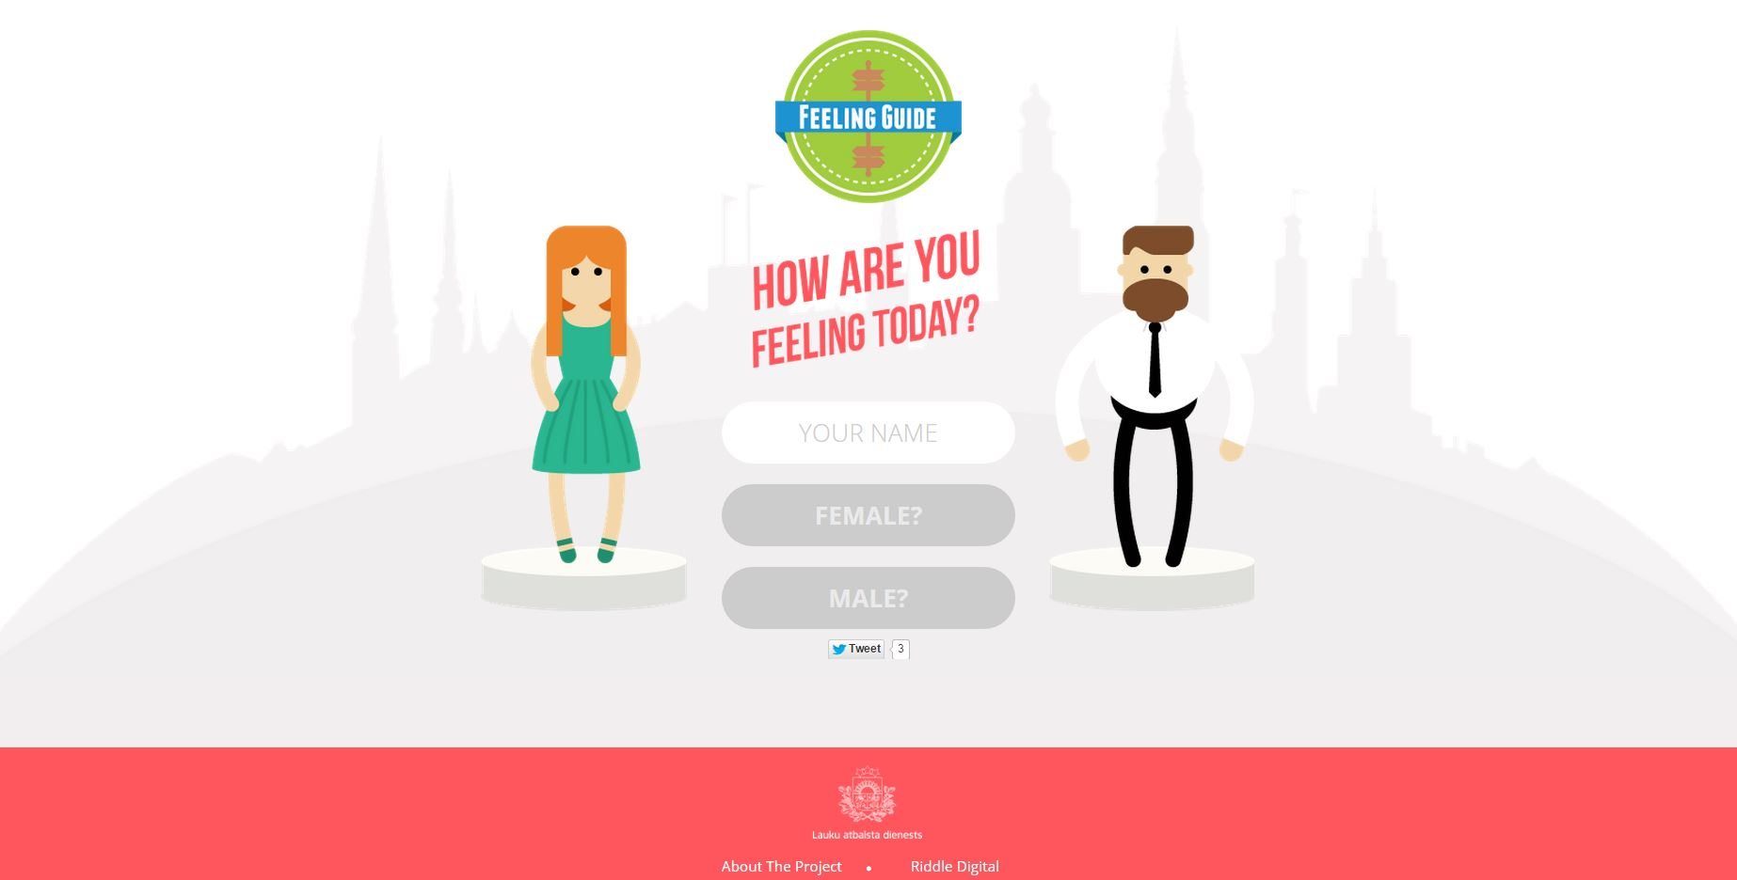
WEB based application «Feeling Guide» (1)
https://vimeo.com/122094273

Slide 7
WEB based application «Feeling Guide» (2)
www.sajutugids.com
The employees can find a summary from all last years trainings in a new interactive visual form.
Give visually appealing advice on how to make the day better, not only for oneself, but also for colleagues.
Available from all types of mobile devices with Internet access.
Available in two languages – Latvian and English.
Available to anyone who wants to improve their well-being.

Slide 8
«Feeling Guide» - the blog
Challenge for year 2015/2016.
More flexible and interactive.
Source for feedback and opportunity to participate (employees of RSS and anyone else).
Repository of learning materials, useful information, inspiring stories and stress management techniques.
Available in Latvian and English for use of general public.

Slide 9
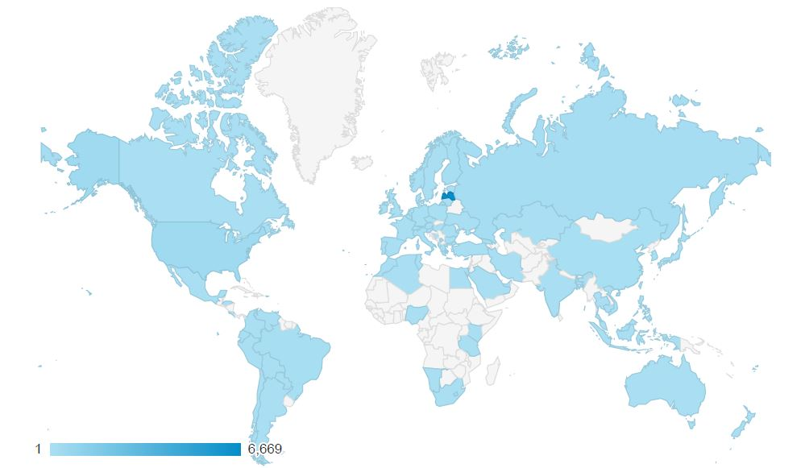
The statistics of «Feeling Guide»
more than 13 000 users
more than 50 000 page views
one in four of the visits are from a person who has already used the application
the average time spent on the application: 3 – 10 minutes
the WEB page is visited from more than 50 countries – Russia (1364), US (1278), Brazil (187), China (135), Finland (101), Japan (97), Germany (95) and other countries.

Slide 10
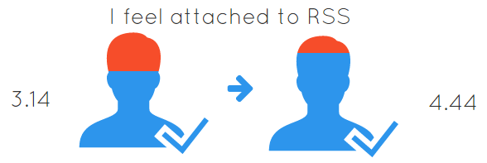
Results of The Year of Well - Being

Slide 11
Thank you!
Ērika Gromule
Head of Personnel Division
erika.gromule@lad.gov.lv
+371 67027696

