Slide 1
Feeling Guide - an Electronic Tool for Improving Employee Well-Being
Head of Personnel Division Ērika Gromule

Slide 2
Rural Support Service
The Rural Support Service is responsible for implementation of a unified state and European Union (EU) support policy in the sector of agriculture, forestry, fisheries and rural development.
was established on 1 January 2000
operates under the supervision of the Ministry of Agriculture
the number of personnel – 783
https://vimeo.com/117562187

Slide 3
Annual tradition
2014 has been named as «The Year of Well - Being» in the RSS, thus giving attention to the evaluation and prevention of psychoemotional work environment risk factors.
2015 has been named as «The Year of Safety».

Slide 4
The Year of Well - Being activities (1)
In order to find out the opinion of its employees and identify the problems, the RSS has carried out a survey on the psychoemotional work environment and discussions with employees.
It was determined that most of the RSS employees acknowledged that the work they have to carry out is stressful, complicated, time – consuming and requires a lot of responsibility. At the same time the employees rate their work as interesting.

Slide 5
The Year of Well - Being activities (2)
In order to realise «The Year of Well – Being», the RSS carried out a stress management campaign.
RSS organized stress management trainings, which were separated – two day training for managers and one day training for the rest of the employees.

Slide 6
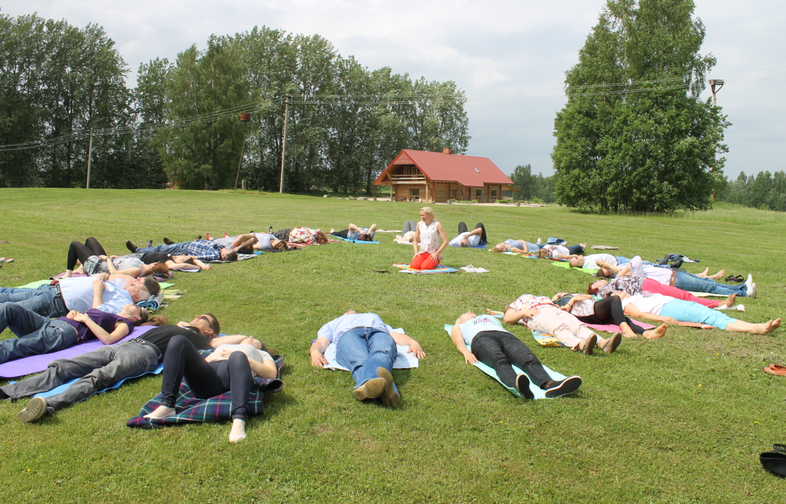
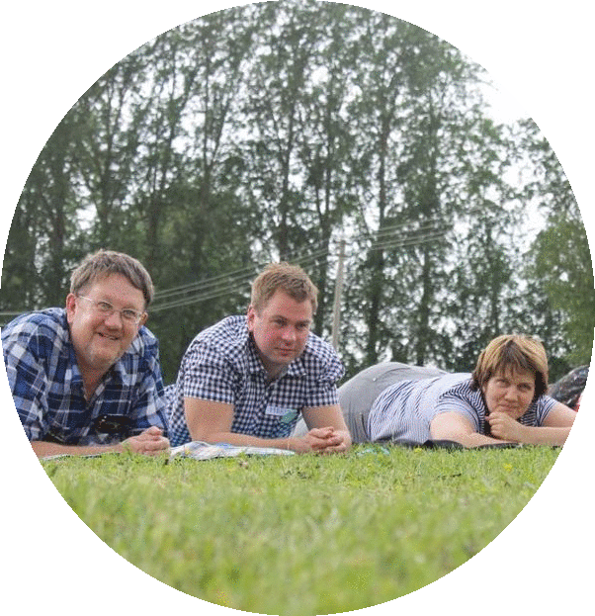
The Year of Well - Being activities (3)

Slide 7
The Year of Well - Being activities (4)
Training materials
Stress management techniques
Information
Easy access
Attractive interface
A “helping hand” for employees

Slide 8
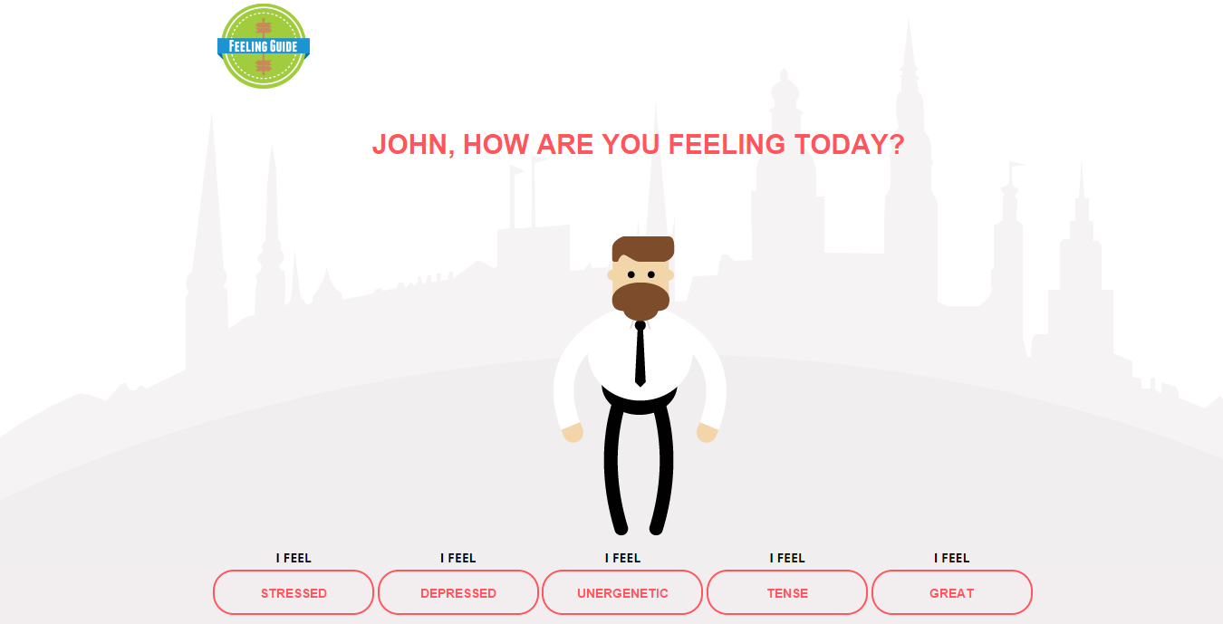
«Feeling Guide»
Asks a simple question – “How are you feeling today?”
Offers 5 possible feelings
Gives tips for feeling better or helping a colleague

Slide 9
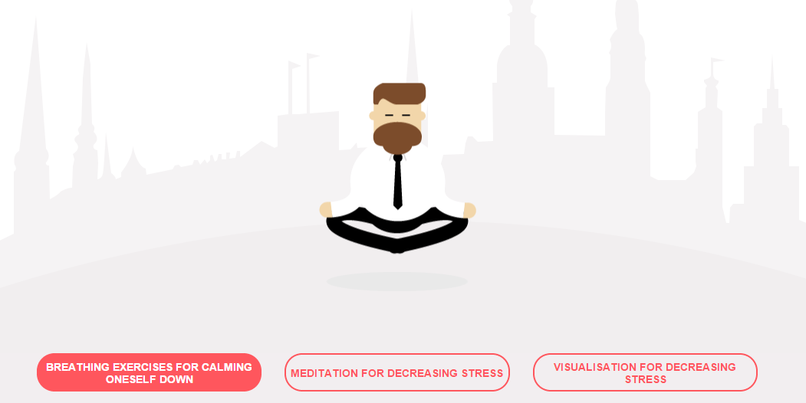
I feel stressed

Slide 10
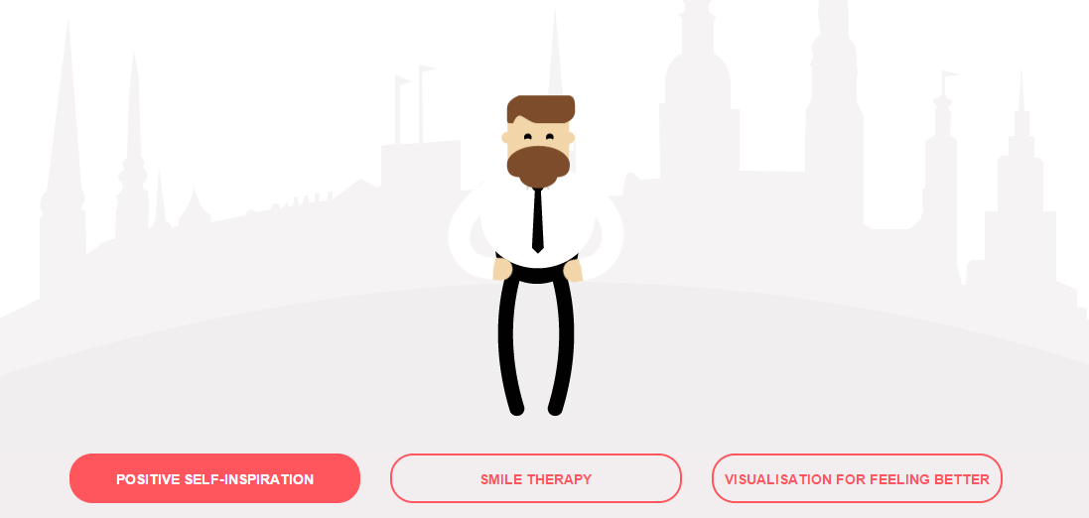
I feel depressed

Slide 11
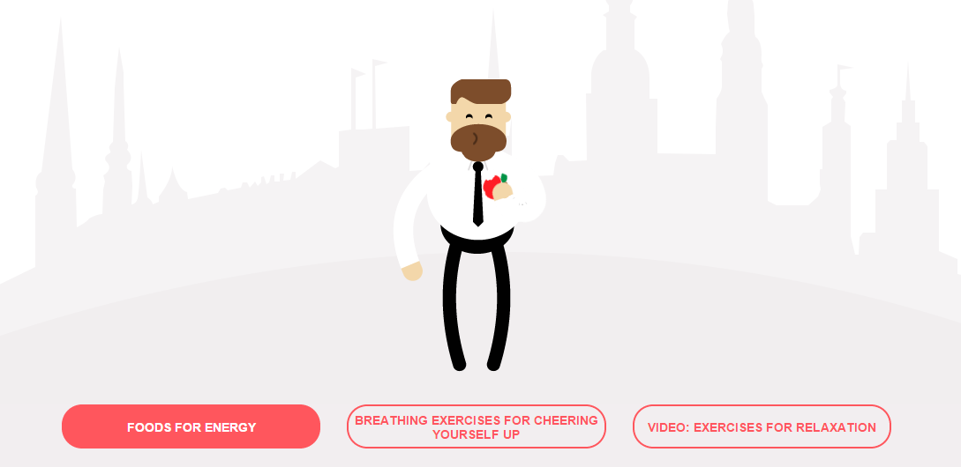
I feel unenergetic

Slide 12
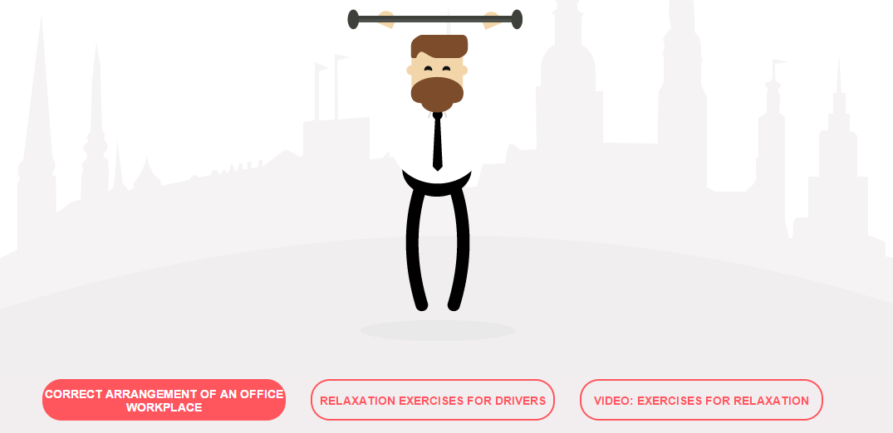
I feel tense

Slide 13
I feel great

Slide 14
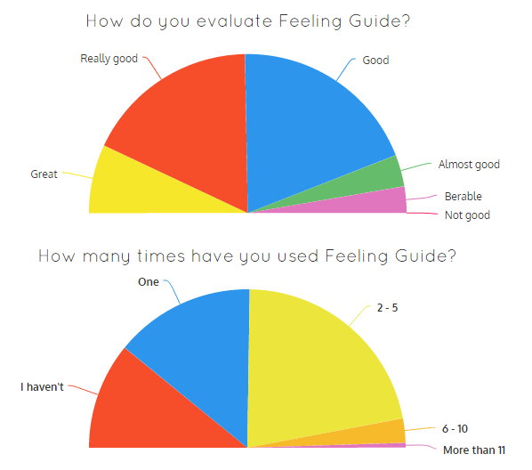
Results of the Year of Well – Being (1)

Slide 15
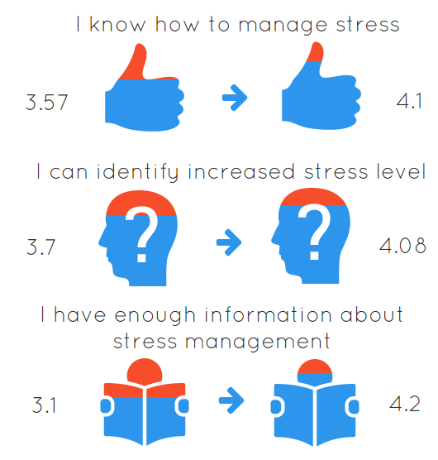
Results of the Year of Well – Being (2)

Slide 16
Results of the Year of Well – Being (3)

Slide 17
«Feeling Guide» - the blog
Challenge for year 2015/2016
In order to improve the well being of RSS employees we have developed the Feeling Guide blog where you can find:
Learning materials from different seminars, courses RSS employees have participated in year 2015
New methods for managing stress
Articles about topics related to well being
Possibility to receive feedback, submit questions, comments and participate
Professional comments

Slide 18
What positive lessons have we learned?
Higher employee engagement means stronger feedback and higher loyalty
It is possible to develop a successful project without extra finances; the key is in good collaboration
Initiative is risk worth taking – do not be afraid to talk with employees about sensitive topics and listen to them. Even if it is not always what you want to hear.

Slide 19
What would we do different?
The primary tool of the Feeling Guide could be developed on a different technical platform – to be more flexible and the information could be changed more easily
The primary tool would be more visual - more information would be in style of infographic, small video etc.
There would be stronger engagement in development of Feeling Guide from our employees in different departments

Slide 20
Success factors
Enthusiasm and initiative of its employees
Ability to find ways of training and motivating more than 750 employees with limited funding – and developing a multimedia tool for everyone

Slide 21
How can others integrate it?
Feeling Guide is available to anyone that is why organisation can use it:
To improve wellbeing of employees
To supplement training materials
To show an example of employee engagement
RSS invites everyone to use Feeling Guide and share their ideas how to make the blog better

Slide 22
Thank you!
Ērika Gromule
Head of Personnel Division
erika.gromule@lad.gov.lv
+371 67027696

