Slide 1
8th Quality Conference
Session: 10.1 DK
Title: Digitalization of the work processes –introducing It-mobility at Rail Net Denmark, Maintenance Services

Slide 2
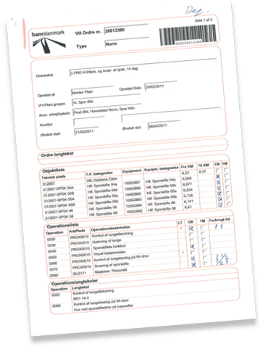
10 min Case presentation – The objective and the challenge
The objective of the Programme ”IT Mobility” is to ensure that the employees working in the tracks will be ”paper free” by 2016
Challenge:
Workforce 600 employees:
  Craftsmen or uneducated
  Average age 49
  Male
  20% dyslexic and another 30% with reading and writing skills at a class 3-4 level
  Very mixed IT skills, many who has never touched a pc

Slide 3
10 min Case presentation – what happened and what have we achieved so far
Early Information and initial involvement at all organisational levels
Ensured a high level of professionalism and seriousness
95% of 600 employees have been tested
160 employees needed training, 94 dyslexic
81% believe they have gotten better at Danish reading and writing
Test result show the employees have improves their skills with 25,5%
Okt. 2012 – Mar. 2014
Dec. 2014 – mar. 2016
Project
”Educated for the future”
Programme ”IT Mobility”
Organisational
Implementation
activities
Activities | Timings
Info meetings about IT Mobiliy programme and educated for the future project for all employees and managers | Okt. 2012 – Jan. 2013
Test of reading and writing skills, all employees and local managers | Nov. 2012 – Jan. 2013
Basic danish reading and writing courses at local VUCs | Jan. 2013 – Mar. 2013 Dec. – Mar. 2014
Activities | Timings
Info meetings about IT Mobiliy programme and educated for the future project for all employees and managers | Okt. 2012 – Jan. 2013
Creating ”following group – local managers” and ”local super user organisation” | Spring 2013
Roll out of tablet to all employees | Autumn 2013
Development and roll out of ”job order app” | Dec 2014- apr 2015
Development and roll out of ”time registration app” | apr 2015 – nov 2015
Development and roll out of ”documentation app” | dec 2015 – mar 2016
Clear connection between need for reading and writing skills and the IT Mobility programme (WHY)
All employees and their local managers got an early say in what they expected from the programme, apps, functionalities, how to work with tablets, information etc. (HOW)
The programme had “faces” and a communication channel got established (WHO)
Finding resources for super users, local change agents, project participants etc. among the employees during a 4 year programme got easier (INVOLVEMENT)

Slide 4
10 min Case presentation – the plan and activities
Project deliveries (eg Time registration app, a tablet, a job order app etc)
5. Evaluation and follow up
1. Project idea, PID
OI
5. Evaluation and follow up
1. Understanding the change
2. Analysis and specification of requirements, contracts with suppliers
4. Organisational Implementation activities (training, involvement workshops, communication etc.)
Organisational Implementation
Process
(change management)
2. Deeper organisational analysis, involvement of the employees and local managers, organisational implementation plan
4. Go Live implementation
3. Formalised involvement of the organisation, planning specifc organisational implementation activities such as training
3. Development of products

Slide 5
10 mins case presentation - impact
Lessons learned – a copernican revolution or Danish fairy tale?:
  The vision and the organisational change process is what ensures return on investment – not the tablets and apps!

Slide 6
5 mins of moderated Q&A
Sustainability:
  We have institutionalised the Danish reading and writing courses for new employees. New courses this winter
3 things we did great:
  Early involvement and true involvement (inputs and opinions are actually used and responded to). The super users are the ones driving the local change process in the organisation.
  Believing in the organisational change process – staying true to the concept, even when things get difficult and timings and economy is tight
  Top management engagement, without it no organisational implementation
3 things we would do better:
  Initial analysis and business cases can be too promising compared to the actual results, we had to downsize our expectations and change the benefit realisation plan
  Deeper analysis of the impact of a programme like this
  Staying more true to the Programme management method (MSP) and ensure a focus on cross project steering

Slide 7
In depth presentation of the case – 15 mins
The challenge:
  The employees work all over the country and they mainly work at night
  Resources are tight – production company, every man hour out of the production cost us money, so we have to plan long term and do all our training during winter
  It requires a lot of central coordination
Implementation of the business apps is going on:
  Almost done with the second app, third app will be implemented during winter 2015 and spring 2016
  We’re very tight on time, tight on money and on local support resources.
  It is a HUGE transformation of the whole organisation – pulls out teeth!!

Slide 8

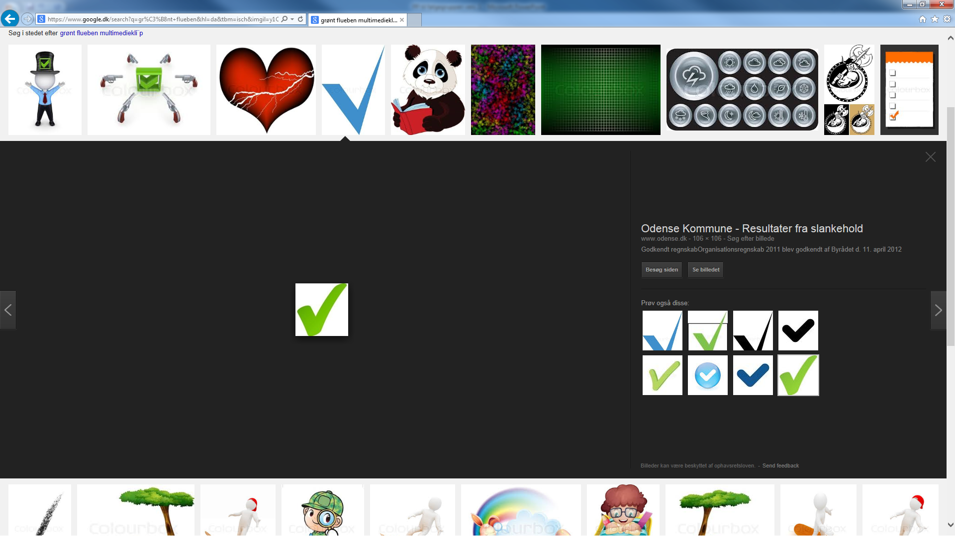
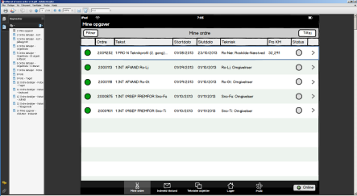
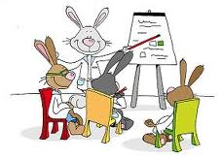
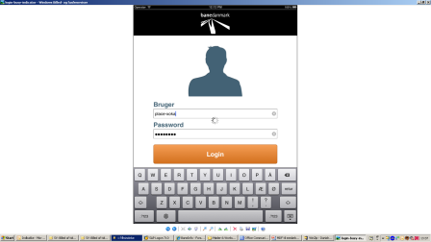
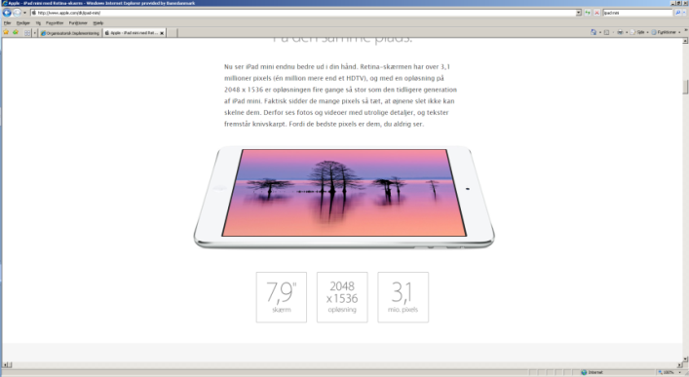
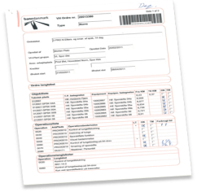
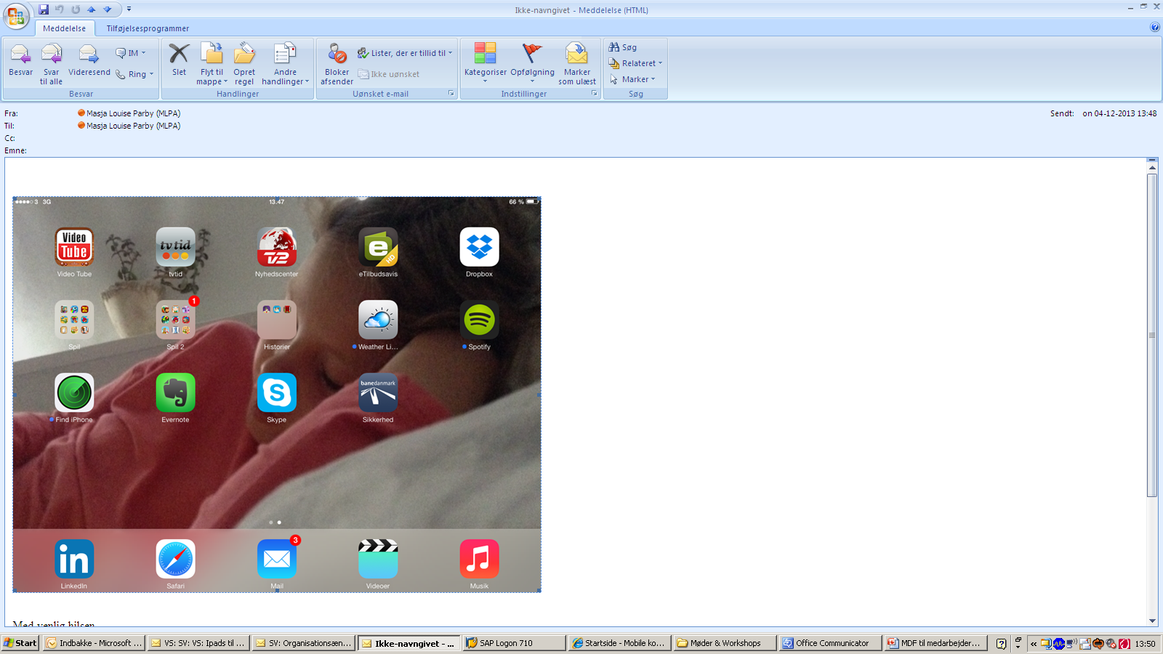
In depth presentation of the case – 15 mins
446 employees trained by the end of april 2015
The projects of the ”IT Mobility” programme
GPS Tracking
2. ”Educated for the future”
3. iPad-mini
4. Safety rules app
All managers (approx 90) trained in the new approval portal april 2015
5. Joborder app
6. Mobil
Time registration
app
7. Documentation app
160 employees educated by Q1 2014
approx. 600 employees trained at the end of november 2015
xx employees trained in Q2 2016

Slide 9
In depth presentation of the case – 15 mins. The ”educated to the future”
Labour organisations:
  Two of our labour organisations had individually asked whether we would take part in improving our employees reading and writing skills
IT mobility programme established in 2012
  As part of the programme we decided to run mandatory tests of all 600+ employees and local managers as well as mandatory courses for the ones who needed it
  Goal was to train all employees to a reading and writing level of class 7 (dyslexic should generally improve their skills)
Surprising results:
  It was a surprise to us that the test result showed a a big group of the managers had difficulties reading and writing as well and needed courses

Slide 10

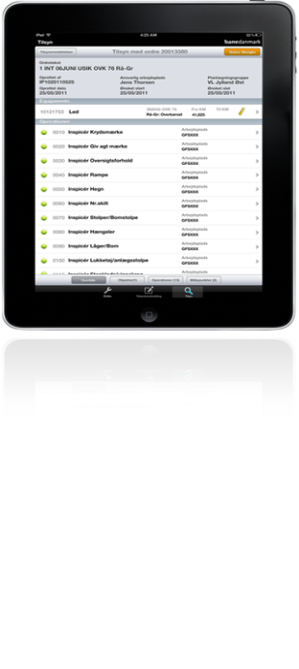
In depth presentation of the case – 15 mins. Training concept
We need to train 450-600 employees in 3 business apps during one year
We have 26 local super users. They each have to train 20-30 men. The training consists of:
  1 day of training for the super users in each app, then a couple of weeks for their own learning-by-doing and sparring with each other and the projects
  Approximately ½ day training for each employee in the basic functionalities
  Max 10 men per training course
  Each super user then follows up at least once on each of their men during the first two weeks with the new app
  The organisational implementation team follow up with the super users and local managers.
Everyone practice with learning-by-doing
Super user followas up
Super duper users train the super users, who train their colleagues

Slide 11

In depth presentation of the case – 15 mins. Local manager meeting before roll out
What we expect from you as managers
You’re the managers, the super users ”just” train. That means:
  You’re the ones who have to explain and answer all sorts of organisational questions, which doesn’t concern the functionality of the apps. E.g. what will the administrative personnel be doing after the roll out
  You’re the once who have to define the local needed changes based on the benefits we need to realise together
    Apps will create some automatic changes
    Apps provice a huge potential for changes, which you as managers have to support and carry out
  You’re the once who have to ensure the local changes are implemented and maintained.
The organisational implementation team will help as much as you need!!
Local manager meeting approx 2 weeks before roll out of each app
Demo. We talk about the new solutions and possibilities. We define the local needed changes together. We define commucation activities. We prepare you for the reactions you might meet and questions you need to answer
Follow up meeting approx 3-6 weeks after the app has been rolled out
How did it go. What went well. What can we do better next time

Slide 12
In depth presentation of the case – 15 mins
The results so far:
  30% of our employees and local managers have recieved a basic reading and writing skills course and have improved their skills significantly (25% better results). The courses have been very positively recieved;
    Because we never articulated it as a problem!
    Because we see it as mandatory in order to ensure the employees are equipped for general further education within Rail Net Denmark
  The 20% dyslexic employees have received special training in apps and relevant reading methods for people with dyslexic challenges
  600 employees have had an iPad for approximately 2 years. They are allowed to use it as much as they want to – at home too. The result is that more than 95% of the employees use their iPads daily or at least weekly and have gotten familiar with the technology before they had to learn the business apps

Slide 13
Interaction on transferbility
We believe there is a high level of transferability because:
  We use overall programme-, project- and change mangement methods and adapt them to the local organisation and concrete situation
  The overall objective of the activities in the programme is to:
    Deliver the relevant products
    Ensure benefit realisation through organisational implementation of the products
  The difficult tasks are:
    To maintain management focus for such a long period of time, because of daily business and other relevant business changes and projects going on at the same time
    To understand and acknowledge the needed resources for such a large organisational change (it always takes longer, requires more resources and only gives back 50% or less of the expected benefits)
    To change or close down projects, which turned out to be irrelevant. However, it is highly required for the programme to survive, that all projects are relevant all the time

