Slide 1
8th Quality Conference
Session 7: Towards a more transparent and accountable public administration
Central Electronic Registry of Public Procurement
Ioannis Panolias, Public Procurement Officer
1-2 October 2015
Esch-Belval , Luxembourg

Slide 2
Index
Insert your own text here
Insert our own text here
10. Would do differently
11. Success Factors
12. Pitfalls
13. Evolution and Next Steps
14. Statistical and Help Desk Data
1. Our Identity/ CERPP
2. Before CERPP Application
3. Main Objectives
4. CERPP Search Screens
5. Implementation and Actions
6. Results achieved
7. Benefits for All
8. Lessons Learnt

Slide 3
Our Identity - CERPP
General Secretariat of Commerce is a National CPB for public procurement
Management and function of a free access central e-registry (CERPP)
Conceived and developed as an in house project by a small group of people working in the Public Administration
Target groups: C.A’s, Suppliers, Citizens
Established by Law, effective from 04/02/2013

Slide 4

Before CERPP application
Fragmented data entry
Dispersed publicity
Innacurate contracting authorities number
Controversial administration procedures
Lack of statistical data
Inadequate decision making

Slide 5
Main Objectives
Integrated data entry in a centralised system
Open source of procurement opportunities
Create statistical database
Monitoring tool for C.A’s actions on P.P
Communication with civil society

Slide 6
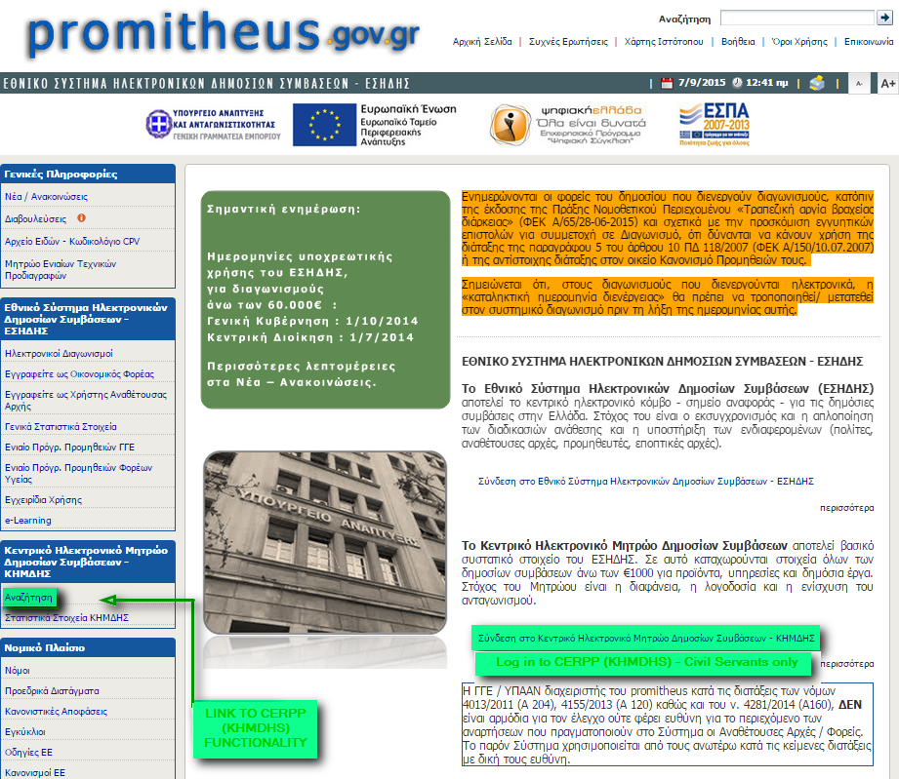

Slide 7
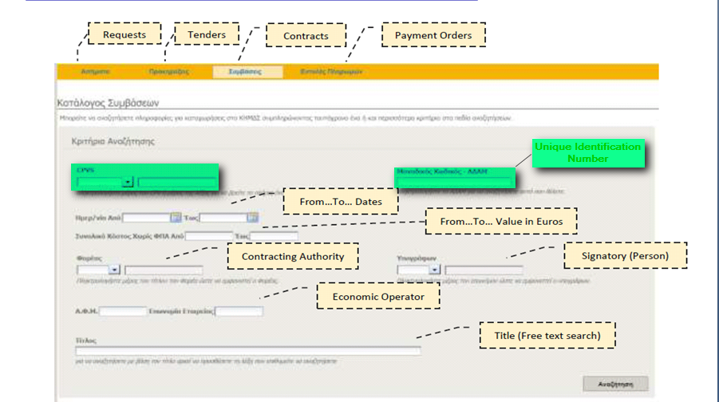

Slide 8
Gradual CERPP implementation in the Public Sector
Since 04/02/2013
Ministries
Since 02/04/2013
Central Government and Administration,
Independent Bodies, Hospitals e.t.c
Since 02/05/2013
Local Authorities ( Regions, Municipalities)

Slide 9
Actions for Promotion and
Support of CERPP
Issue of circulars
Ad Hoc meetings with C.A’s
Presentation workshops
Since 09/2011,
27 seminars took place for 667 employees from 174 C.A’s
Actions
Training
Help Desk
Project Team
IT procedure for support and answering C.A’s questions.
Telephone calls.
System demonstration on Secretariat’s Premises.
Consists of 7 groups to cover administrative and technical aspects.

Slide 10
Results Achieved
Transparency
New tool against potential procurement manipulation
Standardization of procedures
Re-engineering C.A’s map
More informed decision making
Progress towards a more reliable public procurement environment

Slide 11
Benefits for Central Administration
Through monitoring CERPP Central Administration can, among others:
observe demand and supply in public procurement
get a better overview of the market, especially concerning monopolies or oligopolies, leading to suitable measures of correction
aggregate demand and perform Framework Agreements
observe contract values / trace patterns of high value contracts and repeated awardings
Notes:
σδφ

Slide 12
Benefits for Contracting Authorities
Through monitoring CERPP Contracting Authorities can, among others:
search and compare technical specifications/ contract values for all public procurement / set up tender notices
Uniform and cohesive administrative practices
Use CERPP as e-repository for all procurement documents
Notes:
σδφ

Slide 13
Benefits for Economic Operators
Through monitoring CERPP Economic Operators can, among others:
observe market trends and public procurement, plan accordingly
use the Registry as a technical specifications repository
be informed about upcomimg tenders at an early stage (approved request)
observe up–to-date contract values
Notes:
σδφ

Slide 14
Lessons Learnt – Did Well
C.As showed remarkable adaptability to the system
Promote Public Procurement Importance
Build strong relations between our CPB and C.As

Slide 15
Would Do Differently
Build a better communication strategy
Longer adaptation period for all parties
Multiply organized training sessions

Slide 16

Success Factors
Strong determination against C.As exceptions
Failure to comply leads to inability of relevant payments
Will for improvement

Slide 17

Pitfalls to avoid
Inadequate adaptation – no trial period (On the job training the hard way)
Delay in vertical dispersion of info regarding the new e-tool (significant number of C.A’s)
Insufficient number of employees allocated to Help Desk

Slide 18
Evolution and Next Steps
Functionalities are being updated in order to provide more interoperabilities and user-friendly features
Still...
Online advertising of the Registry / Annual conference to be held for information exchange, resolution of issues e.t.c.

Slide 19
CERPP Statistics 1/3

Slide 20
CERPP Statistics 2/3

Slide 21
CERPP Statistics 3/3

Slide 22
Help Desk Data
12,000 help desk tickets
More than 1.2 million uploads
More than 15,000 users

Slide 23
Thank you for your attention
General Secretariat of Commerce and Consumer Protection
Konstantinos Tzanetopoulos - ktzanetopoulos@eprocurement.gov.gr
Stavroula Mouzaki – smouzaki@eprocurement.gov.gr
Ioannis Panolias – panolias@gge.gr

