Slide 1
Encounter-based service as a source of effectiveness and user-satisfaction
Elina Lehto-Häggroth, Vice Mayor

Slide 2
CAF self-assessment in Vantaa is a Part of Budget Process
Departments, result divisions and those profit centers that have their own budgets utilize the CAF (Common Assessment Framework) model in assessing and developing their operations, compile a description of their own operations, based on the CAF questions, at least once per council term.
2014: describing and assessing Partnerships and Resources, Processes, and Social Responsibility results
2015: describing and assessing Leadership, People and People results
2016: describing and assessing Strategy and Planning, Citizen/ Customer -oriented results, and Key Performance results
The results of these assessments can also be utilized in compiling a description of the operating environment.
In the year following the assessment, the committee's budget proposals will include the conclusions—based on the assessment—of how strategy and operations should be developed.

Slide 3
Encounter-based service as a source of effectiveness and user-satisfaction
Encounter-based innovation
Top down: day care
Bottom up: the yards of day care units and schools
Mixture: recommenders
2. User-producers
Self-service libraries
Schools and day care units: New Learning
3. Partnerships:
Private day care providers
Sports facilities
Art galleries and concerts

Slide 4
(continued)
4. Integration
- Pähkinärinne library and youth premises
- Finnish Schools on the Move
- Child art pedagogues in early childhood education and care
5. Space Utilisation
- Schools

Slide 5
(continued)
6. New interaction and methods with citizens
service design, e.g. Hakunila library
co-planning and co-design
transparency and openness in actions
7. New Leadership
delegating and supporting the encounter level
empowerment for innovation
low organisation
agility and flexibility

Slide 6
Change of costs 2009-2014 -◊- operational costs/child using the service -o- deflated *) operational costs/child using service
*)Statistics Finland: Price index of public expenditure, the social sector 2005=100

Slide 7
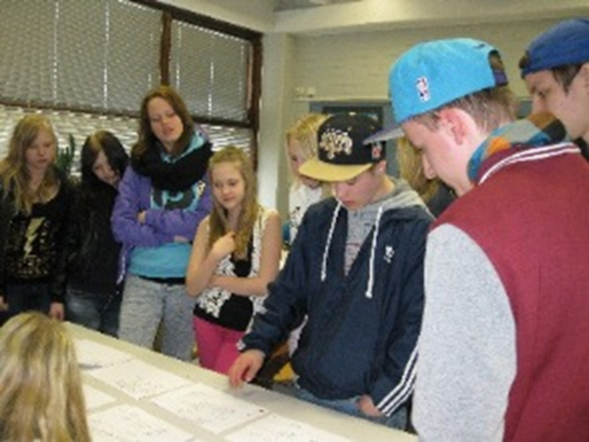
Hakunila library
Costs:
A similar project in the Metropolitan Helsinki Area cost 440 000 euros.
In Hakunila, the total costs were 130,000 euros, of which the City of Vantaa’s share was 90,000 euros, the Ministry of Education and culture financed the project with 25,000 euros and the remaining 15,000 euros were donated by different companies.
Making use of old materials; inclusion of the young; listening to the client; togetherness; increased use of the library; library granny and grandpa

Slide 8
Conclusions
Service innovations do not fit the conventional perceptions and definitions of industrial innovation.
The interaction of service personnel with clients and service-users may lead to new knowledge and this can lead to innovations.
The aim is that ideas/new practices are developed by front-line employees together with clients/citizens and are integrated in the organisation.
(Sørensen-Sundbo-Mattsson: Organisational conditions for service encouter- based innovation. Elsevier 2013)

Slide 9
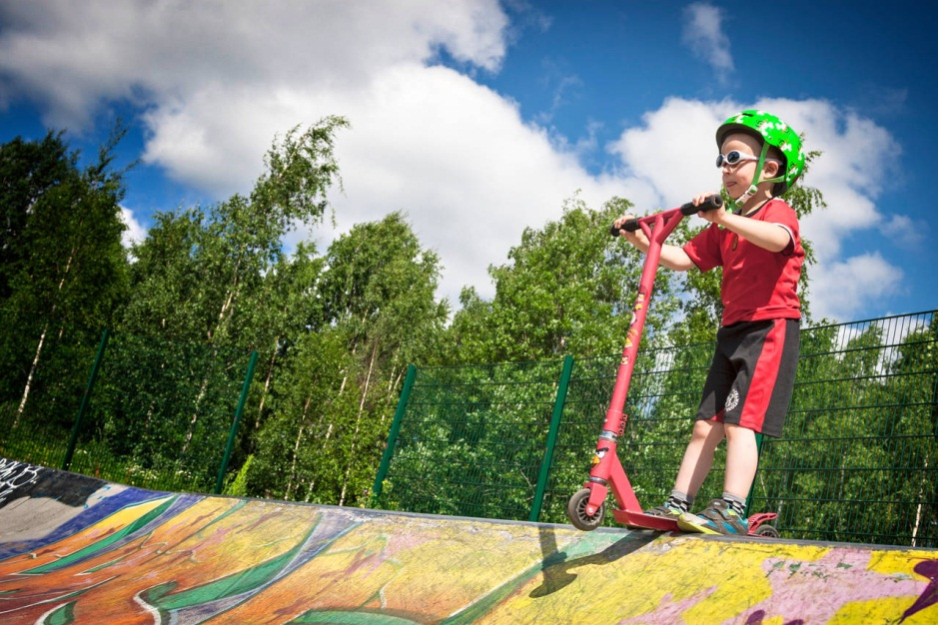
Thank you

