Slide 1
8th Quality Conference
« Strengthening the capacity of public administration in tackling current and future challenges »
6.1 Youth Protection Agency Amsterdam

Slide 2
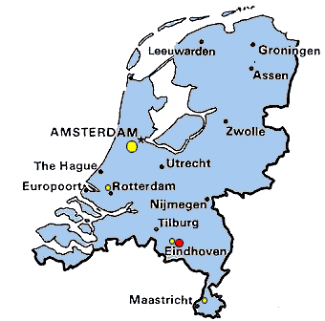
What we do and where?
case management in child and youth welfare: child protection and youth parole
greater Amsterdam area - 16 municipalities
population 1.5 million
3200 multi problem families with
> 7000 children
270 family workers
15 team managers
total staff: 410

Slide 3
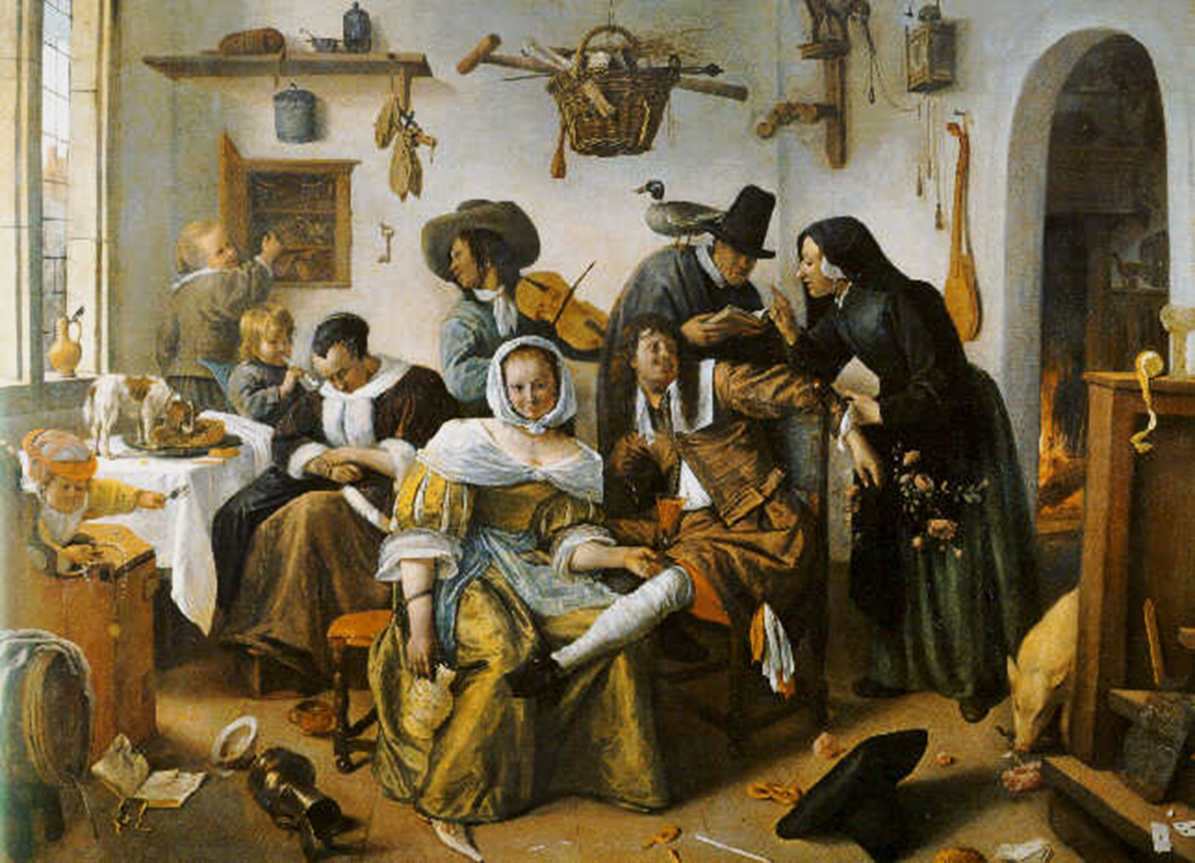
Dutch Multi Problem Family
Landlord: get them out!
Madge: ADHD or just doesn’t listen?
Dad: alcoholic… no worries..
Service provider: they don’t ask for
help!
Peter: lover or pimp?
Tim: neglect alert from nursery!
Joan: girlfriend or prostitute?
Mum: 34, disorganized or mentally challenged?
Notes:
The kind of families we work with in Holland and in Odense.
Long history; multiple failed interventions
Multi problem: mental health, behavioral, drugs, child welfare, gang involved, school, etc
Lacking resources, Frustrated, anxious, fearful - they don’t want us, distrust.
Parents may want us to take over parenting, Difficult to get family involved and keep them involved, Other family members may have MH, DA, Corrections
It is not about individuals it is about the whole family as a system.
Principle – Work with the whole system in the room!

Slide 4
Kevin‘s house

Slide 5
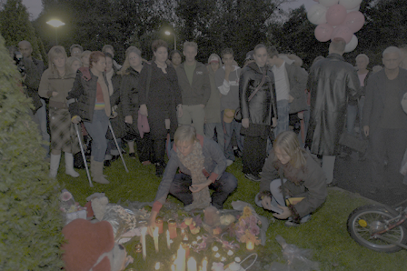
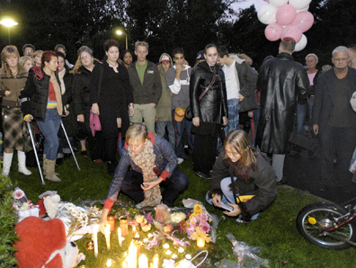
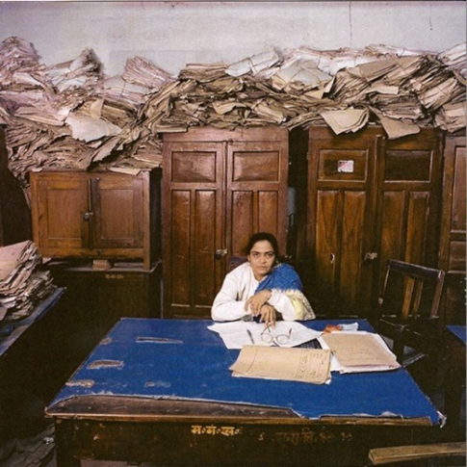
Challenges
no money, near bankruptcy
no safety for children
bureaucratic dysfunction
no focus on results
no worker satisfaction
no leadership at any levels
no support from stakeholders and public opinion
but…. never waste a good crisis!

Slide 6
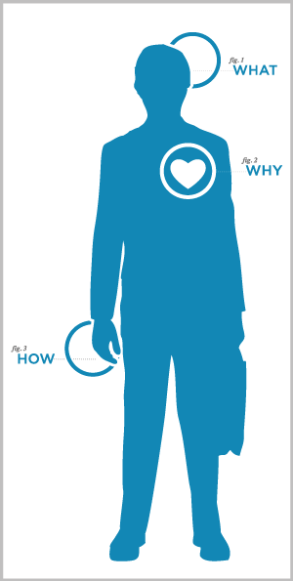
Systems approach?
why? existence…
what? do we need to do?
how? do we do it?
Notes:
If you start from your focus point who would be your client? In the presentation we saw in this conference Why is not an essential question.
People did not know / live what the purpose of organization was
Keep your end of the bargain!
Management was not good at keeping their end of the bargain!

Slide 7
Why?
stop transgenerational transference
“Every child safe - forever”
meaningful measurements
targets
→ outcomes
Notes:
What is the purpose of the organisation, what does society expect us to do.
Transgenerational for example domestic violence should not happen in the future when the kids have there own kids!
Not about setting Targets and control every step in the proces but about meaningful measures
How many court orders do you have, how long do the court orders taken, can you make it shorter
Outcomes are: every child safe, no recidivism
First measure on the whiteboard >> do we meet with families? Not did we make the proper documents in time.

Slide 8
What?
one family – one plan – one worker
functional family parole
bottom up redesign with Vanguard method
principles of value work

Slide 9
Problem → solution
cause
problem?
solution
analysis
cause ?
analysis → best intervention → sustainable change
Notes:
50%
6

Slide 10
What?
understand
check
do
plan
implementation
make perfect
John Seddon, Vanguard Method
Notes:
Start with CHECK Talk about what you need to and understand do to get a new how that fits with the purpose – meaning of your organization

Slide 11
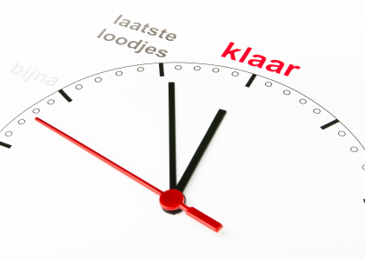
How? > transformation
2014/15
2013
2012
2011
roll in “how”
2010
start of main group
program
management “what”
2008/9
roadshow
“why”
crisis

Slide 12
Impact?
within 3 years
75% reduction of unnecessary reporting
budget per child → budget per family
total budget from 53 to 35 million euros
expected business case results doubled
investment 2 years
2 million from ministry of safety & justice
1 million from municipality of Amsterdam
2 million from own training budget

Slide 13
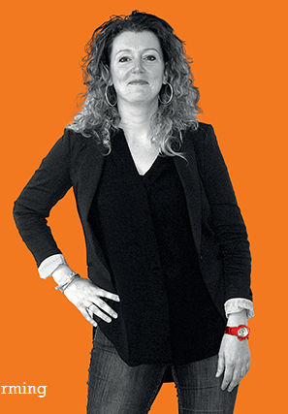
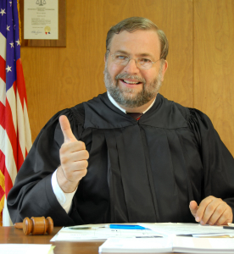
Results
proud!
&
happy!
families
workers
judges

Slide 14
Results > January ‘12 to July ’15 <
improved client and staff satisfaction
court measures 61% ↓
enforced out of home placements 53% ↓
parole measures 46% ↓
legal guardianship 16% ↓
service referrals 28% ↓
annual savings over 20 million euro
currently 3200 families in care, of which
2000 without court measures or force!

Slide 15
Join our
in-depth session on systems change and sustainable transformation Every child safe
forever!

