Slide 1

8th Quality Conference
« Strengthening the capacity of public administration
in tackling current and future challenges »
6.1 In-depth Youth Protection Agency Amsterdam

Slide 2
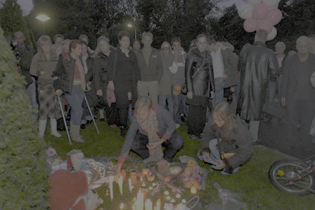


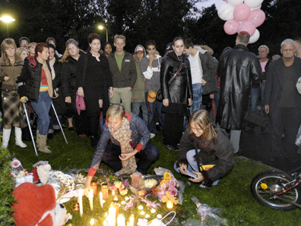

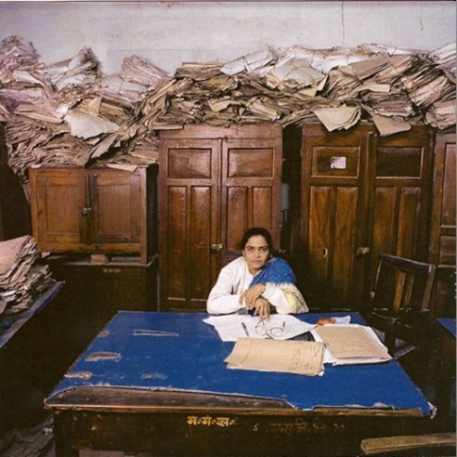
Challenges
no money, near bankruptcy
no safety for children
bureaucratic dysfunction
no focus on results
no worker satisfaction
no leadership at any levels
no support from stakeholders and public opinion
but never waste a good crisis!

Slide 3
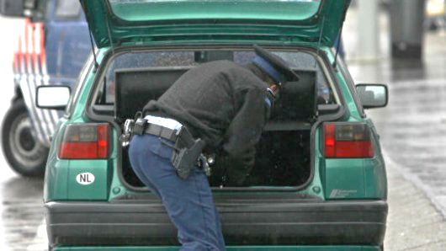
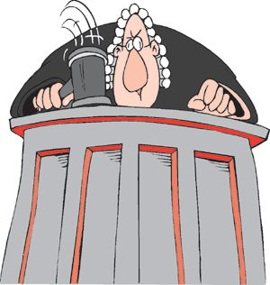
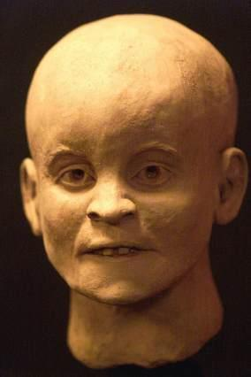
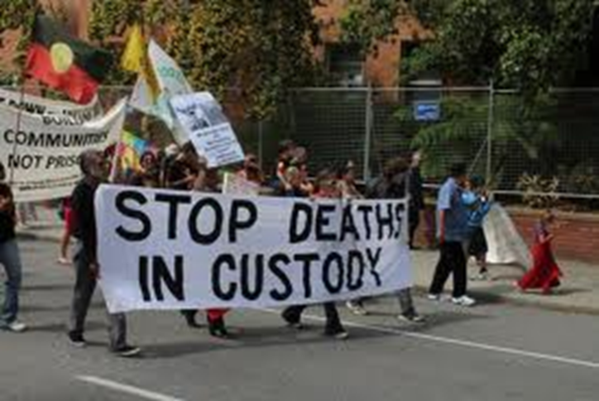
Good crisis 2008 / 2009

Slide 4
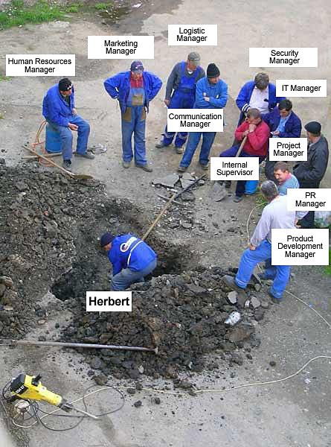


Good crisis red tape and system failure

Slide 5

Multi problem system
budget chains & 200 of care programs
more than 20 professionals involved per family
operation frankenstein

Slide 6

Why?
stop transgenerational transference
“every child safe - forever”
meaningful measurements
targets
→ outcomes
Notes:
What is the purpose of the organisation, what does society expect us to do.
Transgenerational for example domestic violence should not happen in the future when the kids have there own kids!
Not about setting Targets and control every step in the proces but about meaningful measures
How many court orders do you have, how long do the court orders taken, can you make it shorter
Outcomes are: every child safe, no recidivism
First measure on the whiteboard >> do we meet with families? Not did we make the proper documents in time.

Slide 7
What?
focus on child safety
one family – one plan – one worker
functional family parole
bottom up redesign with Vanguard method

Slide 8
What?
Understand
→(personal) crisis
check
do
plan
implementation
make perfect
John Seddon, Vanguard Method
Notes:
Talk about what you need to and understand do to get a new how that fits with the purpose – meaning of your organization

Slide 9
What? → Munro reports!
What is the purpose?
c
u
s
t
o
m
e
r
s
How well is the worker facilitated
to do the value work at transactional moments?
Notes:
9

Slide 10
What? → leverage!
purpose
measures
method

Slide 11
What? → start with check!
understand
check
do
plan
implementation
make perfect
John Seddon, Vanguard Method
Notes:
Talk about what you need to and understand do to get a new how that fits with the purpose – meaning of your organization

Slide 12


  Results from ‘check’
many workers & reports per child
death by
meeting
measurements
method
IT
w₁
w₂
fw
ps
case load = x
targets
1st contact
plan < 6 wks
full case load
how the deal with the case load?
w₃
w_{i}
fw
tm
software separate
workflows
> 1500 variables
> 20 separate workers for
protection, parole & voluntary
cut & paste
extensive journaling
fw
fm
Analysis of 60 files on client value → 60% worse 30% no difference 10% some improvement
Notes:
12
Change the worker and you get another year of protection measures.
Average number of workers in family career = 7 over three years
Old way of thinking and working
No systems approach – serial – separate workflows for different types of case work / privacy barriers between workers
IT is the answer it will solve our problems
Targets help us to control wath they do - control helps us with the work
Division of work is efficient
Staff should be differentiated; we need specialist, generalist and lots of (cheaper) secretaries for the administrative work
Standard scripts lead to cost reduction : simple administrative work in the front office is cheaper

Slide 13
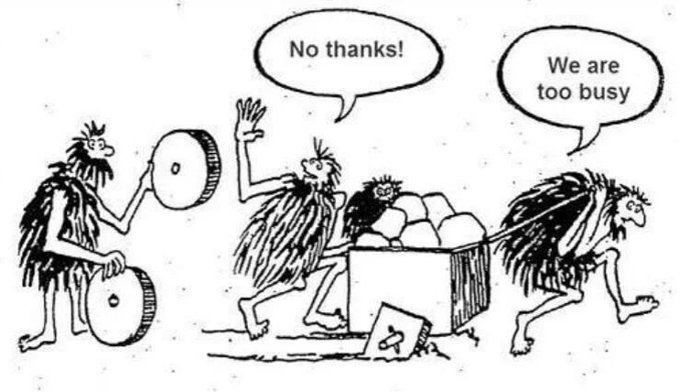

  Transformation
Notes:
Culture change is hard and takes stamina!

Slide 14
What? → plan to make perfect!
understand
check
do
plan
implementation
make perfect
John Seddon, Vanguard Method
Notes:
Talk about what you need to and understand do to get a new how that fits with the purpose – meaning of your organization

Slide 15
  Results from ‘plan’
reporting
case meeting
measurements
methode
IT system
family workers
what is the next step to do?
Functional Family Parole
(FFP)
new layer
1 family plan
+ team manager
+ psychologist
old
1 document
always
up-to-date
once a week
minimum demands
1.
2.
-
9.
strengths
+
worries
-
meetings
with family
and services!
Notes:
15
All children in the family safe forever
One family plan with and in the words of the family
One famil y- one plan – one worker – one team

Slide 16
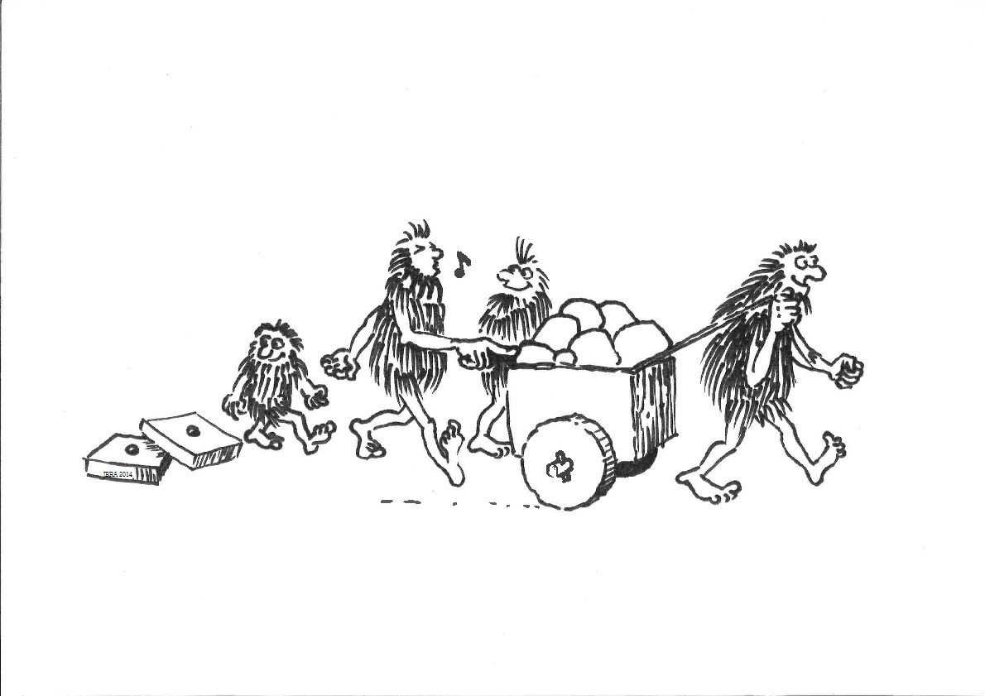

  Transformation

Slide 17
What? → do to make it normal!
understand
check
do
plan
implementation
make perfect
John Seddon, Vanguard Method
Notes:
Talk about what you need to and understand do to get a new how that fits with the purpose – meaning of your organization

Slide 18
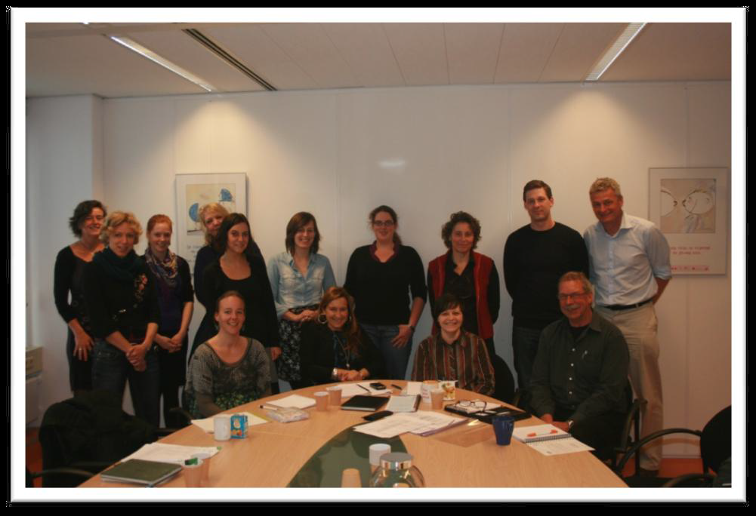
How… did we do it?
main engineer – master plumber
main group of 10 workers
(3 specialisms), a psychologist
and a manager
“roll in” → normative experience
main group responsible for roll in of all
35 teams, one by one!
Notes:
50%
6

Slide 19
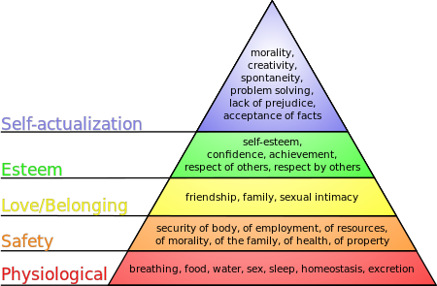

How → good enough?
Maslow’s Hierachy of Needs

Slide 20
How? problem → solution
cause
problem?
solution
analysis
cause ?
analysis → best intervention → sustainable change
Notes:
50%
6

Slide 21

Intensive Family Case Management - IFCM
Generalize
Evidence-Based
Change Program
Link to…
Gen’l
Engage & Motivate
Support & Monitor
Link to…
Gen’l
Evidence-Based
Change Program

Slide 22
IFCM - a way of life
a philosophy / belief System based on respectfulness
family focused intervention involving alliance with and involving all family members → balanced alliance
a phasic change model that is focused on risk and (especially) protective factors - strength based
with interventions that are specific & individualized
to families and family members
and an overriding relational (not problem) focus
Based on Functional Family Parole FFT-LLC Seattle, Alexander and Kopp 2012
Notes:
22
IFCM Intensive Family Case Management
Philosophy and beliefs systems about people /problems/change
Respect-understanding them on their terms
Engaging and motivating is our job and without it don have the have. come into not want do do the work as the family or hopeless..etc..
Individually. respecting on their terms..Relationally..relational assessment
Refer to FFP model developed by Jim Alexander and Douglas Kopp

Slide 23
Good and not so good
good
focus on multidisciplinary teams
annual team audits by peers
augmentation of professionalism & creation of learning environment
not so good
alignment of IT after transformation
issue management is difficult = Andon cord
40% turnover in staff
transferability examples
City of Odense - case managers started in 2013
Youth Protection Zeeland case managers started in 2013
other organizations are trained or made a start with Vanguard Netherlands
the approach is universal: all organizations in the public sector can do this
join our platform: “Every child safe – forever”

Slide 24
The day of a case manager
08.30 travel to first house visit (bike)
10.30 meeting with family, care and cure & police
12.00 lunch
12.30 case meeting with basis team at HQ
16.00 wrap up at office
16.30 crisis call + emergency visit parole youth
17.30 at police station → transfer kid to crisis team
18.30 home
21.00 txt message from kid and crisis worker

Slide 25
Professional working environment
one office building (not 16!)
IT supports family centered method
bike – car – public transportation
laptop - smartphone – video conferencing
flex meetings
training, feedback, supervision
competency management, HR support
Notes:
50%
6

Slide 26
Examples - professional working environment
Organization values trough Social Return on Investment; catering as a learning environment for (former) clients
Facilitate client visits
(lockers, laptops, coffee to go)
Facilitate meeting your team and colleagues: (coffee, meeting points, central plaza
Visualize organization values: Every child safe forever

Slide 27
Changing management thinking
command & control thinking |  | systems thinking
top-down | perspective | outside-in
functional specialization | design | demand, value, flow
separated from work | decision-making | integrated with work
outputs, targets, service levels standards: relate to budget | measures | capability and variation relate to purpose
contractual | attitude to customers | what matters?
contractual | attitude to suppliers | co-operation, mutuality
manage budgets and people | role of management | act on system
control | ethic | learning
reactive projects by plan | change | adaptive, integral, emergent
extrinsic | motivation | intrinsic
Adapted from Mirjam Coret, Vanguard Netherlands
Notes:
Systems Thinking for Service Organisations
1. Vanguard www.lean-service.com Systems thinking for service organisations There is a better way to make the work work… …a way that improves service, improves revenue, reduces costs and improves morale So why isn’t everybody doing it?
2. Vanguard www.lean-service.com What is management’s role? The manager’s role is to….. ….act on the system
3. Vanguard www.lean-service.com Changing management thinking Command and control thinking Systems thinking Top-down perspective Outside-in Functional specialisation design Demand, value and flow Integrated with workSeparated from work decision-making Budget, targets, standards, service levels, activity etc. Capability versus purpose, variation measures Act on systemManage budgets and people ethic
4. Vanguard www.lean-service.com Service centre design and management Traditional thinking leads to significant sub-optimisation Higher costs, poor service, low morale and what problems are managers trying to solve?
5. Vanguard www.lean-service.com The place to start is check Check Do Plan
6. Vanguard www.lean-service.com The service centre hierarchy Manager Service level Abandon rate Costs Team Leader Call volume Call length Time available Inspection Agent
7. Vanguard www.lean-service.com Service centre (front office) design Monitor: activity scripts procedures quality calls in sort (IVR) do the work service levelvolume in
8. Vanguard www.lean-service.com First big mistake Failure to understand the nature of demand All demand is treated as ‘units of production’
9. Vanguard www.lean-service.com Second big mistake Assuming the workers can be held accountable for the work they do.
10. Vanguard www.lean-service.com John’s calls per day calls days x x today 100
11. Vanguard www.lean-service.com John’s capability 125 x x x xx calls days x 100 xx x 75
12. Vanguard www.lean-service.com Third big mistake Management acts in many ways that damage the organisation’s ability to absorb variety: Scripts, procedures, activity measurement, IVR, automated work scheduling and ‘work flow’ systems and so on….
13. Vanguard www.lean-service.com Seeing the invisible misroutes and drop outs Causes of variation: Demand Activity management Scripts Procedures Inspection calls in sort (IVR) do the work not trained against demand failure demand Consequences: customer dissatisfaction and high costs
14. Vanguard www.lean-service.com Service centre (back office) design mail in sort allocate do the work Monitor: activity procedures quality volume in volume outactivity backlogs
15. Vanguard www.lean-service.com Seeing the invisible mail in sort allocate do the work re-workerrors re-work fragmentationfailure demand alarming end-to -end times lost time duplication
16. Vanguard www.lean-service.com Design to absorb variety demand minimal or no sort work to close or input ‘clean’ to flow measures permanent: demand, capacity, one-stop, time, accuracy (sampled), value created (sampled), agent capacity. temporary: type and frequency of: demand, ‘dirt’ in input, waste in flow.
17. Vanguard www.lean-service.com Typical results Increased capacity Better service Lower costs Improved morale
18. Vanguard www.lean-service.com The Vanguard model for ‘check’ What is the purpose (in customer terms)? Thinking6 System Conditions5 1 Flow : Value work + Waste4 Capability of response3 Demand : T + F What matters? 2
19. Vanguard www.lean-service.com
20. Vanguard www.lean-service.com Three things ever manager needs to know 1. There is no reliable method for setting targets 2. Targets ALWAYS sub-optimise performance 3. Using measures derived from the work leads to results that could never have been conceived as targets

Slide 28
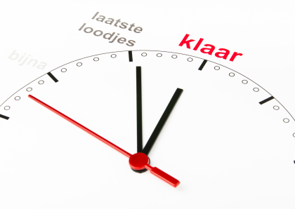
How? > transformation
2014/15
2013
2012
2011
roll in
“how”
2010
start of
main group
program
management
“what”
2008/9
roadshow
“why”
crisis

Slide 29
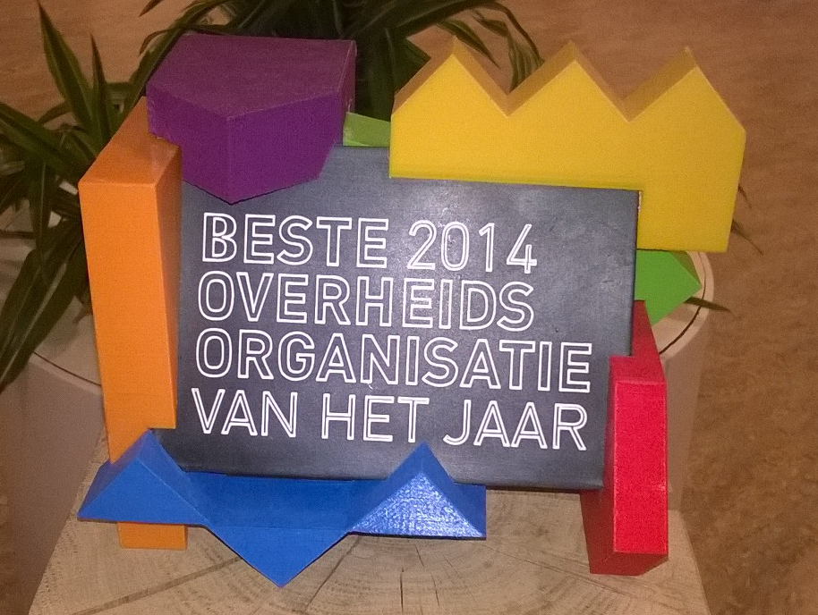
Dutch public sector award 2014

Slide 30



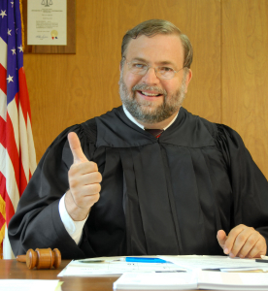
Results
proud!
&
happy!
families
workers
judges
Notes:
Inge about research and implementation.

Slide 31
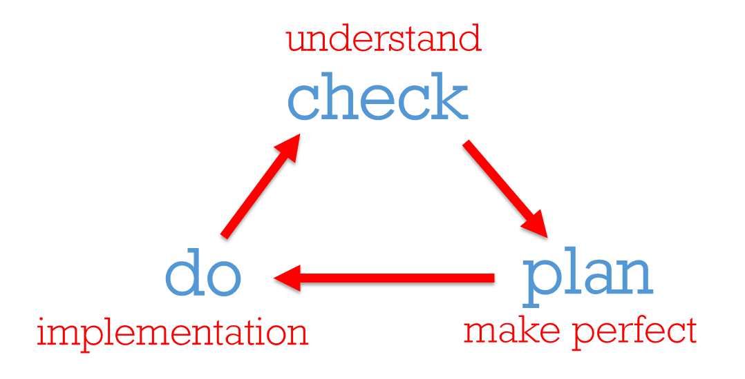
Quality assurance
next step = back to the WHY
annual team audits
back to basics
new IT system
2nd roll in
Notes:
We are building a learning organization.
Learning loops double learning loops
Teammanager reflection video’s eye openers

Slide 32
Every child safe - forever
every child safe
forever
marc.dinkgreve@jbra.nl

