Slide 1
8th Quality Conference
Session No: 5
Speak up! Opportunities of Apps and Social Media
App “Football”: “Pass to Get a Better Result!”

Slide 2
Campaign “Pass to Get a Better Result!”
#mobapp #Football
#website #letssharetheburden
www.mazaksslogs.gov.lv
Good «football»✔
Bad «football»✘

Slide 3
How it all begins....
2012 I Initiative of the State Chancellery
“Let’s share the burden!”
Nov 2013
“Pass to Get a Better result!”
Mobile app “Football”
Website “Let’s share the burden!”
#many #constructive #suggestions #musthave #nextlevel

Slide 4
Website “Let's share the burden” www.mazaksslogs.gov.lv
Since Nov 2013: more
than 400 suggestions
Actions:
Informal meetings
Cooperation
Consideration
Response/reply
https://www.youtube.com/watch?v=PQe1b00SkaE
#betterregulation

Slide 5
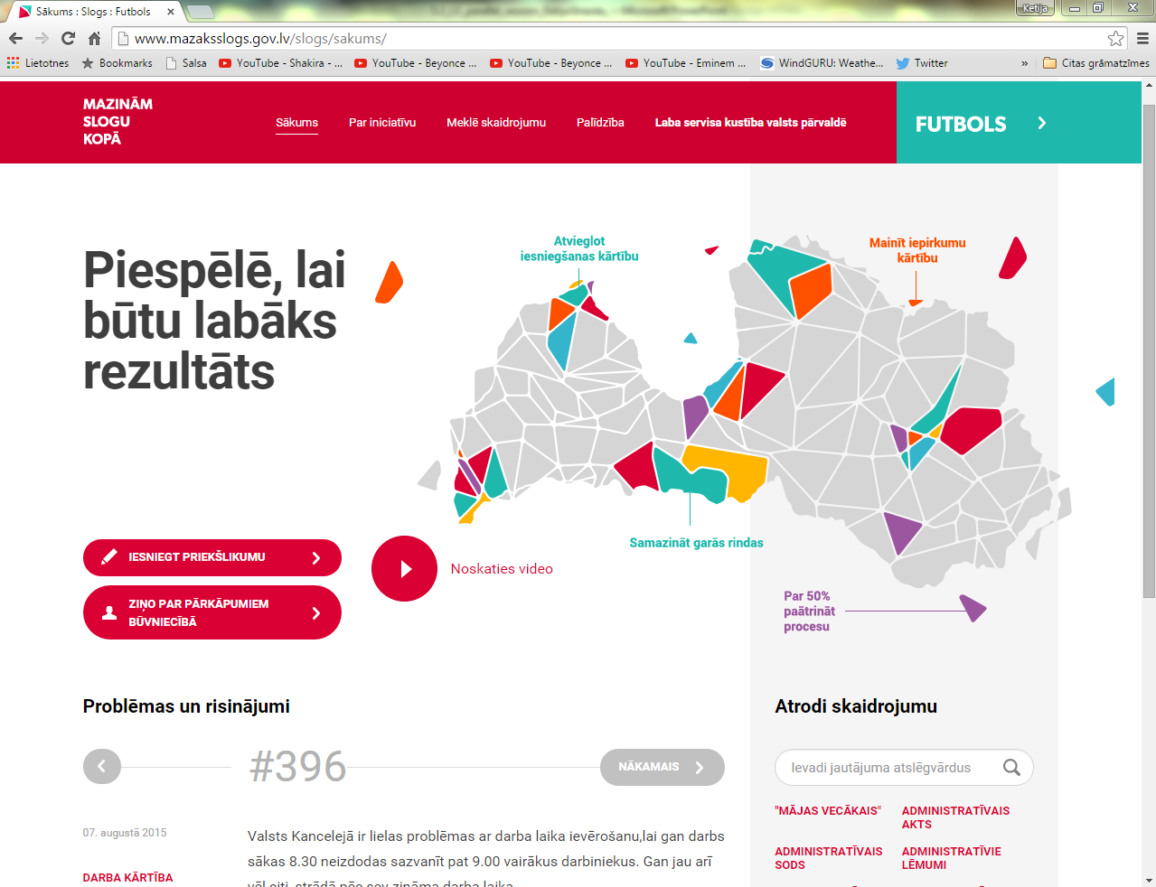
www.mazaksslogs.gov.lv

Slide 6
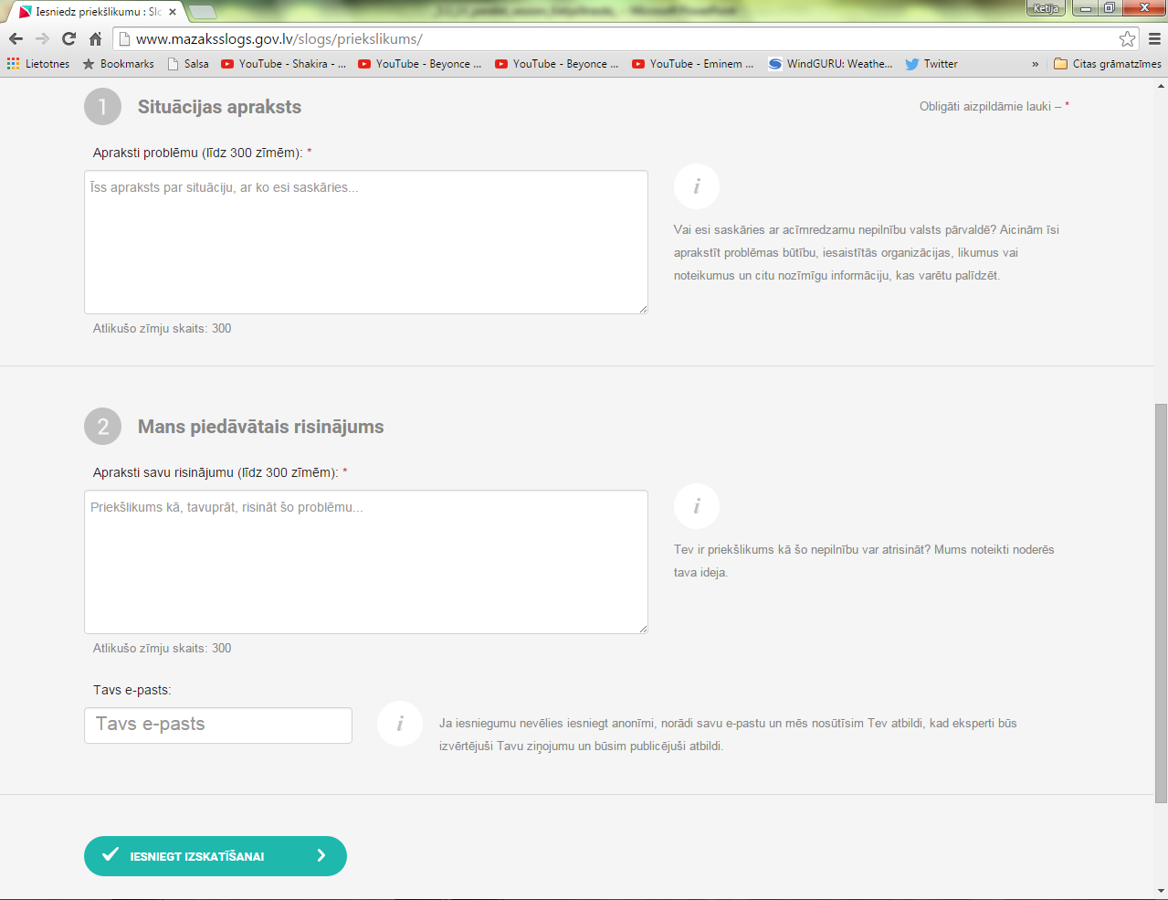
How to participate?

Slide 7
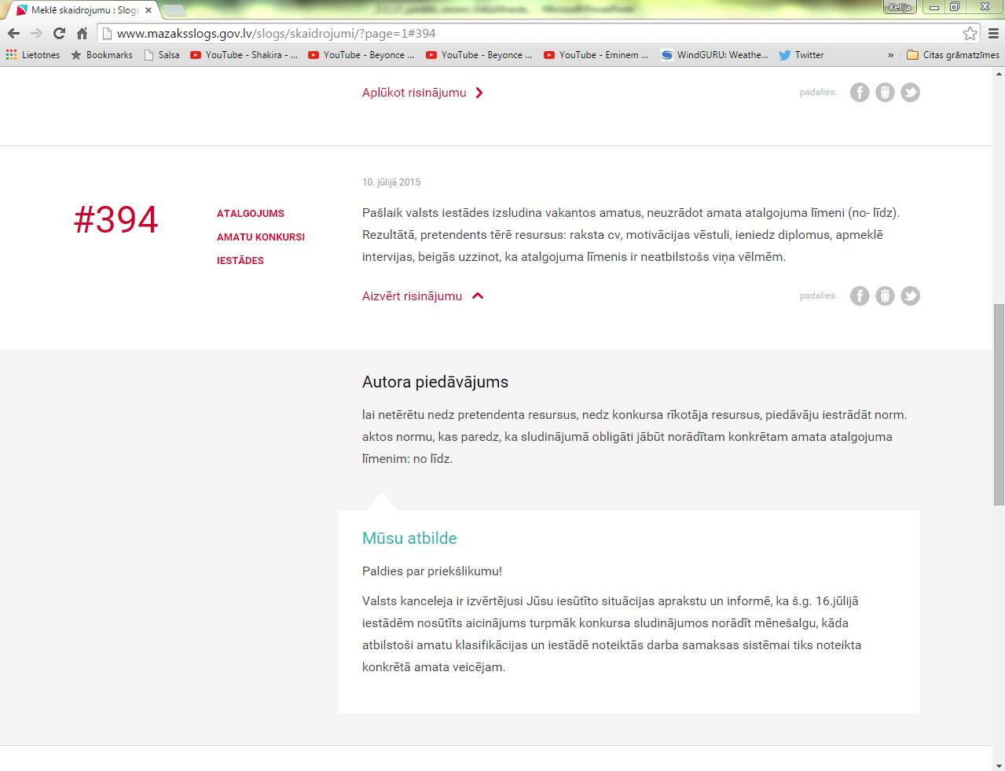
Public view
#394
Situation
Suggestion
Answer

Slide 8
Mobile App “Football”
Simple
User Friendly
Helpful
Functional
Downloads:
iOS (Apple) – 1300<
Android- 1500 <
«Sometimes less is better»
https://www.youtube.com/watch?v=3p0Br5LI82k

Slide 9
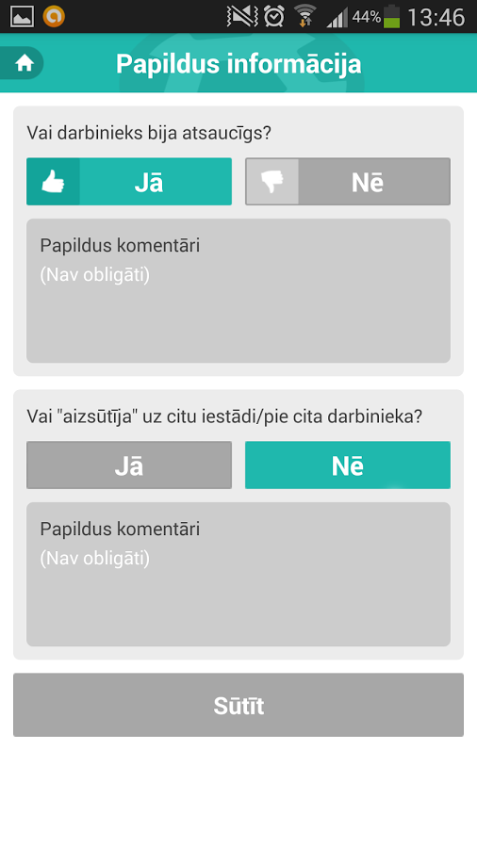

Slide 10
Results

Slide 11
Development
National
International
Customer service handbook for
civil servants and employees
Nagotiations with
European Commission
to introduce the app “Football”
throughout Europa
Campaign
“Good service movement
in public administration”

Slide 12
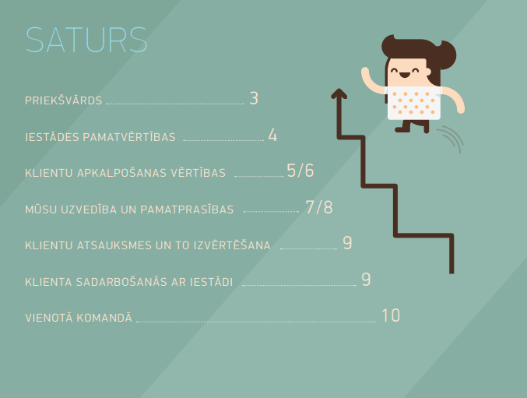
Customer service handbook for civil servants and employees
http://www.mk.gov.lv/img/img/klientu_apkalosanas_rokasgramata.pdf

Slide 13
Thank you! #Latvia #success #innovation

