Slide 1
8th Quality Conference
Session: 5
Speak up! Opportunities of Apps and Social Media
Football- «Pass to Get a Better Result!»

Slide 2
Campaign «Pass to Get a Better result!»
#mobapp #Football
#website #letssharetheburden
www.mazaksslogs.gov.lv
Good «football»✔
Bad «football»✘

Slide 3
How it all begins....
2012 I Initiative of the State Chancellery
“Let’s share the burden!”
Nov 2013
“Pass to Get a Better result!”
Mobile app “Football”
Website “Let’s share the burden!”
#many #constructive #suggestions #musthave #nextlevel

Slide 4
Website “Let's share the burden” www.mazaksslogs.gov.lv
Since Nov 2013: more
than 400 suggestions
Actions:
Informal meetings
Cooperation
Consideration
Response/reply
https://www.youtube.com/watch?v=PQe1b00SkaE
#betterregulation

Slide 5
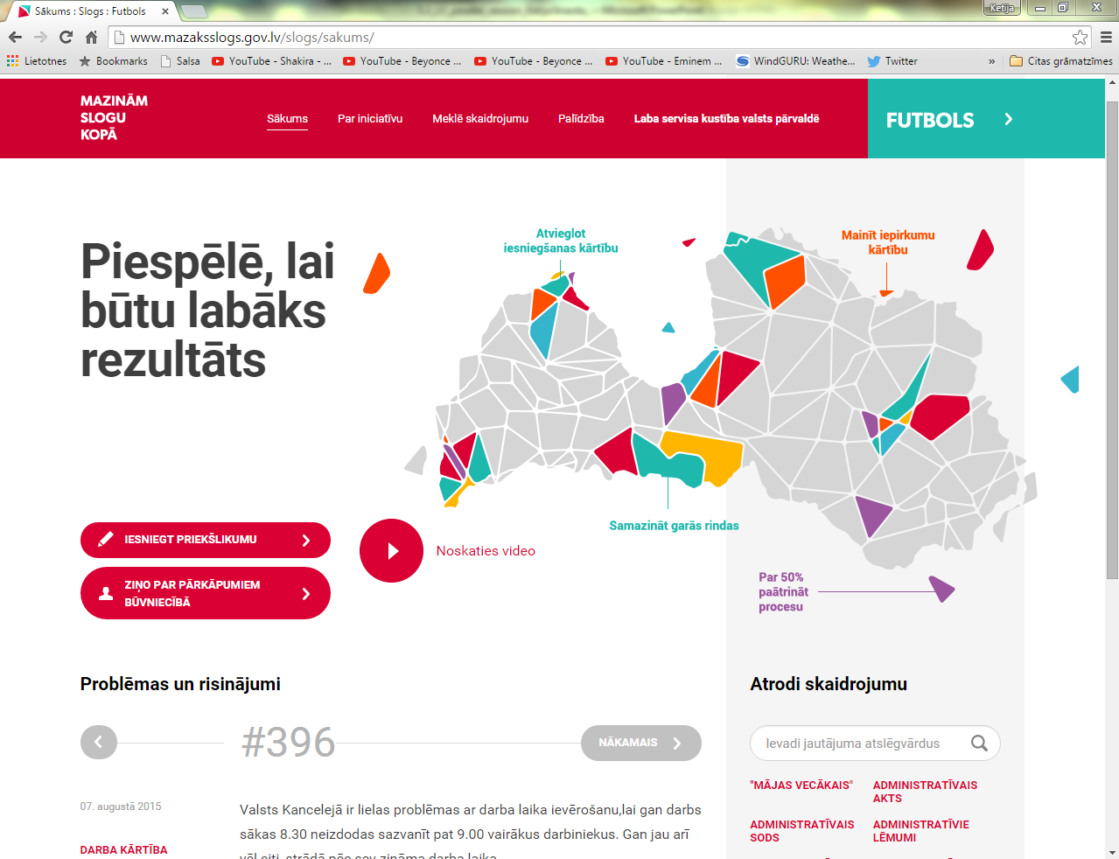
www.mazaksslogs.gov.lv

Slide 6
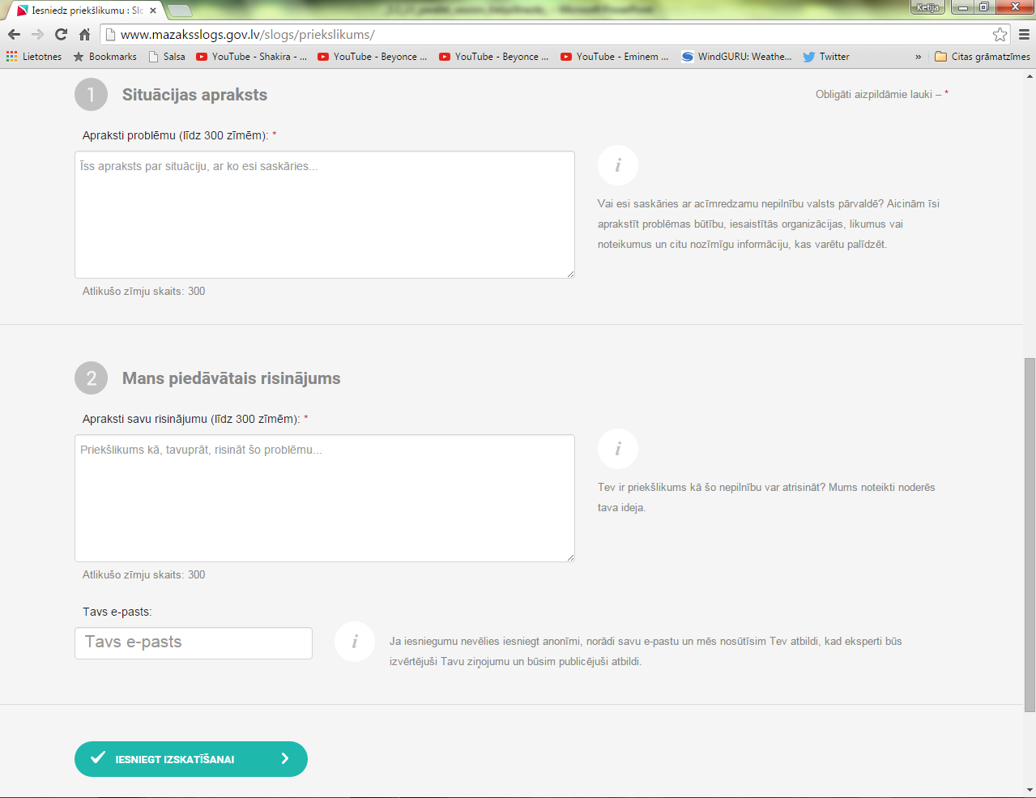
How to participate?

Slide 7
Procedure from A to Z
Consideration
Publish
Recieve a suggestion
Prepare an answer
Cooperation

Slide 8
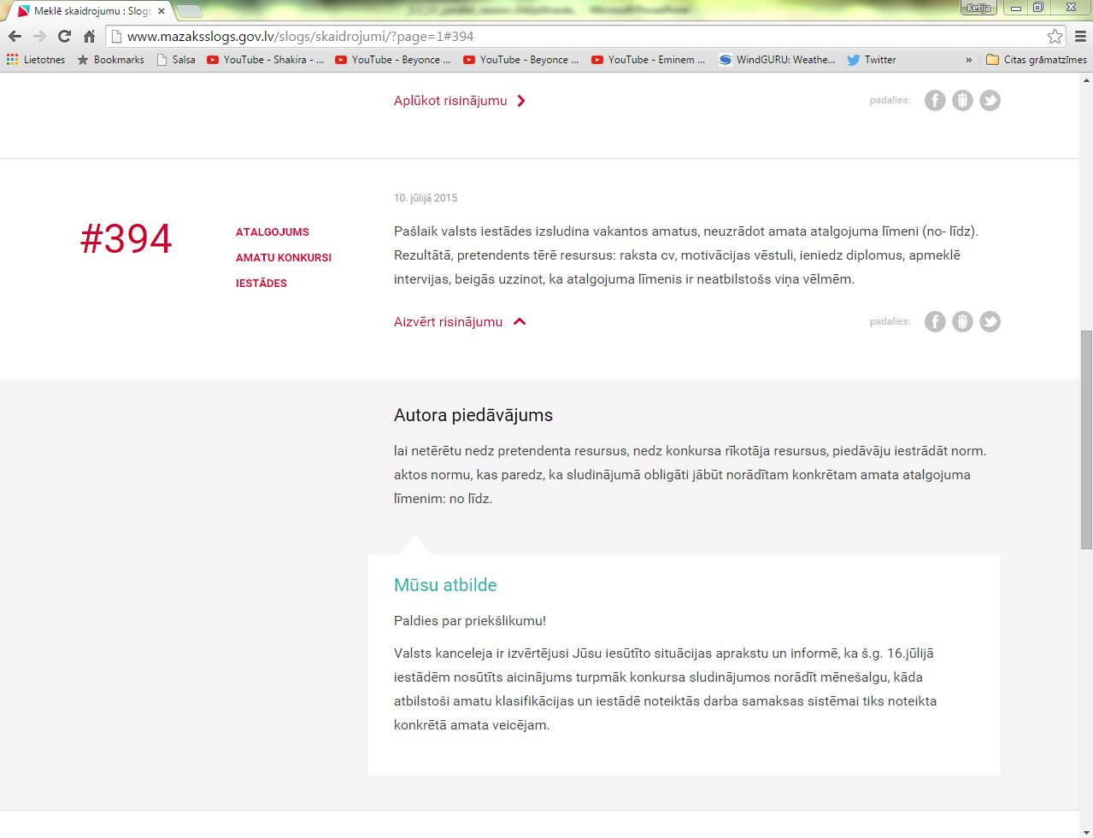
Public view
#394
Situation
Suggestion
Answer

Slide 9
Mobile App “Football”
Simple
User Friendly
Helpful
Functional
Downloads:
iOS (Apple) – 1300<
Android- 1500 <
«Sometimes less is better»
https://www.youtube.com/watch?v=3p0Br5LI82k

Slide 10
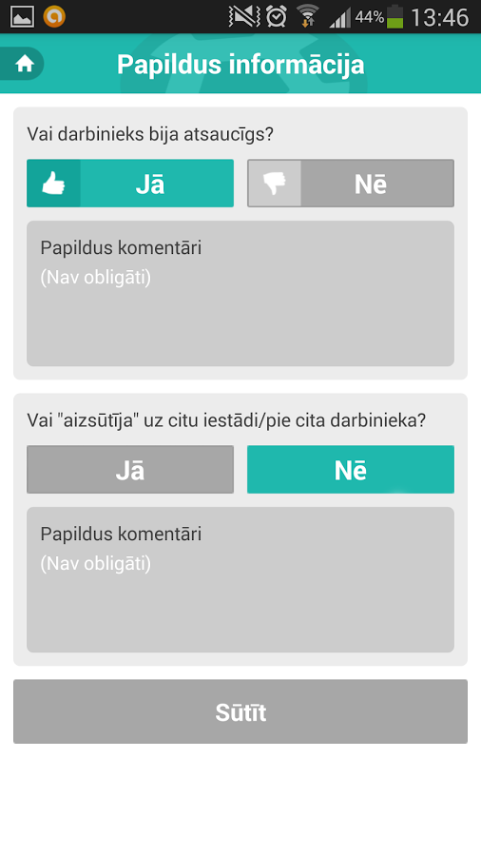

Slide 11
Development
National
International
Customer service handbook for
civil servants and employees
Nagotiations with
European Commission
to introduce the app “Football”
throughout Europa
Campaign
“Good service movement
in public administration”

Slide 12
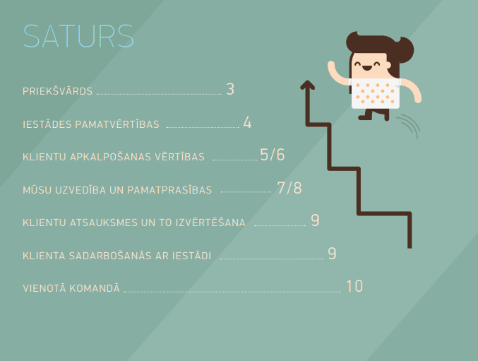
Customer service handbook for civil servants and employees
http://www.mk.gov.lv/img/img/klientu_apkalosanas_rokasgramata.pdf

Slide 13
Results

Slide 14
Success factors
real examples and results
public administration becomes more modern
relatively low funding leading to considerable benefits

Slide 15
Things we would do differently... if we knew
promote better understanding of the campaign
more communication activities

Slide 16
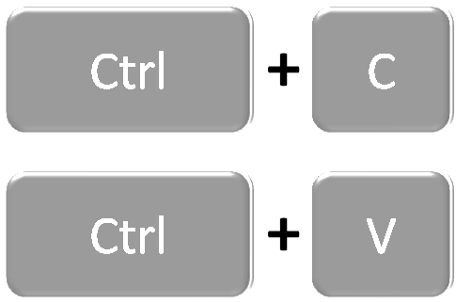
Advise for those who want to copy us
ensure professional examination
maintain commitment
involve civil servants and employees
ensure a targeted promotion campaign
perform an initial review and to align the initiative according to the habits and requirements of local people

Slide 17
! Remember !
maintain a simple way of communication
obey the terms and ensure replies to questions and opinions as soon as practicable;
promote personal and cooperative attitude
inform the society about the results

Slide 18
Goals
1th initiative of this type aimed at promoting public involvement
closer cooperation-
society vs public administration
improved legal regulation

Slide 19
Thank you! #Latvia #success #innovation

