Slide 1
8th Quality Conference
Session 5: Speak up! - Opportunities of Apps and Social Media
Title: Public Administration – Closer to the Citizens through Social Media

Slide 2
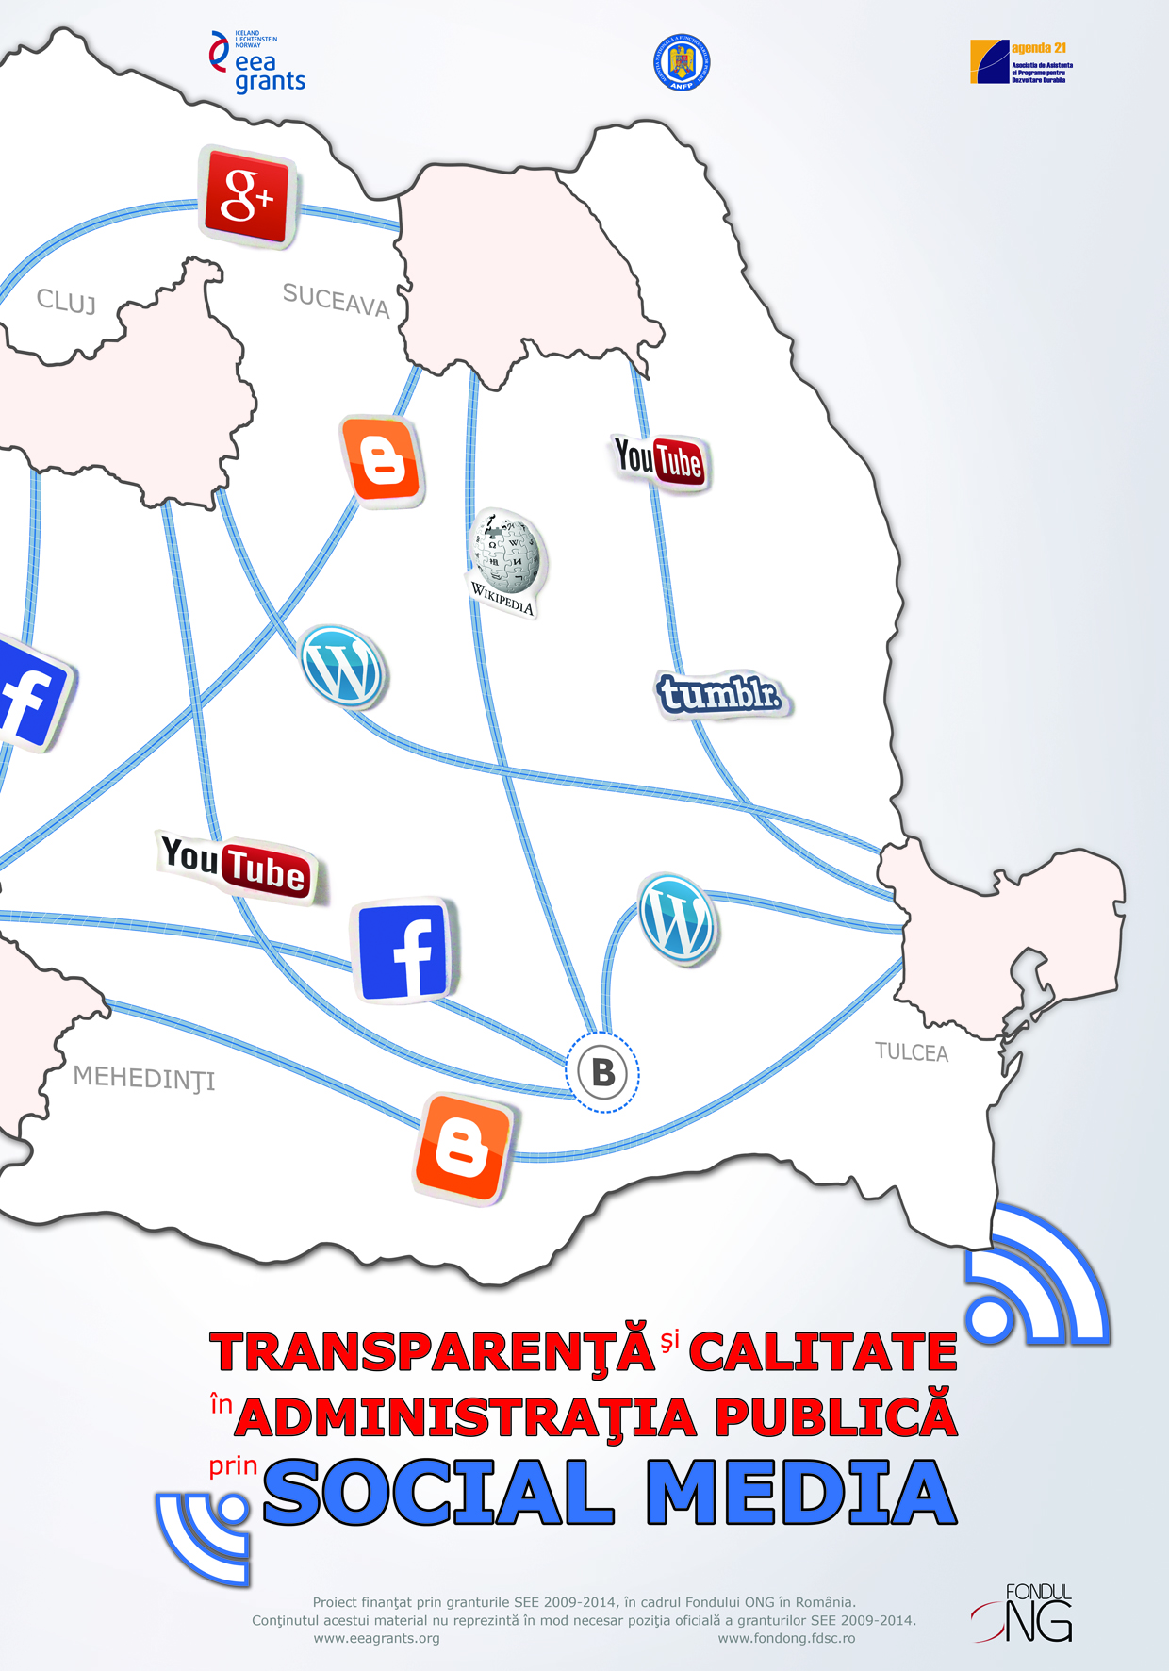
general facts on the case
a project: Transparency and quality in public administration through social media
co-finance: EEA grants 2009 – 2014, the NGO Programme in Romania
two traditional partners – NGO & administration: the association Assistance and Programs for Sustainable Development (APSD)–Agenda 21 and the National Agency of Civil Servants (NACS)
one year: 1 May 2014 – 30 April 2015
local partners: county councils, prefect’s institutions, mayor’s offices, local services in Bucharest and 4 other counties in Romania

Slide 3
journey
low citizen participation in decision making and in drafting public policies
collaboration with volunteers and NGOs in each location
involvement of civil servants in the institutions in each location on engaging with citizens through social media
problem
objective
activities
results
use of social media networks in public administration as instruments to ensure transparency of public institutions, increase awareness and involvement of citizens in decision-making, enhance quality of public services delivered
training sessions on the use of social media: for volunteers and civil servants
handbook on the use of social media in PA
research report: PA – Closer to the Citizens through Social Media
a monitoring methodology
workshops back to back

Slide 4
outcome: PA closer to citizens through social media
an increased and intensive use of social media:
15/20 institutions had never had a social media account until the project started
some institutions that have a very specific and narrow public obtained more than 500 Likes during the project
19/20 institutions still use social media on a daily basis
most of them launched awareness and fundraising campaigns on social media networks and have more than 10k reach
they have a 100% response rate on Facebook and a few of them are labeled as Very responsive – under 5 minutes responses
establishing basis for social media use in PA
some of the persons responsible with social media entered an informal group for digital communication in PA and had multiple meetings with the Ministry for Information Society which is responsible for the implementation of the Digital Agenda for Romania and discussed possible actions for increase the use of social media in PA

Slide 5
context
problem
causes
low citizen participation in decision making and in drafting public policies (30%)
reduced performance of public institutions
corruption
financial crisis: people more focused on personal issues
citizens think their opinion wouldn’t matter
citizens don’t have the time

Slide 6
objectives
promoting citizens' fundamental right to participate in public affairs by establishing effective channels of communication and consultation among citizens by the 20 local partners
increasing transparency and good governance of/in the 20 local partners and their capacity to attract citizens in decision-making processes in local communities using social media networks
encouraging volunteerism to benefit the community by training 30 volunteers, representatives of civil society and voluntarily involving civil servants in the process
promoting a No Hate Speech campaign by the 20 public institutions/ authorities involved in the project and 5 local NGOs together with 25 volunteers

Slide 7
impact
increasing the role of civil society/ citizens in promoting good governance
civil servants and citizens being involved in co-designing public policies, co-working to enhance transparency and render quality to services delivered by public authorities through innovative means
good governance is almost always associated with the use of IT and both the Digital Agenda for Romania and the Government Program for 2012-2016 foresee the use of “e-Government, Interoperability, Cybersecurity, Cloud Computing and Social Media”, fields which aim to increase efficiency and reduce costs in the public sector in Romania by modernizing the administration

Slide 8
innovative features
introducing a training session on the use of social media in public administration
designing a Handbook dedicated to civil servants who have as main duties managing social media for their institutions
creating social media accounts for mayor’s office in small towns or for very targeted local public services (public health, work inspection)
organizing “events” on social media platforms in order to increase the quality of public services delivered and to co-product better policies: polls, consultations

Slide 9
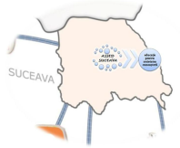
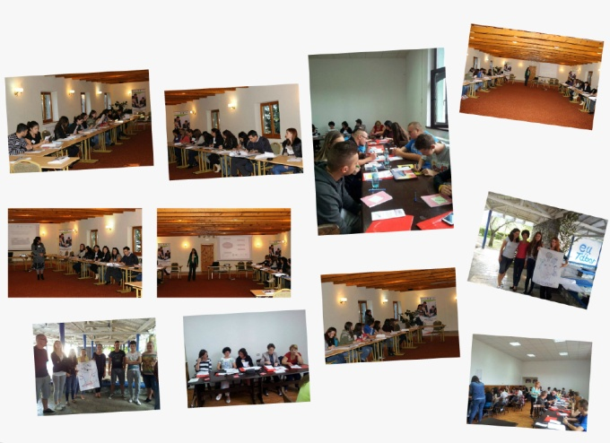
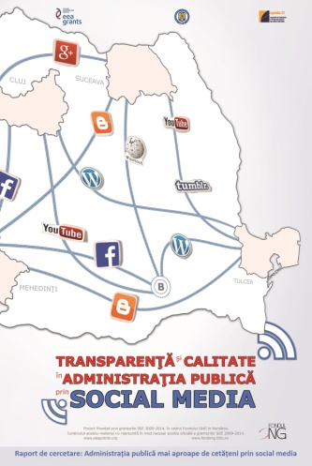
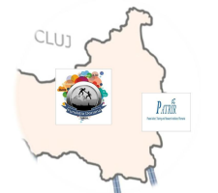
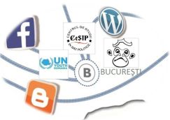
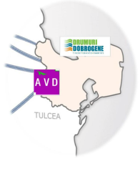
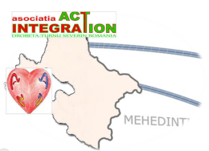
collaboration with volunteers
10 NGOs from 4 counties in all regions of Romania and in Bucharest involved in the project
30 volunteers selected and trained
2 training sessions
1curriculum: legislation on PAR, transparency, FIY and social media, communication, monitoring procedures
monitoring methodology applied for 2 questionnaires for interviews with 1,200 citizens and1,015 civil servants
research report: PA – Closer to the Citizens through Social Media

Slide 10
research report on citizens involvement in decision making and the use of social media
aim: to identify measure to contribute to increasing citizen participation in decision making through the administration-wide usage of social media
objectives: to diagnose the current status on transparency of PA, communication and mechanisms to engage citizens in drafting public policies, use of social media
hypothesis: citizens satisfaction on services provided by public institutions is higher where the latter use social media
research consisted of 2 parts: self-assessment of the 20 public institutions and citizens satisfaction measurement on:
relation/ communication (including social media) with citizens;
quality of services
citizens participation to making public policies

Slide 11
research report on citizens involvement in decision making and the use of social media
quantitative (questionnaire) and qualitative (observation sheets - interviews) research
main findings of citizens satisfaction:
still a low participation of citizens to decision making, but a bit higher than in pre-existing statistics (42.6%): citizens mainly carrying for solving personal issues
major concern for citizens in which they want to have a say in: jobs
32.7% of citizens think they don’t have enough time to be involved, 24.9% think is useless and 28.4% of the latter wish to participate in the future

Slide 12
research report on citizens involvement in decision making and the use of social media

Slide 13
research report on citizens involvement in decision making and the use of social media
main findings of citizens satisfaction:
still a low degree of trust in PA (64.8%)
57.7% citizens use social media daily
only 5% use social media to get info on PA activities and 0.3% use it to respond to public institution’s initiatives to involve citizens

Slide 14
research report on citizens involvement in decision making and the use of social media
main findings of citizens satisfaction:
reasons not to engage with institutions on social media: face to face is better, no time, not necessary, no trust in online communication
citizens satisfaction degree on public institutions’ communication on social media is average (33.8%)

Slide 15
research report on citizens involvement in decision making and the use of social media
main findings of public institutions self-assessment:
discrepancy on citizens satisfaction degree and civil servants perception on how the citizens satisfaction degree is (76.5% satisfied)
discrepancy: the services are focused on citizens needs (912 civil serv)
over 75% civil servants are satisfied on the way the institution they work in communicates with/ consults the citizens, involves them in decision making
some notable insatisfaction on: transparency (11%) and efficiency of consultations with citizens (14.8%)

Slide 16
research report on citizens involvement in decision making and the use of social media
main findings of public institutions self-assessment:
20% of institutions have strategies on social media use for: online petitions/ requests for information, online debates, polls, gathering ideas for local development plans
87.1% consider useful engaging with citizens through social media
+
-
reduced distance between citizens and civil servants
more transparent institutions
eliminate citizens that don’t use social media or do not have proper equipement/ skills
generating also irrelevant discussions
if not used properly by institutions can lead to mentaining/ spreading conservatory views of citizens that favor face to face interaction

Slide 17
handbook on the use of social media in PA
1
what is social media? short history
2
social media networks
3
world-wide tendencies in social media
4
benefits of social media use in PA
5
institutional framework for social media use in PA
6
selection criteria for social media channels
7
good practices on social media use in PA
8
tools to measure impact of social media use in PA
9
social media strategies and campaigns

Slide 18
training on social media
figures
1 curriculum on social media use in PA developed and delivered
1 training session on social media delivered on a three days period
40 civil servants from 20 participant public institutions and authorities trained

Slide 19
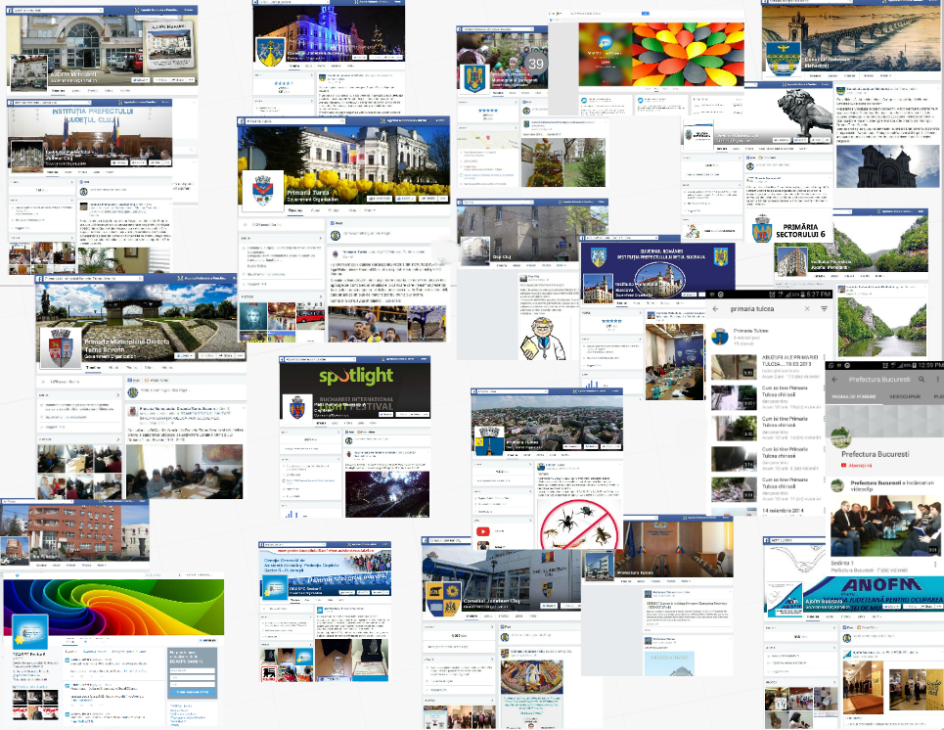
social media channels
figures
more than 60 social media accounts developed/ created: Facebook, YouTube, Google +, Twitter, Instagram, Blog

Slide 20
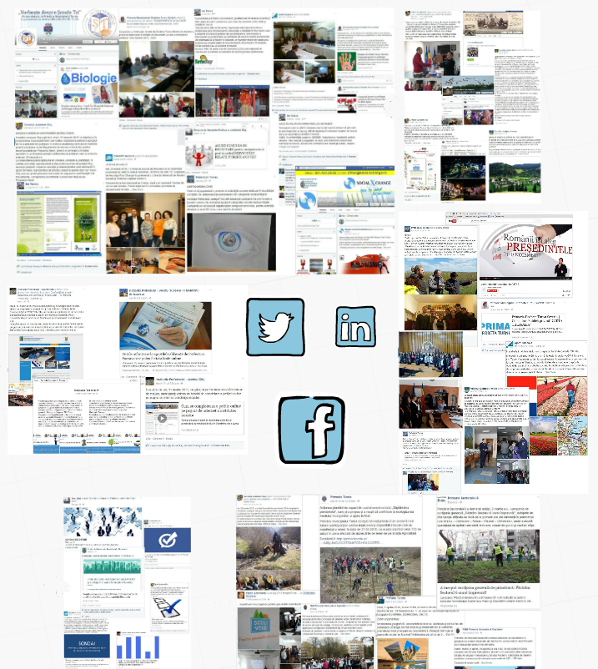
social media events
social media events
more than 60 social media events on informing/ consulting the citizens on matters of public interest such as:
environment protection actions
public consultations on different public policies: development plans for cities, for the Danube Delta
social campaigns
online polls on citizens satisfaction on services delivered
information on different events

Slide 21
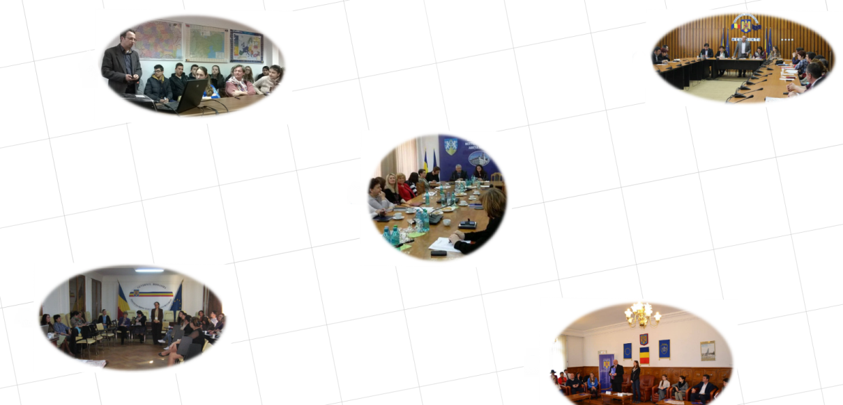
monitoring back-to-back workshops
figures
4 institutions in each county and Bucharest + NGOs involved in the project presented self-assessment reports and evaluations after monitoring the online activity of the 20 institutions in the project during 5 back-to-back workshops

Slide 22
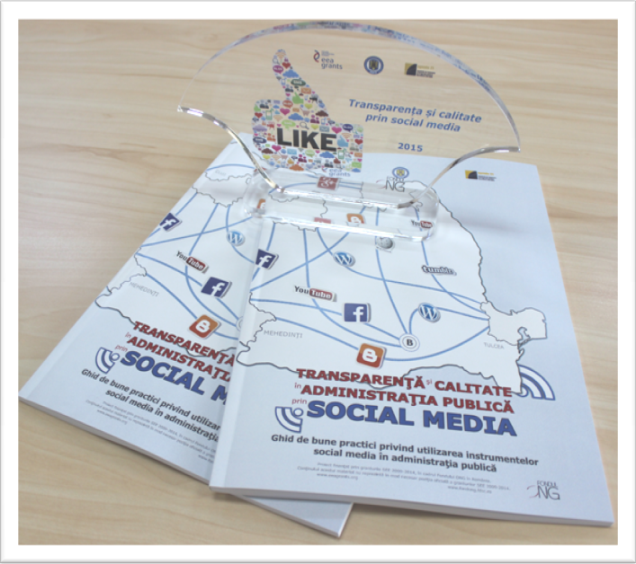
good practices guide
figures
1 national competition for good practices on the use of social media in public institutions and authorities
32 practices included in the guide
10 practices awarded at the final conference

Slide 23
no hate campaign

Slide 24
what‘s next
the training session on the use of social media in PA was introduced in NACS’s training offer on request
the Handbook on the use of social media in PA dedicated to civil servants will be used during the training sessions
including social media use in PA as theme in different events and writing articles on it in the biannual review dedicated to civil servants
good practice exchange and discussions in an informal communicators group in central PA (already discussed internal procedures on using social media) in order to change/ improve legislation
constant dissemination on developments on social media for practioners

Slide 25
lessons learned
there was strong multiplication effect among the 20 public institutions: successful practices where copied by others
there was a strong competition among the 20 public institutions to have the biggest impact (reach, likes etc.)
there is a close connection between e-government initiatives meant to reduce administrative burden and social media, but also a close inter-institutional collaboration to implement campaigns of interest to citizens
heads of institutions have an important role in adopting social media as communication tools and committing to it: they adopted a digital engagement, involving the institution in this project, approving the strategies/ procedures, participating to events during the project’s implementation etc.

Slide 26
lessons learned
main problems of using social media channels in PA: the lack of responsiveness of the institution to complex questions from the audience, inadequacy of language in exchanging from the official website to social media tools, the lack of personnel to manage accounts, lack of interest of citizens participate / to be involved etc.
there is a stringent need for professionalizing civil servants, for training them in using these tools and all other complementary fields (communication, protocol etc.)
do not ignore the public that uses social media and do not focus only on classical interaction

Slide 27
lessons learned
did great
would do differently
involving volunteers from civil society
contracting a social media expert and organizing informal Skype couseling sessions with the project team and the civil servants in each county
monitoring social media use from two perspectives: from inside (colleagues of civil servants in charge with managing social media accounts) and outside (volunteers) and organizing back to back workshops
the handbook
select the participating institutions based on voluntary application not randomly
extend the training session to 5 days
focus more on social media use in the study and less on general interaction of institutions with citizens
doing a before and after analysis on social media use

Slide 28
lessons learned
would add
would avoid
workshops in each location where experts on social media meet civil servants in charge with managing their institution’s official social media accounts (after the training sessions)
debates on improving the legislation related to social media use
involving volunteers from civil society in the project without having a strong NGO partner to coordinate them
randomly picking institutions to be part in the project
making a new research if data on social media use in PA is available

