Slide 1
8th Quality Conference
Session: 4
Title: Spin your region up! Students and public administration together
Name: Agata Wojnowska & Anna Cieślik

Slide 2
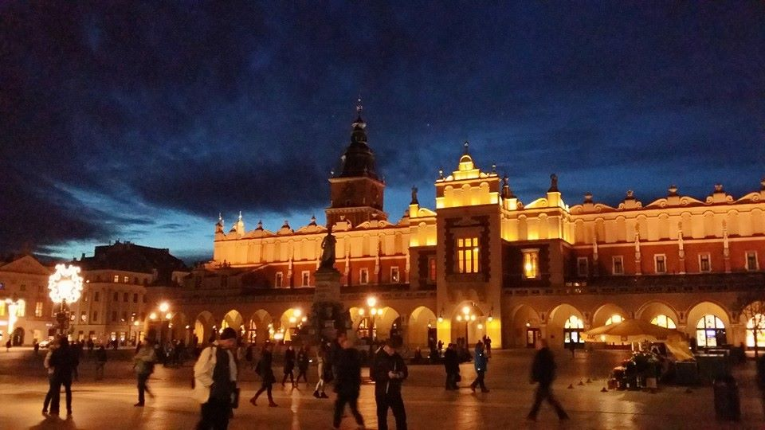
Project background
Kraków is undoubtedly the city of universities,
where each year almost 200 000 students are enrolled in one of many higher education institutions.
source: Paweł Maliszewski/Voivode’s Office

Slide 3
Problem
SPIN-UP project Genesis
understanding students' expectations about their diploma theses,
who repeatedly raise the need of writing the theses on subjects, which pose an actual problem, not being „purely theoretical”.

Slide 4
Objectives
The project will facilitate
the cooperation between academia and public administration,
and
implementation of the developed solutions in Malopolska Voivodeship Office (MVO) departments,
as well as enable young people to write their theses on the grounds of actual problems.

Slide 5
Results
The tool
As a result of the collaboration between the Voivode’s Office and AGH University of Science and Technology (AGH) the virtual tool has been launched on the University server. The tool is named: Students’ Innovation Platform – Industry and Administration (abbreviation in Polish: SPIN-UP)

Slide 6
How does it work?
Malopolska Voivodeship Office (MVO)
SPIN-UP
AGH University of Science and Technology (AGH)

Slide 7
How does it work?
Collecting subjects from MVO departments (QUESTIONS).
Master thesis – PROBLEM SOLUTION
Consultation of the subject
(AGH-MVO)
Step 1
Step 2
Step 3
Step 4
Step 5
Picking the subject by the thesis supervisor and student (AGH)
Processing.
Guidance provided by the employee of MVO – the author of the subject

Slide 8
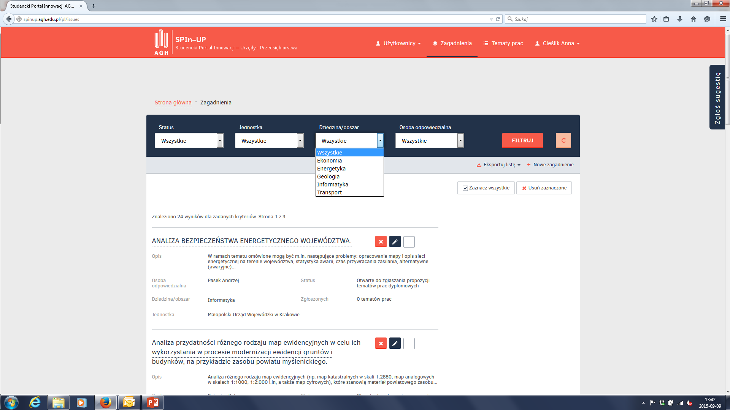
How does it work?

Slide 9
Benefits for the students:
writing the thesis on the ground of real problems,
getting acquainted of the officials’ work environment,
access to specific documentation.

Slide 10
Benefits for the office:
access to the intellectual potential of the university,
original view on problems, which the civil servants face in their everyday work,
access to equipment and research tools.

Slide 11
Contribution
Enhancing social responsibility in public administration
Our goal is to convince the students that, together with the regional authorities, they are able to change the reality and make lives of the Region’s inhabitants easier.
Ownership and shared responsibility.

Slide 12
Innovativeness
What makes it new and interesting?
source: https://www.flickr.com/photos/hamptonroadspartnership/5351622529/

Slide 13
Perspectives source:https://www.flickr.com/photos/marfis75/8757110485/

Slide 14
Sustainability
Currently the platform contains over 20 thematic scopes submitted by the Malopolska Voivodeship Office.
The AGH students, supported by their supervisors will soon choose the subjects for their theses.
The first dissertations will be ready in the next few months.

Slide 15
Lessons learned
3 things we did great:
Collaboration with our partner – AGH, source: https://www.flickr.com/photos/vegaseddie/5700609302/
Engagement of the MVO departments in cooperation with students,
Open up to innovative ways of solving problems

Slide 16
Lessons learned
3 things we would do differently:
We would have run the project earlier,
We would have started the work over the formalities earlier,
We would have expanded the project by engaging other universities – and we will!

Slide 17
Goodbye!
Thank you for your attention.
We hope to see you at in-depth working session!
Agata Wojnowska & Anna Cieślik

