Slide 1
Strategic vision of Air Navigation Administration in multi-levels networks

Slide 2
Sample Slide − Agenda / Table of contents
1
Case description Parallel session 10’
ANA short description
A snapshot on a chain of changes
Change process
Why do we want to change ? To where ?
How to change in real life ?
2
Q/A – Perspectives Parallel session 5’
Innovation process In depth session 25’
Internal and external analysis
Stakeholders
Multi-levels system
Certifications and award
ANA economic impact
Main results
3
4
Transferability In depth session 20’
8
In depth session 30’

Slide 3
1. CD- ANA short description
Public administration
202 people
Core Business is aviation and aeronautical
One of the major actors on Airport
2 main missions
Air Navigation Services Provider
Aerodrome operator
Issue: Strategic vision design and implementation

Slide 4
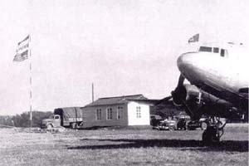
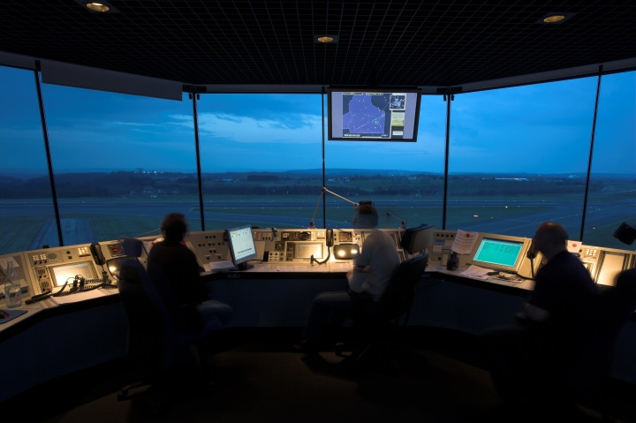
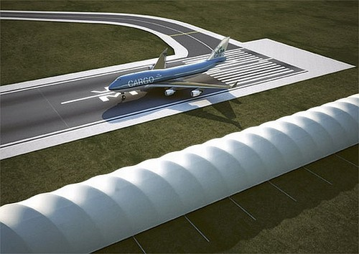
1. CD- A snapshot on a chain of changes
Law, 22th June 1949 for the organisation of airport service.
2009-2017 Strategic vision design and implementation
20XX Future evolution
Triggers
Results
Are-we well suited to the reality in the sector ?

Slide 5
1. CD- Why do we want to change? To where?
2009-2017 Strategic vision design and implementation
Triggers
Results
New regulations
New european network
New competitors / stakeholders
Management changes
Economic changes
More safety
Movements increasing
ANSP certification
Aerodrome operators
Synergies and new services

Slide 6
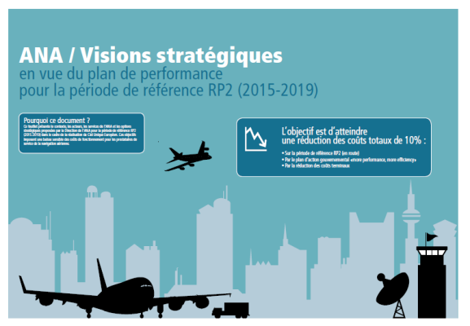
1. CD- How to change in real life ?
Create the foundation for strategic change
Define the initial strategic initiatives and structures
Long-term strategy for the future
Air navigation service provider

Slide 7
1. CD- How to change in real life ?
1
Develop & present Strategic Vision& plan-ANAFuture-andAerodrome
Identify Strategic legislative/regulator issues an future options
2
Assess options : Legal,operational,financial,technical and social costs and benefits
Present assessement results/ reach agreement on implementation options with MDDI
3
Establish an implementation action plan with resources/risks/process/projects
Identifiy relevant aerodrome issues with ref EU 139/3014 certification requirements
Establish a common vision and understanding with stakehoplders
Clairify responsibilities and accountabilities with stakeholders and partners
Establish regulatory/institutional framework (DAC/MDDI)
4
Roll-out and Implementation of the plan-Project/safety/Quality management
5
Develop/agree a transition management plan
Formal certification(Airport)/ service level agreements
Ensure ongoing regulatory support
Asses safety risks & etablish risk management
Stakeholder & User consultation
Transition into operations
Notes:
Assess options : Legal,operational,financial,technical and social costs and benefits
Establish a common vision and understanding with stakehoplders
Present assessement results/ reach agreement on implentation options with MDDI
Develop & present Strategic Vision& plan-ANAFuture-andAerodrome
Identify Strategic legislative/regulator issues an future options
Identifiy relevant aerodrome issues with ref EU 139/3014 certification requirements
Establish an implentation action plan with resources/risks/process/projects
Clairify responsibilities and accountabilities with stakeholders and partners
Establish regulatory/institutional framework (DAC/MDDI)

Slide 8
1.Q/A- Perspectives
Substanibility/Lesson learned
Right balance between stakeholders expectations
Own business model with economic impact in a sustainable approach
Uncertainty is a trigger of innovation

Slide 9
Sample Slide − Agenda / Table of contents
1
Case description Parallel session 10’
ANA short description
A snapshot on a chain of changes
Change process
Why do we want to change ? To where ?
How to change in real life ?
2
Q/A – Perspectives Parallel session 5’
3
Innovation process In depth session 25’
Internal and external analysis
Stakeholders
Multi-levels system
Certifications and award
ANA economic impact
Main results
4
Transferability In depth session 20’
8
In depth session 30’

Slide 10
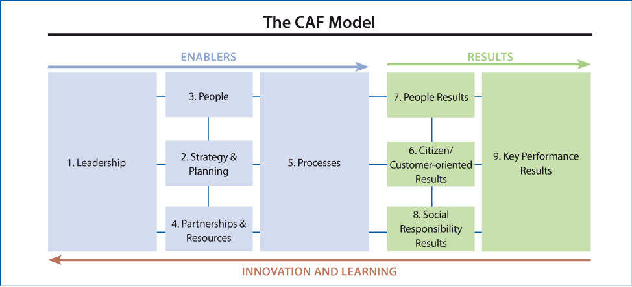
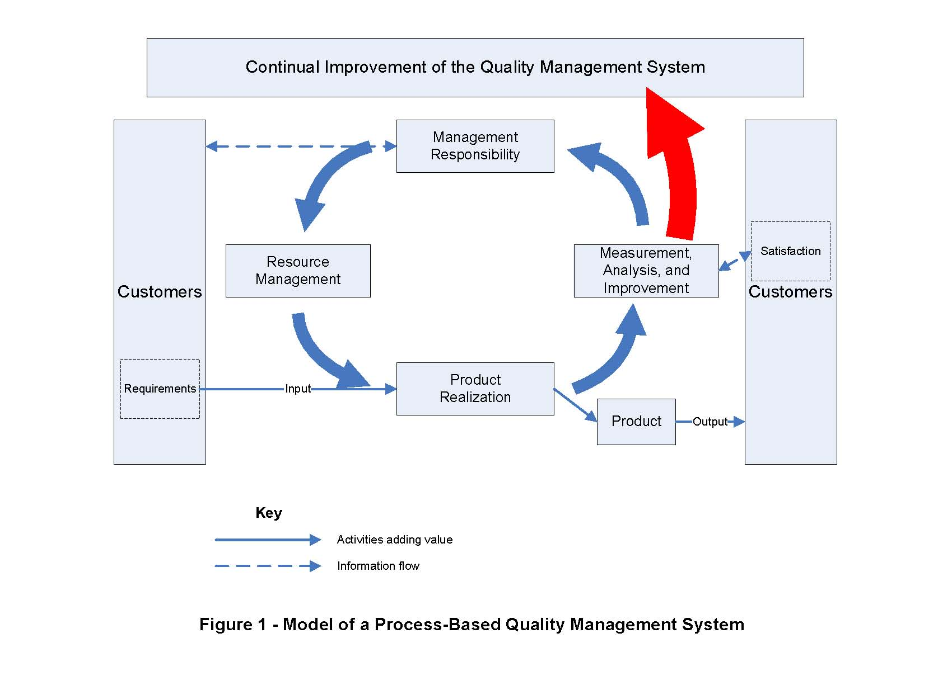
2. IP- Internal and external analysis
Stakeholders
Mapping

Slide 11
2. IP- Internal and external analysis
Stakeholders- Mapping

Slide 12
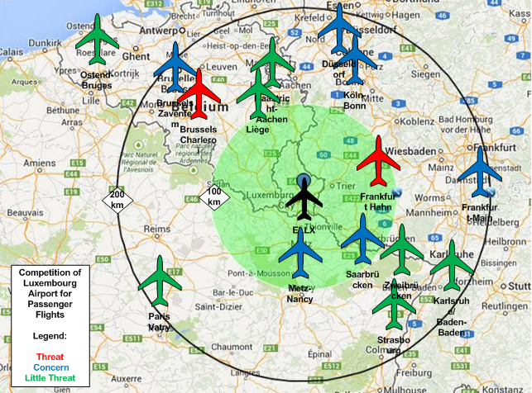
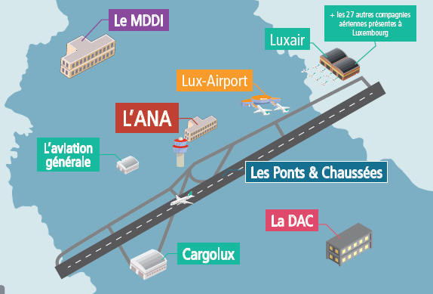
2. IP- Multi-levels system

Slide 13
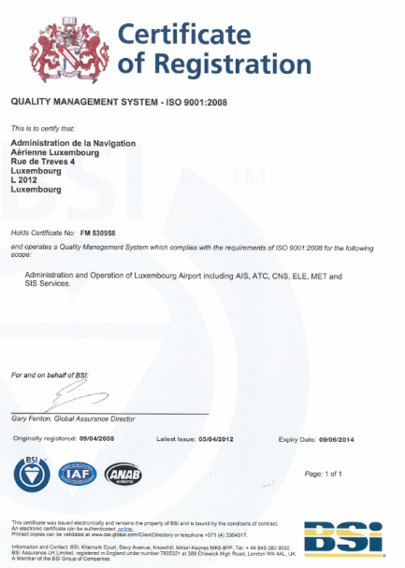
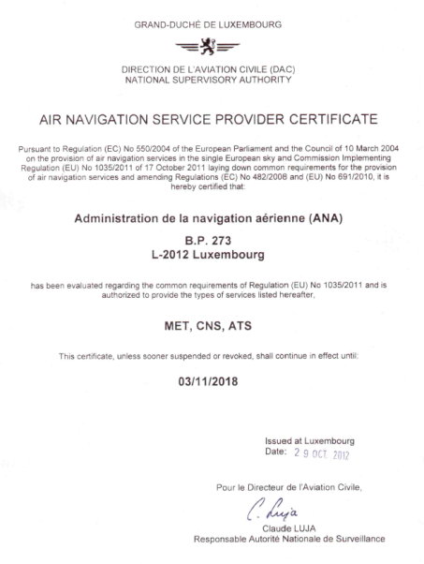
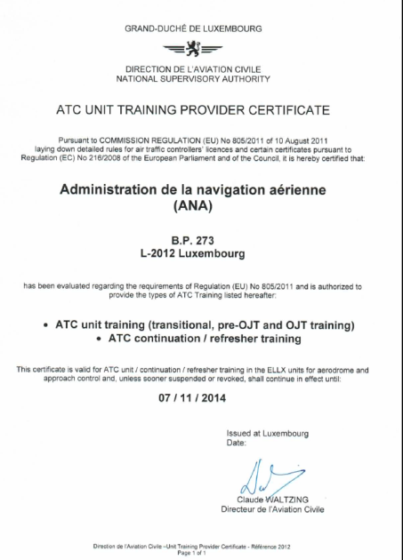
2. IP- Certifications and Award
ATC Unit training CERTIFICAT
07.11.2017
QUALITY AWARD 2014
ISO 9001 CERTIFICAT
09.06.2017
ANSP CERTIFICAT
03.11.2018

Slide 14
ANA Economic Impact
Output 1
Output 2
Outcome
Ensuring Flights in a safe and efficient way
Number Movements
Freight/Passenger
ANA
Economic and social impact
Other organisat..
(Stakeholders) impact
Context

Slide 15
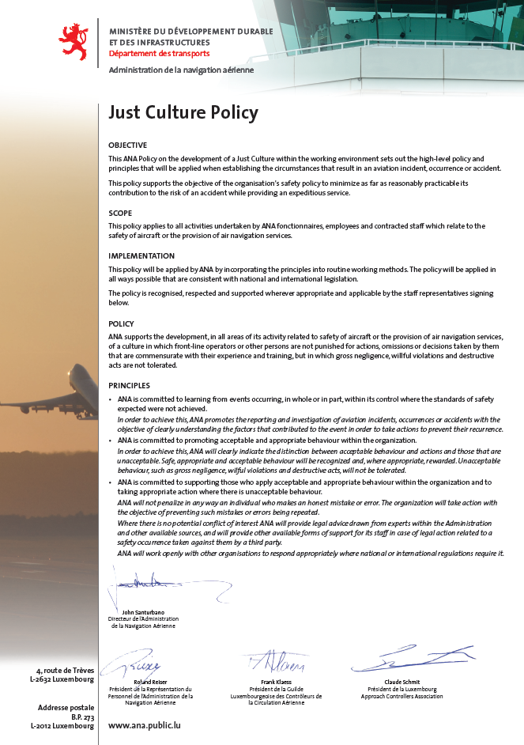
2. IP- Main results
Output 1

Slide 16
2. IP- Main results
Output 2

Slide 17
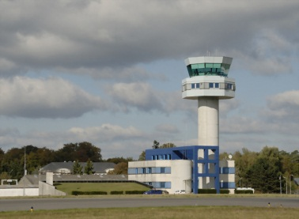
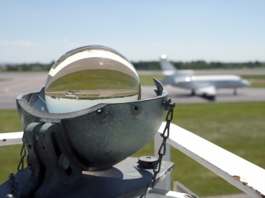
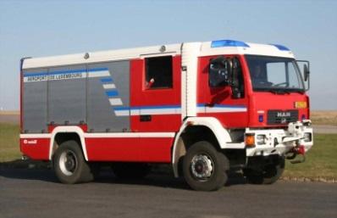
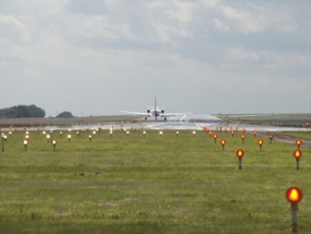
2. IP- Main results
 | Service | Strategic axes / option for change (examples)
 | Air Trafic Control | - Creation of a ground control function (and exploitation of ground radar capabilities). - Successive complete delegation of the LU airspace to a FABEC partner to provide APP
 | MeteoLux | - Provide cost-efficient services to both aeronautical and non-aeronautical users of MeteoLux services through synergies in equipment use and service provision
 | Fire and Brigade | - Closer alignment and reorganisation of SIS as part of a national fire and rescue service.
 | Aerodrome | Coordination and management of aerodrome certification in line with EU regulation and ICAO requirements.

Slide 18
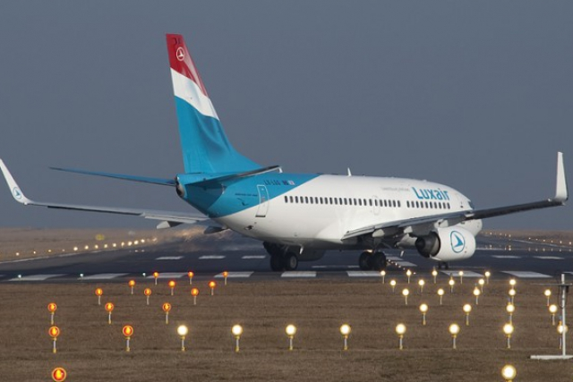
4. Transferability
Common idea of the future = Joint Representation
Move from one single organisation to multi-levels organisations = Collaborative Network
Have an internal and external view of our organisation before deciding major changes
Notes:
Do you think your practice can be transferred to othher countires / Contexts ? Organisations ?
Share 3 success factors
Share 3 pitfalls to avoid
Advice for someone who would want to copy you

Slide 19
CONTACT
john.santurbano@airport.etat.lu
thierry.hirtz@airport.etat.lu
Notes:
Changer journal par report

