Slide 1
8th Quality Conference
Portugal – Lisbon - Europe 2020

Slide 2
TABLE OF CONTENTS
1
Lisbon / Portugal Context of Europe
2
Urban Dimension of Cohesion Policy
3
Lisbon Stategic Framework
LISBOA
CÂMARA MUNICIPAL
Notes:
Changer journal par report

Slide 3
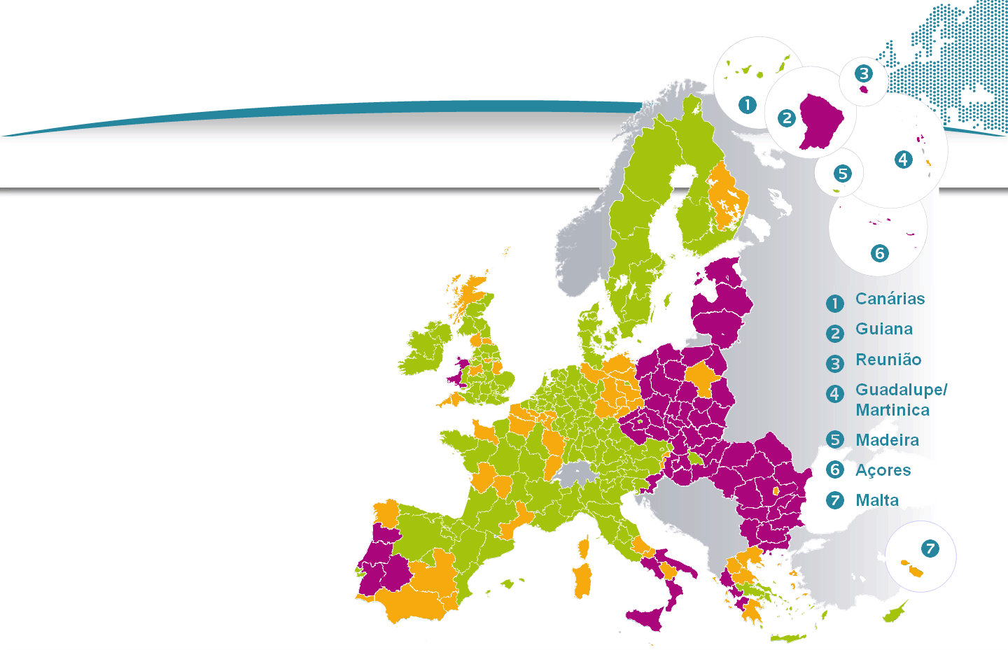
The Multiannual Financial Framework 2014-2020 Eligibility
PIB per capita*
< 75 % da média da UE
75-90 %
> 90 %
*indexUE27=100
Less developed regions
Transition regions
More developed regions
Fonte: CE
LISBOA
CÂMARA MUNICIPAL
Notes:
Changer journal par report

Slide 4
STRATEGY EUROPE 2020 Goals for Portugal in the context of Europe 2020
objective | indicators | GoalPT2020 | 2011
Strengthening R & D and Innovation | Investment: % do PIB | 2,7% a 3,3% | 1,5%
More and Better Education | Early school leavers | 10,0% | 23,2%
 | % Population with higher or equivalent education between 30-34 years | 40,0% | 26,1%
Climate and Energy | Greenhouse Gas Emissions (% change compared to 2005 in non ETS emissions | +1,0% | -8,0%⁽¹⁾
 | % Renewables in final energy consumption | 31,0% | 27,3%
 | Energy efficiency (gain% on primary energy consumption in the reference scenario) | 20,0% | 16,5%
Increase Employment | Employment rate (population 20-64) | 75,0% | 69,1%
Combating Poverty and Social Inequalities | People at risk poverty ⁽²⁾/social exclusion (face change to 2008) | - 200 thousand | -156 th.
LISBOA
CÂMARA MUNICIPAL
Notes:
Changer journal par report

Slide 5
TABLE OF CONTENTS
1
Lisbon / Portugal Context of Europe
2
Urban Dimension of Cohesion Policy
3
Lisbon Stategic Framework
LISBOA
CÂMARA MUNICIPAL
Notes:
Changer journal par report

Slide 6
The Urban Dimension of Cohesion Policy Strategic and Integrated Programming
Challenges of urban areas included in the Partnership Agreement;
Including the allocation of a minimum of 5% of ERDF ITI's implemented by cities;
Detail of the allocations to urban investment priorities and urban integrated strategies in the Operational Programs (Ops);
Reinforced Partnership to involve cities in the design and implementation of the programs.
LISBOA
CÂMARA MUNICIPAL
Notes:
Changer journal par report

Slide 7
The Urban Dimension of Cohesion Policy Principal Elements
Strategic and integrated programming for urban areas;
Specific investment priorities for urban areas;
Focus on sustainable urban development;
Innovative urban actions that can reach up to 0,2% of the total annual ERDF allocations;
Urban development platform - networks between cities and urban policy exchange
LISBOA
CÂMARA MUNICIPAL
Notes:
Changer journal par report

Slide 8
The Urban Dimension of Cohesion Policy Investment priorities specific to urban areas
Promotion of low-carbon strategies
Actions to improve the urban environment, including regeneration of industrial and commercial areas in decline and reduction of air pollution;
Promotion of sustainable urban mobility;
Support for physical and economic regeneration of deprived urban communities.
LISBOA
CÂMARA MUNICIPAL
Notes:
Changer journal par report

Slide 9
TABLE OF CONTENTS
1
Lisbon / Portugal Context of Europe
2
Urban Dimension of Cohesion Policy
3
Lisbon Stategic Framework
LISBOA
CÂMARA MUNICIPAL
Notes:
Changer journal par report

Slide 10
Lisbon Strategic Framework Approved City Government Programme (2013-2017)
More People
More Jobs
Better City
Human Scale City
Entrepreneurial city
Inclusive City
Sustainable City
Global City
3 Strategic Goals
5 Axis
LISBOA
CÂMARA MUNICIPAL
Notes:
Changer journal par report

Slide 11
Lisbon Strategic Framework Approved Documents
Lisbon Strategic Charter (2010-2024)
City Master Plan
(2012-2020)
Strategy
City Government Programme (2013-2017)
+
=
Lx-Europe 2020
Strategy Europe 2020
(2010 – 2020)
European Financial Priorities (2014-2020)
LISBOA
CÂMARA MUNICIPAL
Notes:
Changer journal par report

Slide 12
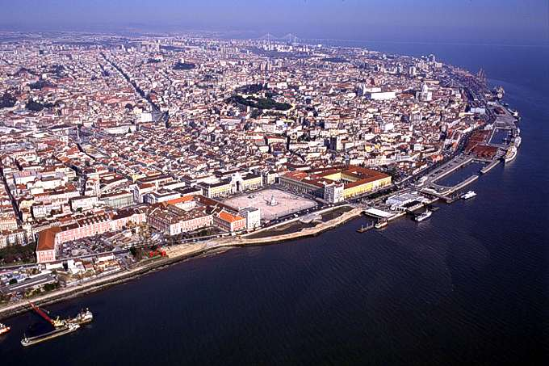
Mission Team Lisbon-Europa 2020 Contacts: lisboa.europa2020@cm-lisboa.pt + 351 217 988 659
Thank You
LISBOA
CÂMARA MUNICIPAL
Notes:
Changer journal par report

