Slide 1
8th Quality Conference
Portugal – Lisbon - Europe 2020

Slide 2
TABLE OF CONTENTS
2
Developed Work
3
Critical Analyze of partnership process
Mission Team Lisbon / Europe 2020
1
LISBOA
CÂMARA MUNICIPAL
Notes:
Changer journal par report

Slide 3
Mission Team Lisbon/Europa 2020 Framework
Created by municipal resolution, April 2012;
Aims to assure Lisbon active participation in the next european programming period:
mobilize the different partnerships with the University, the business community and the social and cultural institutions;
maximize the Lisbon contribution to Europe 2020 strategy implementation;
optimize the use of resources available in the next Financial Framework 2014-2020.
LISBOA
CÂMARA MUNICIPAL
Notes:
Changer journal par report

Slide 4
Mission Team Lisbon/Europa 2020 Mission and Goals
Identify among the EU policies, the areas of greatest importance for the city of Lisbon where the local dimension represents added value;
Monitoring the development of the Regulations, the Partnership Agreement and the Operational Programmes and other tools for implementation and support the Mayor on the respective decisions.
LISBOA
CÂMARA MUNICIPAL
Notes:
Changer journal par report

Slide 5
Mission Team Lisbon/Europa 2020 Mission and Goals
Develop, within the framework of Cohesion Policy:
eligible projects, specially for Innovative Actions in the context of sustainable urban development;
Integrated Territorial Investment projects in the city of Lisbon.
Promote a process of active and participative partnership with all the necessary and indispensable stakeholders in the Planning and implementation of these projects.
LISBOA
CÂMARA MUNICIPAL
Notes:
Changer journal par report

Slide 6
Mission Team Lisbon/Europa 2020 The Monitoring Committee
Created in parallel with the Mission Team;
Includes:
Councilors from various political forces represented in the House;
Representatives from the Institutions of Public Higher Education located in Lisbon;
Representatives of business associations;
Representatives of the municipal councils;
Representative personalities of the cultural and social aspects of the
Aims to ensure a comprehensive overview provides a platform for obtaining and integrating contributions.
LISBOA
CÂMARA MUNICIPAL
Notes:
Changer journal par report

Slide 7
TABLE OF CONTENTS
1
Mission Team Lisbon / Europe 2020
2
Developed Work
3
Critical Analyze of partnership process
LISBOA
CÂMARA MUNICIPAL
Notes:
Changer journal par report

Slide 8
Developed Work Strategy Lx-Europa 2020
The vision we have for Lisbon is a city that is:
Beautiful: that invests in urban innovation and rehabilitation, preservation of its natural heritage and valuation of public space;
Integrating: multicultural and promoter of social innovation;
Diverse: a city of neighbourhoods that promotes investment in technology and knowledge;
Attractive: in terms of tourism, population and resources;
LISBOA
CÂMARA MUNICIPAL
Notes:
Changer journal par report

Slide 9
Developed Work Strategy Lx-Europa 2020
Healthy: that reuses, is energy efficient and technologically innovative;
Creative: that innovates and engages, creating "value";
Friendly: of the elderly, people with disabilities, families and children and urban safety;
Ambitious: universalistic, explorer of the seas and of the brotherhood of the Portuguese language.
LISBOA
CÂMARA MUNICIPAL
Notes:
Changer journal par report

Slide 10
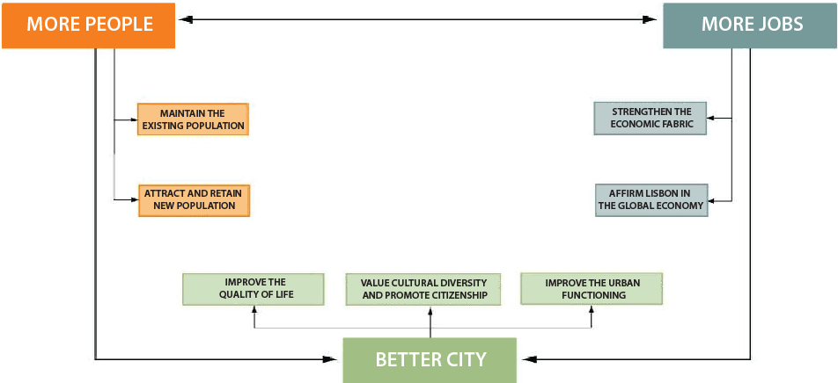
Developed Work Strategy Lx-Europa 2020
LISBOA
CÂMARA MUNICIPAL
Notes:
Changer journal par report

Slide 11
Developed Work Activities
Promotion and development of an active and participated partnership work, through 12 Multilateral Thematic Meetings, involving about 150 participants, in particular municipal services, the entities represented in the Monitoring Committee and contributes from ‘call for ideas’.
Collection and compilation of aproximately 400 Project proposals, aggregated in themes developed in Intervention Areas, which were subject to consideration in the 5th and 6th meetings of the Monitoring Committee.
LISBOA
CÂMARA MUNICIPAL
Notes:
Changer journal par report

Slide 12
Developed Work Activities
3 documents approved
http://www.cm-lisboa.pt/municipio/camara-municipal/transparencia/lisboa-2020
LX – Europa 2020, Lisbon during the next programming period Community
Main aspects to be taken into account in the design and negotiation of the Partnership Agreement: the perspective of Lisbon.
Areas of Intervention in the City of Lisbon - Partners, Projects and Governance
LISBOA
CÂMARA MUNICIPAL
Notes:
Changer journal par report

Slide 13
Developed Work Higher Education Institutions (HEI) contributions
Initiated a process of consultation of the HEI and Enterprises, which, based on the aforementioned city document which sets out priorities for Lisbon, aims to identify projects eligible for joint development.
To a greater densification of areas of intervention and the strengthening of partnerships that could lead to the development of joint projects with a view common and achieve the strategic objective interests of the city.
A Table summarizing the funding priorities by type of recipient, and giving guidance given the categories of projects that may eventually be developed by the Municipality, by the Higher Education Institutions and the Entreprises, alone or in partnership between them.
Structured by the thematic areas of assistance listed in the document "LX-2020 - Lisbon at the forthcoming EU programming period."
LISBOA
CÂMARA MUNICIPAL
Notes:
Changer journal par report

Slide 14
Developed Work 10 Intervention Areas/ 10 structural Projects
Lisboa, City of Learning and Research Structural Project: Lisboa, Erasmus City/’Co -Location’ for the New Knowledge Innovation Community on Active Ageing and Health supported by the European Institute of Innovation and Technology (EIT)
Entrepreneurship and Employability Structural Project: Youth Entrepreneurship and Employability Programme
Lisboa , City of Culture and Interculturality Structural Project: Creative Lisbon
Affirmation of Tourism in Economic Base of Lisbon Structural Project: Congress Centre
Lisboa, Capital of the Sea Structural Project: Campus do Mar
LISBOA
CÂMARA MUNICIPAL
Notes:
Changer journal par report

Slide 15
Developed Work 10 Intervention Areas/ 10 structural Projects
Building Stock Rehabilitation/Risk Prevention Structural Project: Building rehabilitation program oriented towards energy efficiency and seismic resistance improvement
Acessibility For All / Intelligent and Inclusive Mobility Structural Project: Lisboa Accessible City
Quality of Life and Urban Environment Structural Project: Lisboa Solar City
Urban Regeneration Structural Project: BIP-ZIP 2020
Inclusion and Social Cohesion Structural Project: Homeless Integration
LISBOA
CÂMARA MUNICIPAL
Notes:
Changer journal par report

Slide 16
Developed Work Actual dynamics after approved strategy
Kic EIT for Healthy Living and Active Ageing.
International Partners of the Consortium: InnoLIFE -- InnoSTARS
National Partners: Lisbon University and Research Institutions
Smart Cities & Communities an innovation action for large scale demonstration, solutions integrating energy, transport, ICT sectors through lighthouse.
International Partners of the Consortium: London and Milan
LISBOA
CÂMARA MUNICIPAL
Notes:
Changer journal par report

Slide 17
TABLE OF CONTENTS
1
Mission Team Lisbon / Europe 2020
2
Developed Work
3
Critical Analyze of partnership process
LISBOA
CÂMARA MUNICIPAL
Notes:
Changer journal par report

Slide 18
Critical Analyze of partnership process
Partner involvement in process - positive
Municipality’s role as a mobilizer and facilitator - positive
Expectations of management - critical analysis
Beginning with Community regulations , restrictions via AP, POs and specific regulations , figures , maps, etc.
The importance of strong political leadership - critical analysis
Presidency as engine and mobilizing vs less priority and proactive situation)
Difficulties to promote genuine integration - critical analysis
Sectorial character of the instruments implemented , unreal time for preparation of the strategy , eg PEDU , etc.
LISBOA
CÂMARA MUNICIPAL
Notes:
Changer journal par report

Slide 19
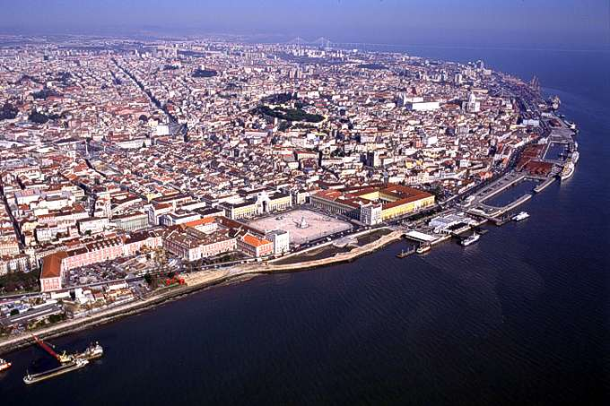
Mission Team Lisbon-Europa 2020 Contacts: lisboa.europa2020@cm-lisboa.pt + 351 217 988 659
Thank You
LISBOA
CÂMARA MUNICIPAL
Notes:
Changer journal par report

