Slide 1
8th Quality Conference
Session: Strategic thinking in a future-oriented public administration
Title: «Quality of public services monitoring as a part of integrated management system for local governments »
Piotr Wierzchoslawski
Krzysztof Pakonski
POLAND

Slide 2
Agenda
1
Why and how did we come up with the project?
Objectives and products
2
Methodology and Quality of Life&Public Services Indices Catalog
3
STRADOM system; strategy; programs; tasks; risks; information security; auditing; warehouse; reports
4
Project output and outcome
Availability of the tools for other local governments

Slide 3
1
Why and how did we come up with the project?
Objectives and products

Slide 4
Why and how did we come up with the project?
Kraków was the first Polish town where performance budgeting started to be implemented in 1994 r. Ten years after, this decision pushed us to develop performance measurement in aim to improve effectiveness and efficiency of our Local Government.
Very soon we discovered that this improvement required a scope of modern and innovative instruments of management…for example :
1
IT tool for supporting the collection and analysis of data related to the planning and monitoring of budgetary tasks
2
Catalog of strategic indicators, including indicators of quality of life and methods of communication with residents
We were also aware of the need of integration of management tools, including performance budgeting, long-term financial forecasts and strategic programs

Slide 5
Why and how did we come up with the project?
Over the last decade, the public finance law in Poland has become more stringent. Public administration bodies have to:
1
Have internal audit procedures in place
2
Define measurable goals and objectives
3
Monitor and evaluate progress in reaching objectives
4
Meet COSO requirements for internal control system
5
Implement risk management procedures and document that works
6
Develop IT security management system and audit it annually
How to successfully implement all required tools without losing sight of the LG mission – i.e. providing quality service to citizens
Problem:

Slide 6
Objectives of the project have been defined in the 2 following sentences
Shape public services in communication with the addressees – customers and monitor quality together with them, making changes, if necessary.
G1
G2
Gather and use information on the needs, strategic goals, programs and operational activity for the evaluation, as well as improving the effectiveness and efficiency of local government

Slide 7
Products of the project
Rules
Set of general rules for an outcome oriented Local Government
Resolution examples
Examples of resolutions implementing the above rules in Krakow and Poznan
Q of Life Ind.
Q of PS Ind
Concept and Catalog of Quality of life indicators and Quality of Public Services indicators
STRADOM system
STRADOM Information system – Applications and warehouse supporting LG management system
Manual
Manual of strategic management applying the STRADOM Information system

Slide 8
2
Methodology and Quality of Life&Public Services Indices Catalog

Slide 9
Concept and catalog of strategic indicators; quality of life & quality of public services
Key steps to elaborate a local Catalog of QL and QPS indicators
Concept of
life/management areas
public services
QL and QPS indicators
Catalog of QL & QPS indicators:
Contextual
Strategic
Objective
Subjective
Survey tools
Examples how to apply the catalog of QL & QPS indicators in LG body to improve the decision making process

Slide 10
Differents types and sources of QL and QPS indicators
Catalog of QL & QPS indicators:
A set of measures defined for each life / management area in order to diagnose its condition and assess the execution of activities.
1
Contextual indicators - we have no decisive impact on their value
2
Strategic indicators – we take responsibility for their value
3
Objective indicators – typically based on public registers and statistics
4
Subjective measures – social surveys

Slide 11
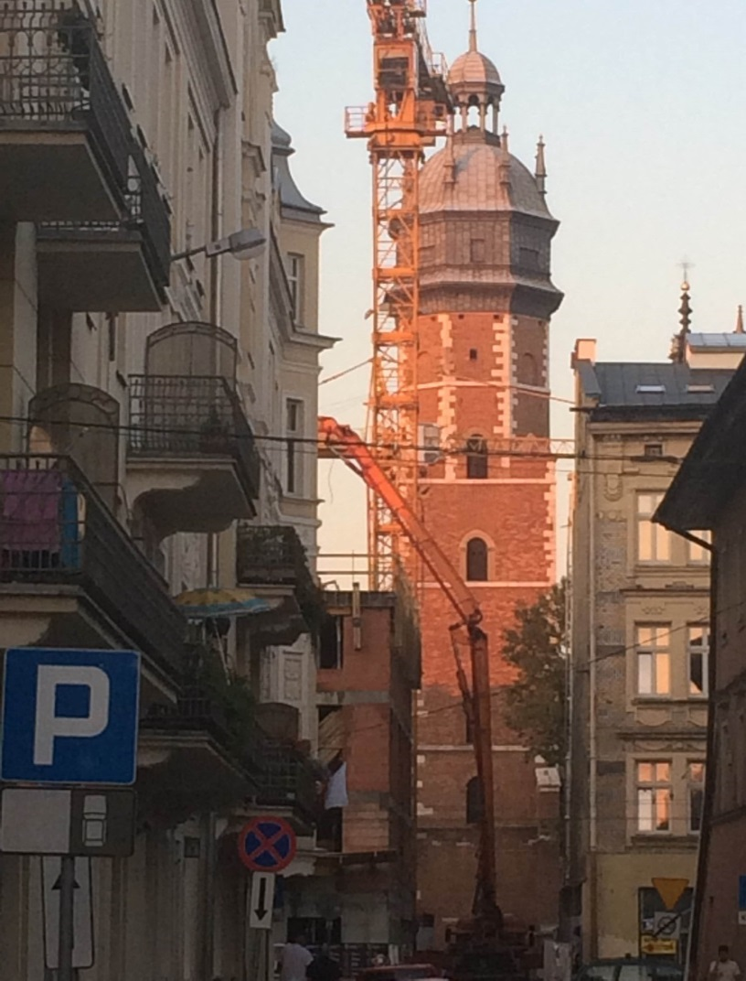
How QL & QPS indicators can improve the well - being of citizens
QL & QPS indicators can be used to to:
1
Diagnose the current state of l./m. areas, propose direction of changes and activities, idnetify risks & challenges
2
Set mesurable results at the level of Development Strategy objectives
3
Set mesurable results of Strategy programs objectives – ‘so that….’
4
Set mesurable results of public services at strategic level
5
To raport to decision makers and citizens on the state of the city, as well as evaluation of programs, services and policies

Slide 12
From budgetary tasks to Quality of Life
Products
Infrastructure and other projects
Service & maintenance tasks in municipal budget
Outputs
Measured with
Effectiveness, efficiency indicators for services & maintenance
Timelines, cost and quality for project products
Outcomes Measured with
Quality of Life indicators
Strategic project progress &
Quality of Public Services indicators changes
Expected influence on
Well-being of citizens and residents
Satisfaction with quality of live in the city

Slide 13
From outputs of tasks to Quality of Life
Outputs of tasks
Kilometers of roads in good maintenance
Tons of garbage collected in a selective manner
Number of preventive health tests provided to inhabitants
Outcomes of public services
Safety of the streets
Percent of drivers who rate street conditions as good
Percent of citizens who rate cleanliness of the streets as good
Percent of citizens who rate waste management as good
The mortality rate from cardiovascular disease - men per 100 thousand.

Slide 14
From outputs of tasks to Quality of Life
Outputs of tasks
Construction of suburban railway stations
Construction of parking places in P&R system
Liquidated coal furnaces
Termomodernisation of public buildings
Green areas in the city
Outcomes of programs
Percent of inhabitants using public transport
Percent of citizens who rate comfort of public transport as good
Air pollution index
Electricity consumption per 1 inhabitant
Gas consumption per 1 inhabitant
Percent of inhabitants with access to green areas 15 minutes walking distance from the residence

Slide 15
Impact of local government’s activities on well-being and life satisfaction
1
Strategic indicators show results of programs & quality public services
General life satisfaction
2
Subjective indicators demonstrate level of satisfaction with services in all areas and importance of each of them
Satisfaction with life in the city
3
Life satisfaction in l./m. areas impacts satisfaction with life in the city
Satisfaction with life within areas of life/ management
4
Satisfaction with life in the city impacts, among others, general life satisfaction
Program results
Public services

Slide 16
Involvement of citizens in the monitoring
process
Every year we realize social surveys of quality of life and quality of public services
The objective and subjective indicators are presented to the citizens on a web site: www.mjup.krakow.pl
The opinions of citizens are taken in consideration during developing analyzes of management areas
The opinions of citizens are deepen during the social consultations or qualitative research to support decision making process

Slide 17
3
STRADOM system; strategy; programs; tasks; risks; information security; auditing; warehouse; reports

Slide 18
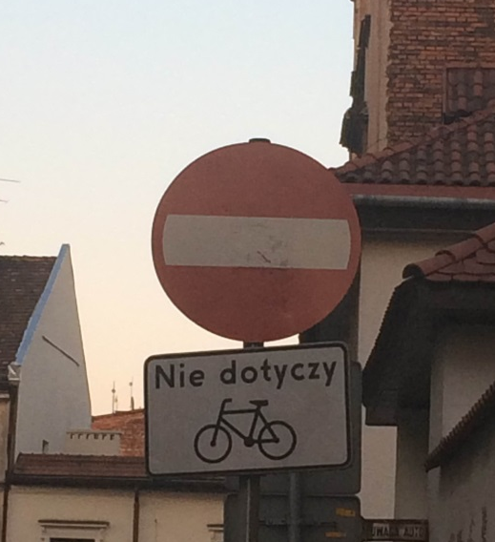
STRADOM information system supports:
multiyear & annual activity planning + financial planning
Monitoring + evaluation on both strategic & operational levels
Management of risk +
internal audit + information security audit
warehouse of above data
+ municipal accounting data + set of reports

Slide 19
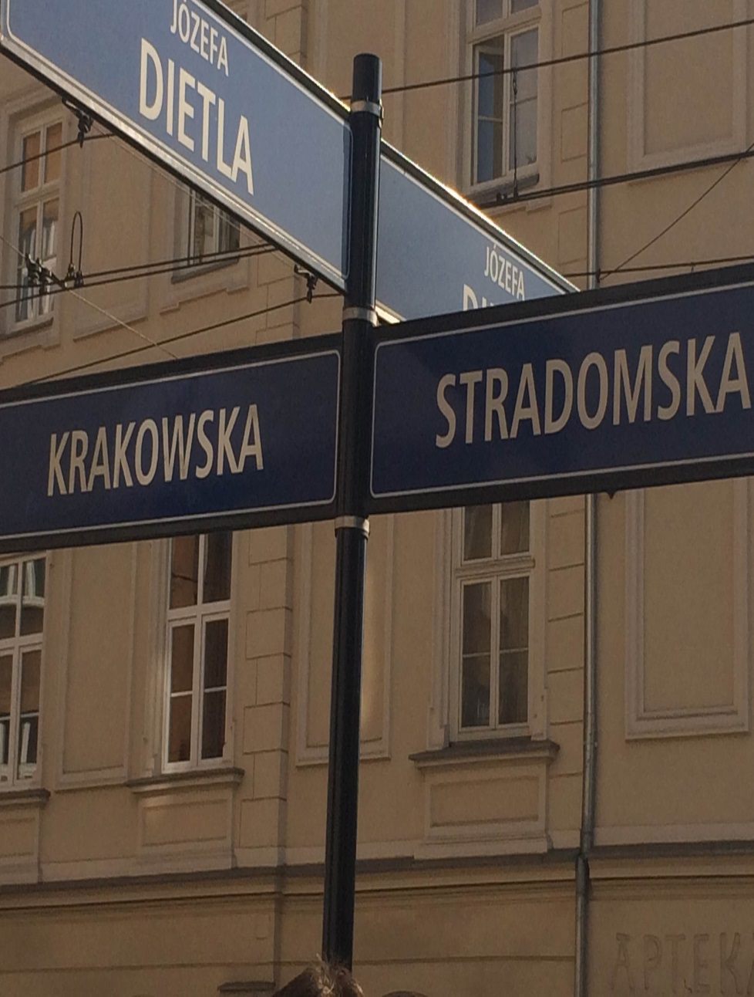
PROGRAMS – major strategy implementation tool
Defined as outcome statement:
GOAL by ACTIVITIES so, that MEASURABLE RESULTS
1
Strategic, outcome indices for progress evaluation
2
Planning and costing facilities
3
Risk identification, evaluation and management
4
Progress and evaluation reports

Slide 20
Program of sustainable transport development
– outcome statement example
weight
goal
Plan the development of transport according to sustainable development rules
So, that
Indicator
Expectation
Contribu-tion of PT journey is at least 60% in 2024
All planed transfer spots are ready and working
PT journeys iagainst all journeys executed in the city
by
Optimisation of the zone and the network of public transportation
Integration of city transport network with trains
base value
number of transfer spots increase indicator
Incre- ase

Slide 21
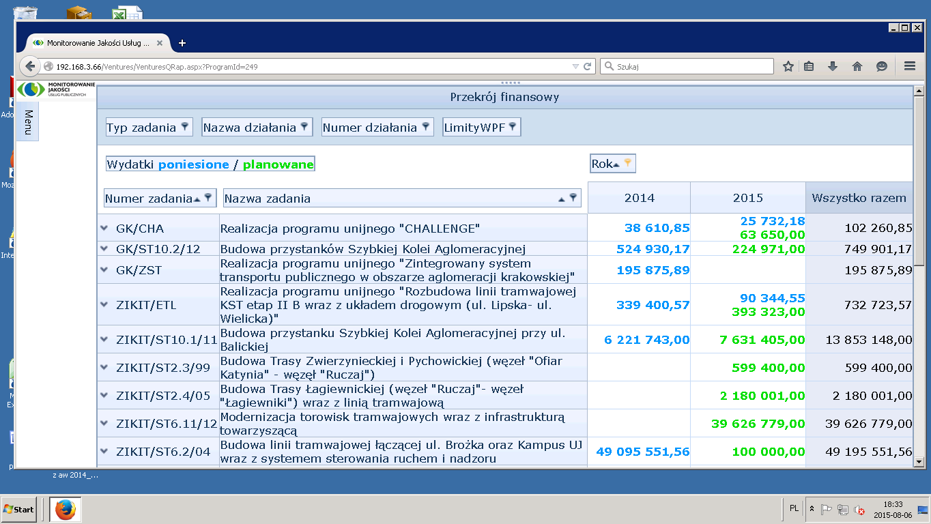
Program –
List of tasks + planned resources and expenditure
Expenditure / plan
task nr
task name
total

Slide 22
BUDGETARY TASKS – performance budgeting tool
STRADOM system supports:
1
Dictionary of product categories
2
Output measures and performace indicators
3
Planning and costing facilities
4
Operational risk evaluation and management
5
Progress and evaluation of output reports

Slide 23
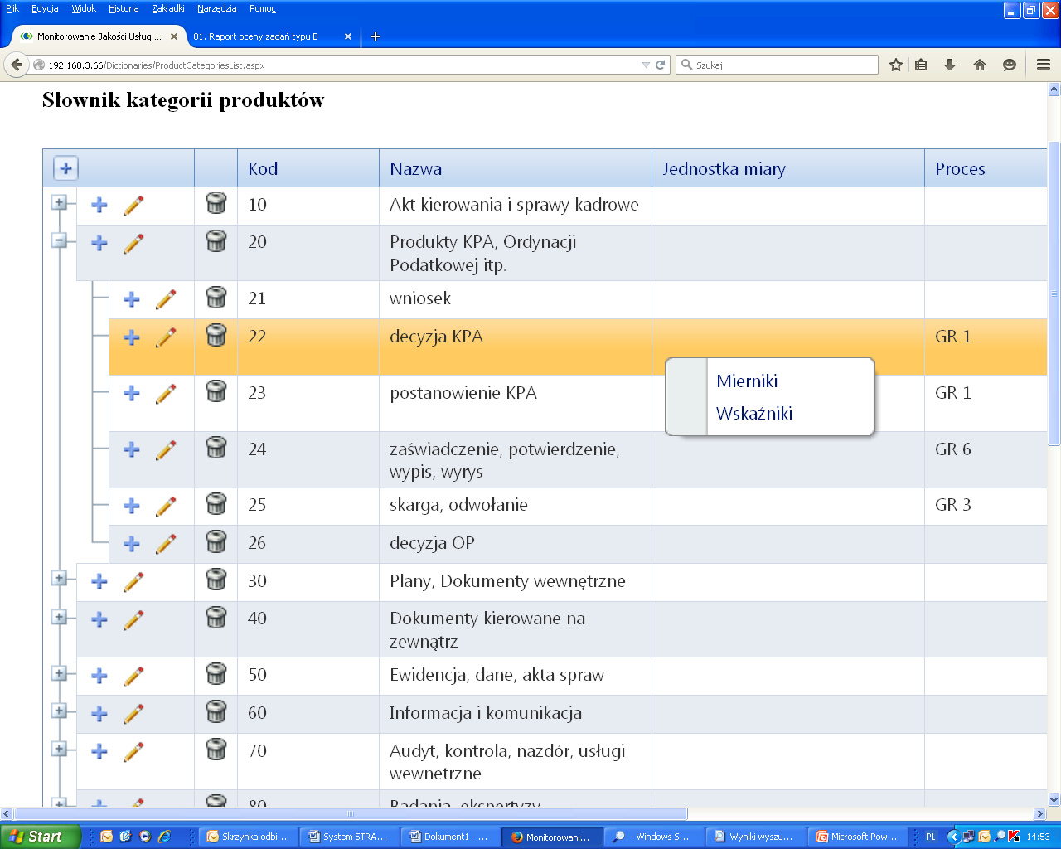
Dictionary of product categories (classes)
– offers set of indicators for each category
symbol
Name of class
Disposition, order, regulation
Products in KPA process
Application
Administrative decision
Measures
Administrative resolution
Indicators
Certificate, testimonial
Complaint, charge
Tax, duty decision

Slide 24
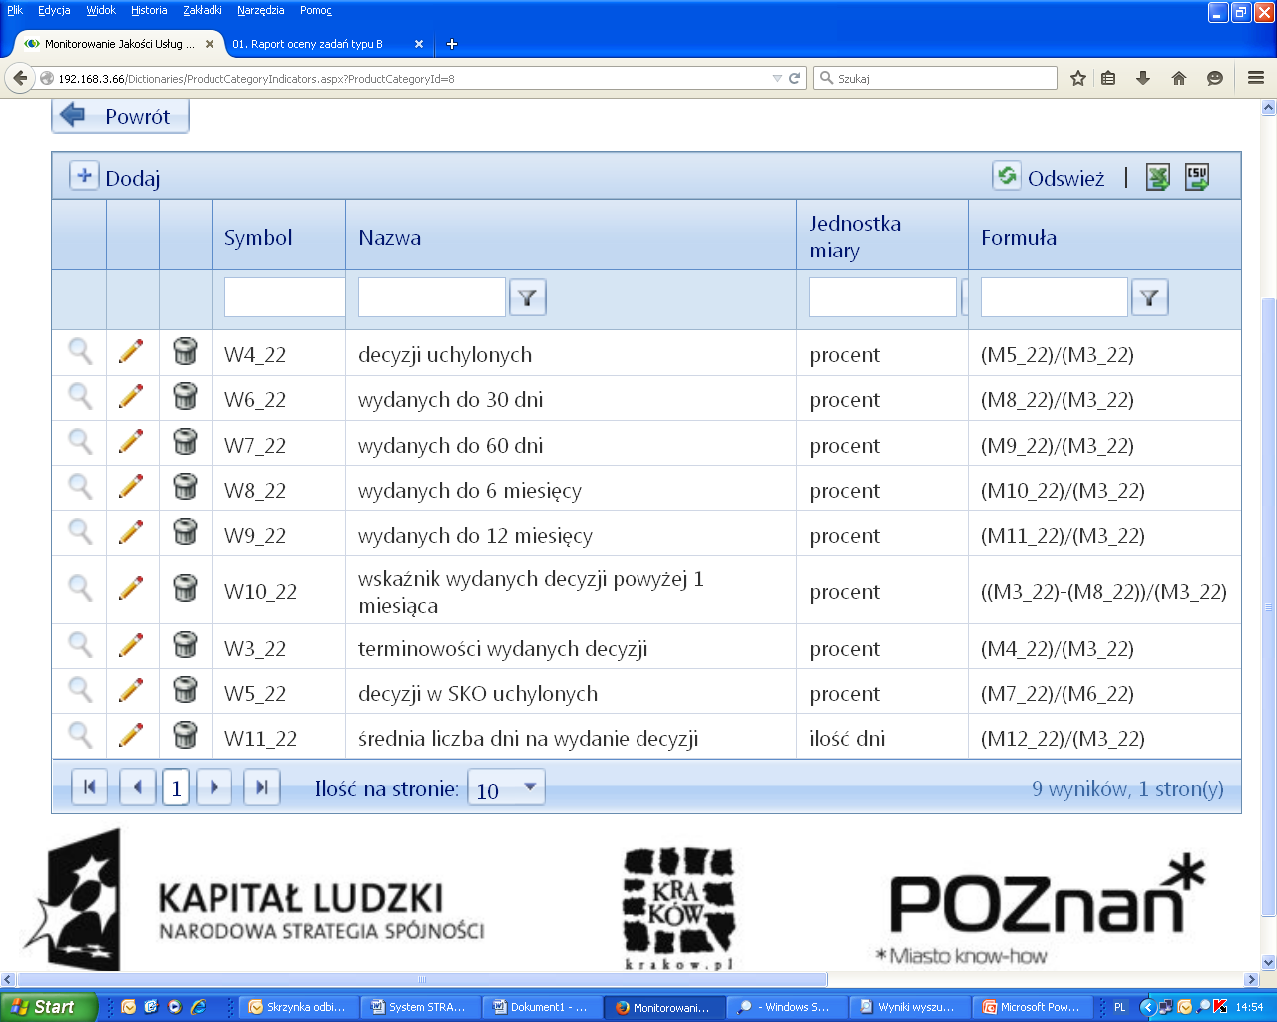
List of indicators offered for product category 22
– each can be selected for monitoring
Name of Indicator
Formula
Canceled decision Ind.
Decision issued within 14 days
Decision issued within 30 days
Decision issued in time Ind.
Average number of days Ind.

Slide 25
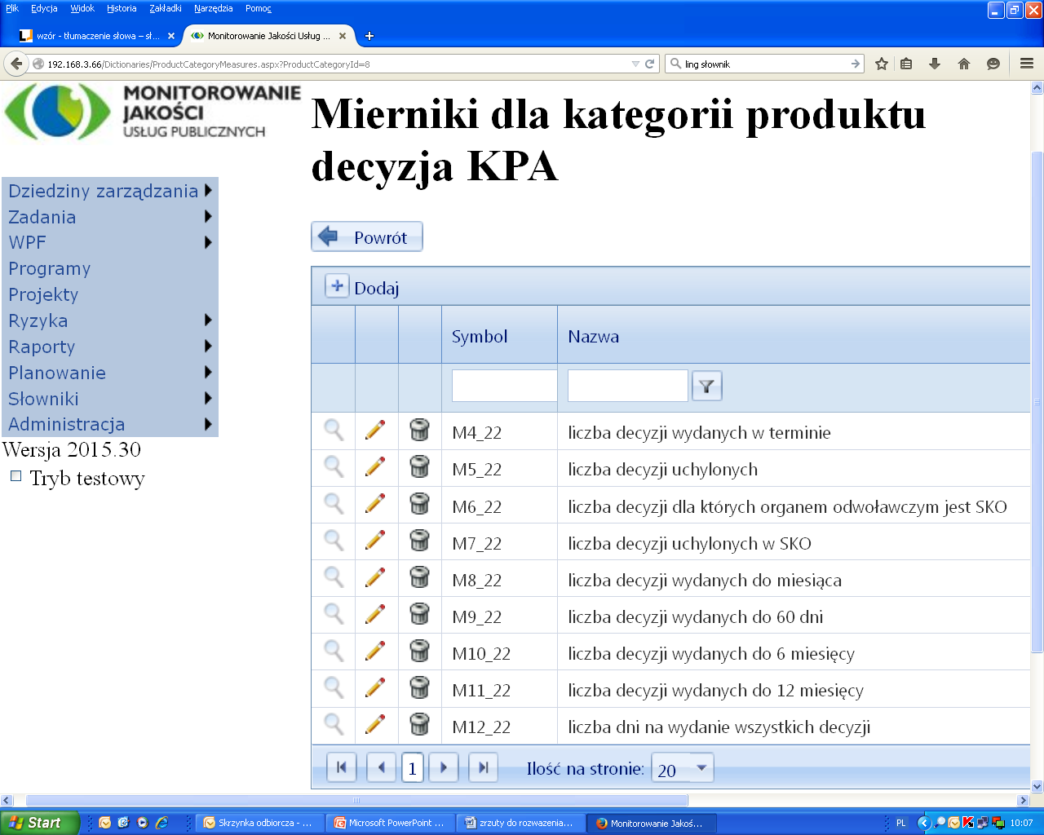
List of measures used in category 22 formulas
– each can be stored in the system
Name of measure
Number of decision issued in time
Number of decision canceled in UMK
Number of decision canceled in SKO
Number of decision issued within 14 days
Number of decision issued within 30 days
Number of days for issuing all decisions

Slide 26
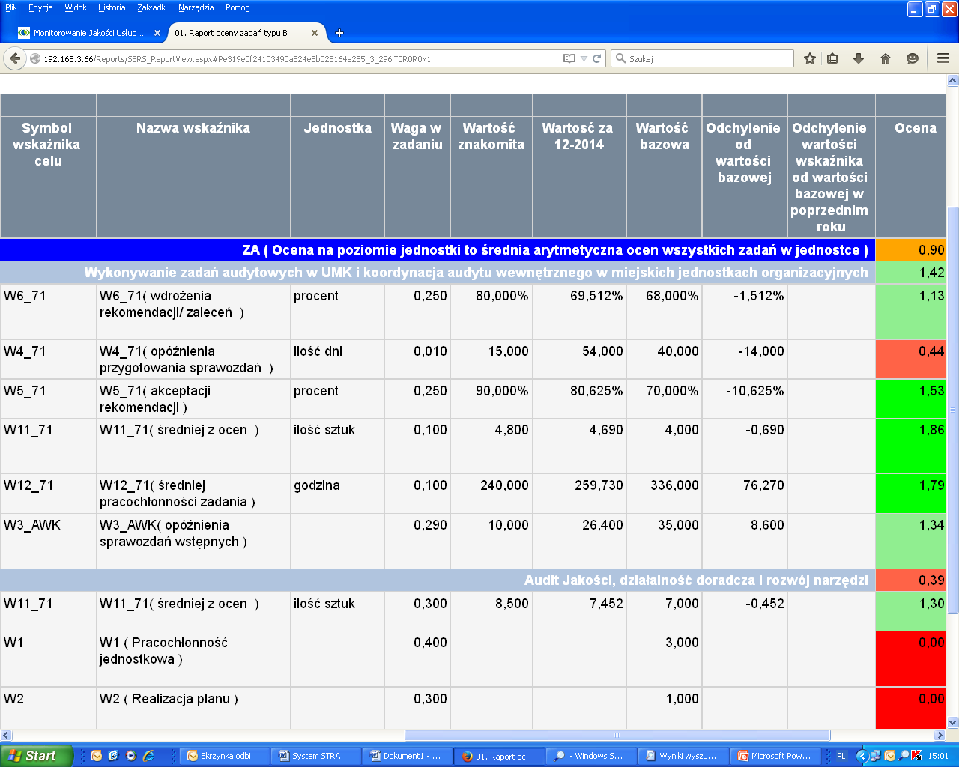
STANDARD REPORT EXAMPLE
TASK EVALUATION SHEET
– presents indictor values in chosen period and calculate the rate
Indicator name
Weight in task
Period value
Base value
Evalu-ation Rate

Slide 27
RISK MANAGEMENT – thread evaluation & action taken
STRADOM system supports:
1
Dictionary of risk categories
2
Strategic risks – long term program goals failed
3
Operational risks – budgetary taks objectives failed
4
Information security risks – info assets damaged, corrupted etc.
5
Map (register) of riks evaluated as medium or more

Slide 28
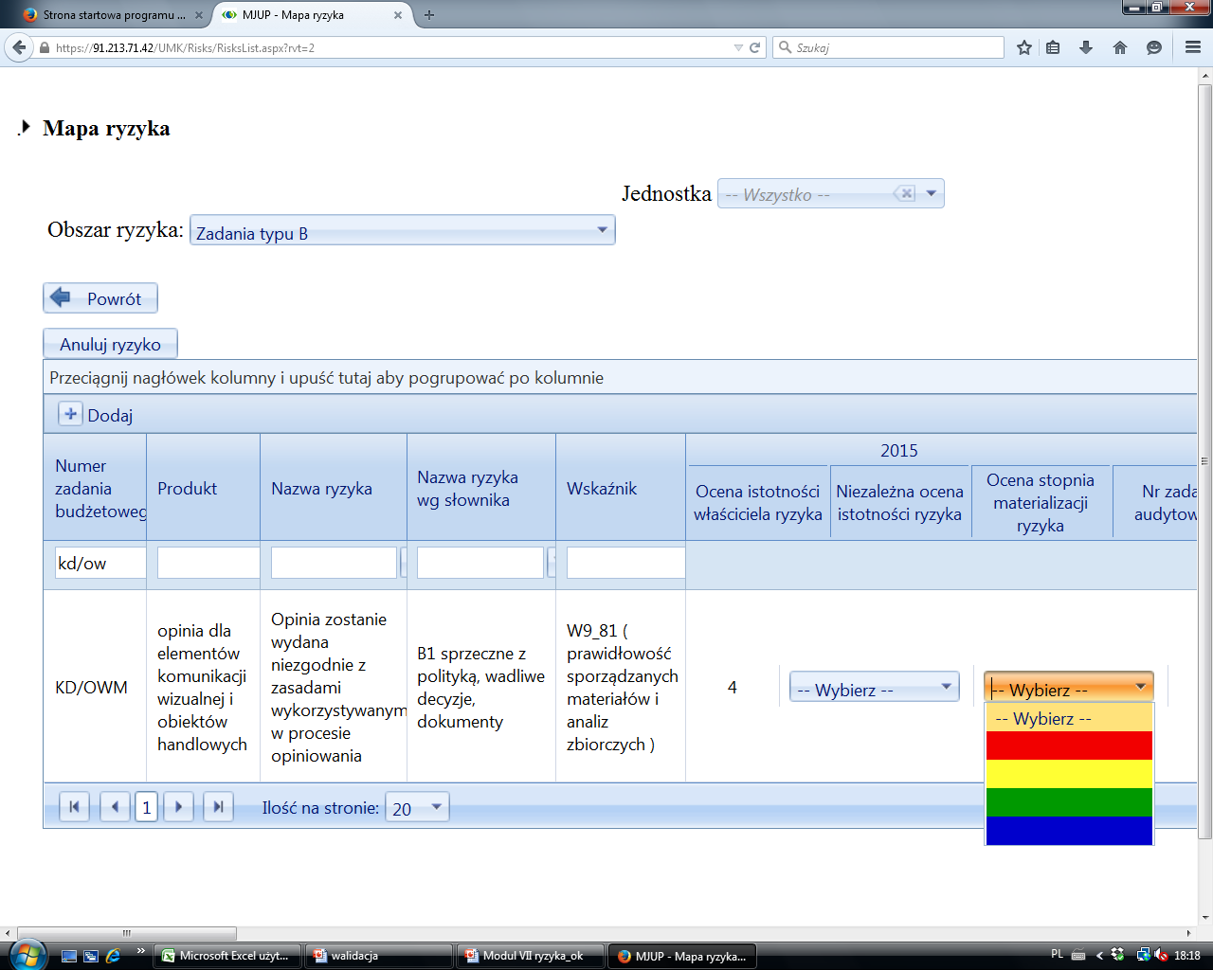
Risk map for Krakow City Hall (operational risks) – presents all risks evaluated as medium or higher
UNIT
Environmental Dpt.
RISK FIELD:
Budgetary task
ADD
Budgetary task number
Risk name
Risk name in dictionary
Indicator
Risk evaluation by owner
Risk evaluation by auditor
Audit
result
Audit engage- ment number
Opinion on cutting of trees
Opinion delivered to late
B1. TIMING FAILED
Percent of opinions issued to late )
medium
choose

Slide 29
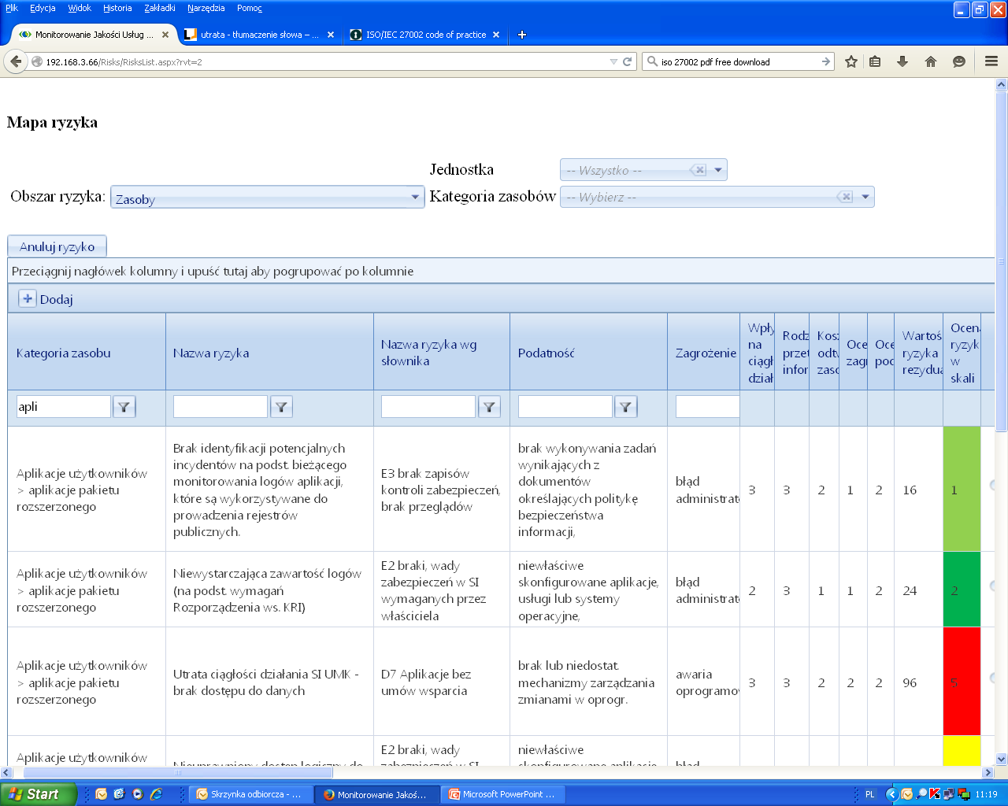
Risk map for Krakow City Hall (Information security)
– presents all risks identified and evaluated in IT area
UNIT:
IT Department.
RISK FIELD:
Information assets
ASSET CATEGORY:
Business applications
Asset
category
Evaluated
factors
Risk evaluation
Risk name
Vulnerability
thread
Business applications
D7. no SLA contract signed
Lack of change management proc.
Application out of service
Business continuity loss

Slide 30
INTERNAL AUDITING – evaluation and consulting on control system
STRADOM system supports:
1
Risk based audit plans
Internal audit
ISO 27001
ISO 9001
……
3
Audit engagement planning – risks to be tested
4
Collection of audit results on the risk map (register)
5
Data on implementing recommendations

Slide 31
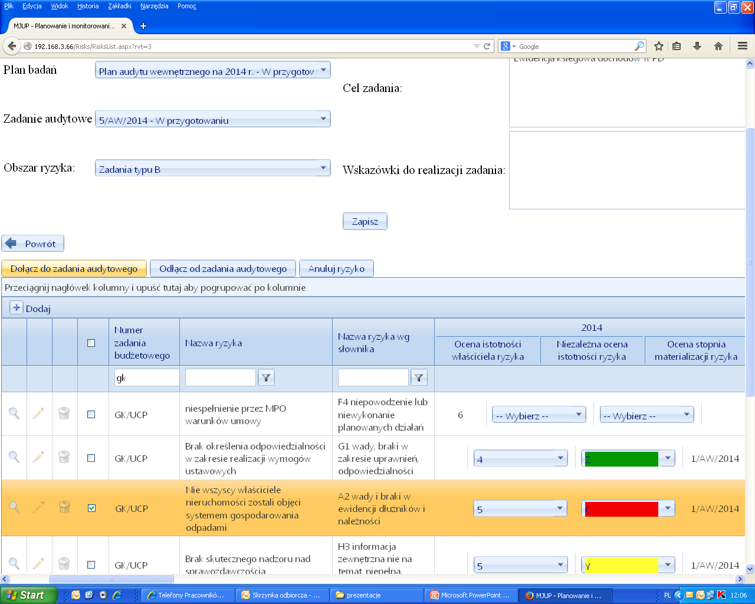
Definition of an audit engagement
- Identification of risks to be studied and examined
KP
Internal audit plan -2015
Audit engagement nr IA_2/2015
Guidelines for IA_2/2015
Add marked risk to the engagement
Risk marked for assignment

Slide 32
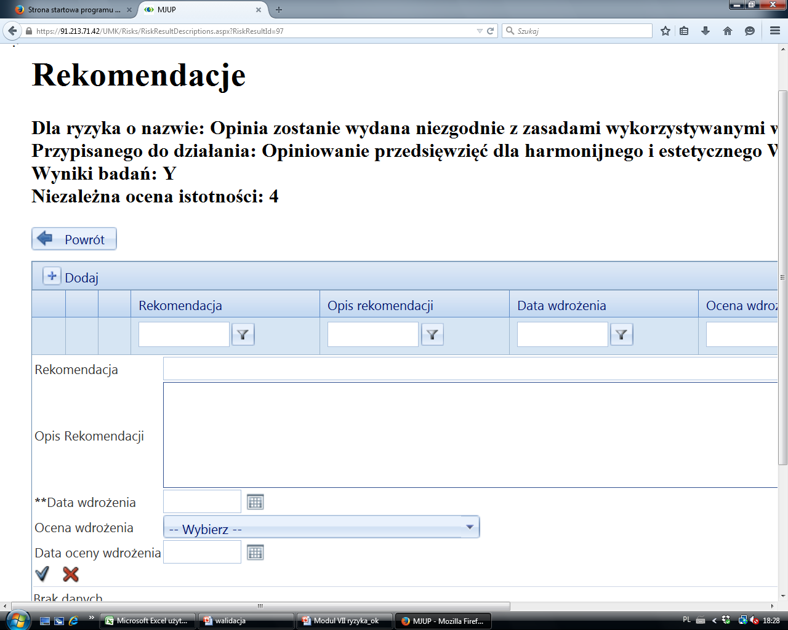
KP
Audit recommendations are recorded and their implementation is supervised
Recommendation
Recommendation description
Implementation date
Evaluation date
Evaluation result
Evaluation date

Slide 33
4
Project output and outcome
Availability of the tools for other local governments

Slide 34
Output and Outcome of the project (in breef)
OUTPUT
New information-based tools supporting integrated local government management.
OUTCOME
LG has better insight into stakeholder preferences and tools to act more professionally i.e. effectively, efficiently and transparently.

Slide 35
Output = what has been achieved
(more details)
Hard data and public opinion presented in QL & QPS Catalog
Outcome (measured by QL & QPS ) and costs monitored in programs
Output results evaluated (by effectiveness and efficiency indicators) in budgetary tasks
Risks identified and evaluated for programs, products and information assets
Risk based audit plans developed and recommendations recorded
Information security audit planned and implementation of recommendation recorded and evaluated
Set of standard static and dynamic reports
The STRADOM system:
Integrate financial & non financial information
Show how resources and actions influence results
Focus and explain key risks at all levels of management

Slide 36
Advantages and availability of the tools
Advantages of the set of tools developed by the project
one integrated system for strategic data, public dialog, activity & financial planning, risk management, auditing data and improvements.
import of current data from local accounting systems
many reports converting collected and imported data into information valuable for management.
knowhow & experience in dictionaries and registers
Availability of the tools for other local governments
STRADOM is available by web browsers and when installed in a service centers it can be used by many local governments.
Local financial planning and accounting systems can be easily integrated using STRADOM interfaces
Demo version of the system and instructional films are available in Polish, but other language versions can be prepared on demand.

Slide 37
Innovation = SET of tools integrating:
Public dialog + measurable goals and objectives
strategic and operational management based on measurable goals formulated in public dialog
Risk analysis, management and information security
risk management system in programs, budgetary tasks and information security
Results evaluated, auditing and continuus improvement
monitoring of effects and results
internal audit and other assurance activities (ISO 9001 and ISO 27001 audits)

Slide 38
Success factors and pitfalls
Pitfalls – lesson learned
Success factors
Time - successful integration will take at least twice much time then planned.
Continuous needs - specify priorities and remember that in one moment the development has to stop.
Opponents and leadership - some of process owners don’t want to take ownership of process adaptation to the new tools and process results… - show that it’s possible!
Flexibility - Scrum (agile method) efficient and user-friendly tool,
Determination – need of involvement of key players to the team and strong support of the CEO
Motivation - Project manager has to have resources to gratify team members,
Cooperation – within the staff (internal experts) and with external experts.

Slide 39
Transferability and perspectives
Challenges
In front of us
Inspire the managerial thinking - mentality problem on staff level – not all the coordinators are ready to take responsibility of results.
Ensure data quality - several hundreds individuals enter data directly to the system – quality of data depends on self discipline & constant attention,
Leadership – dreams about stronger involvement of politicians and public managers.
Tools are implemented, but staff members and organization will have to learn how to use them efficiently at least 2 or 3 years – data alone do not improve performance.
We dream that some media help us to share with citizens information from STRADOM and organize mutual evaluation of progress based on hard data and recorded survey.

