Slide 1
8th Quality Conference
Session 1: Better results via evidence based performance management
Title: Vision – based strategy of the State Railway Inspectorate under the Ministry of Transport and Communications

Slide 2
Our Problem
Source: European Railway Agency, Railway Safety Performance in the European Europe, 2014.

Slide 3
Our Success Story
41,2 %
Improvement

Slide 4
SRI – an Institution with a Clear Vision!
SRI Areas of Activity
SRI Mission
A safe society and safe railway transport, with no accidents and no deaths or injuries of people

Slide 5
The Base of our Zero Vision
Econometric Analysis
Quality management
Strategical thinking

Slide 6
Problem identification
Brainstorm sessions of SRI experts
Statistical verification

Slide 7
Searching for the Root Cause: 5 Whys
Collision
SPAD
Driver
Driver was tired
Inadequate attention at the signal
He was working for 12 hours
Why?
Measure: to check and change working, driving and rest time rules for train drivers.
Why?
Why?
Why?
Why?

Slide 8
Selecting the Right Measures
Brainstorm sessions of SRI experts;
Experience of other NSAs.

Slide 9
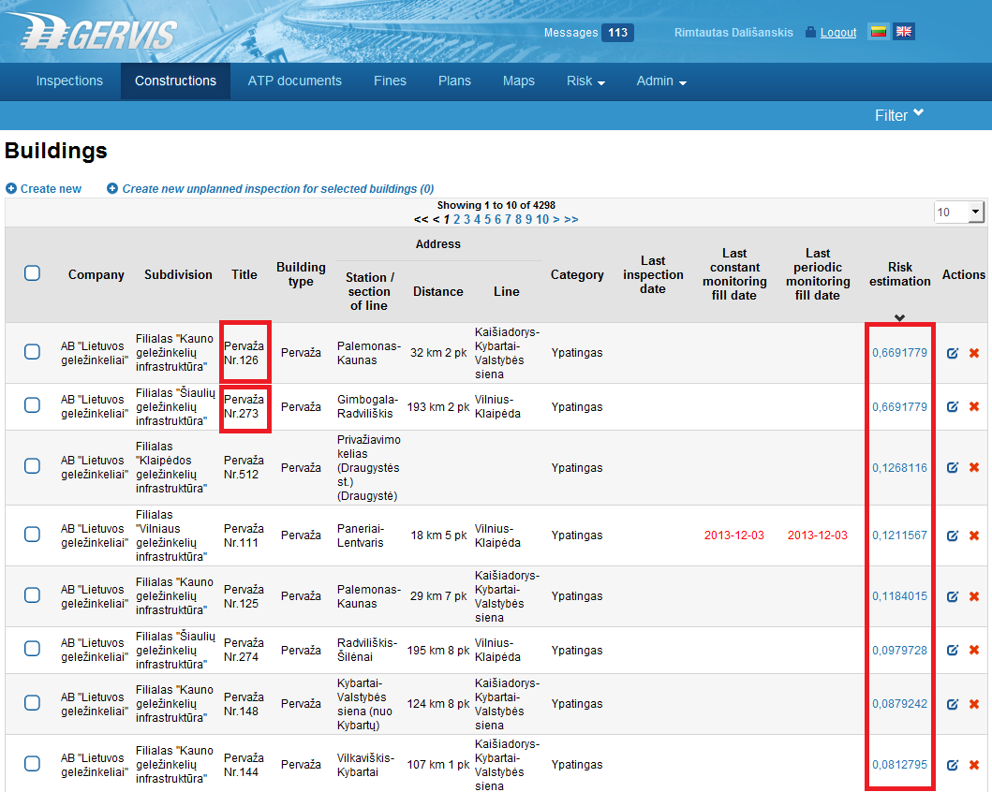
GERVIS: an E – tool for Statistical Analysis

Slide 10
Monitoring and the Progress

Slide 11
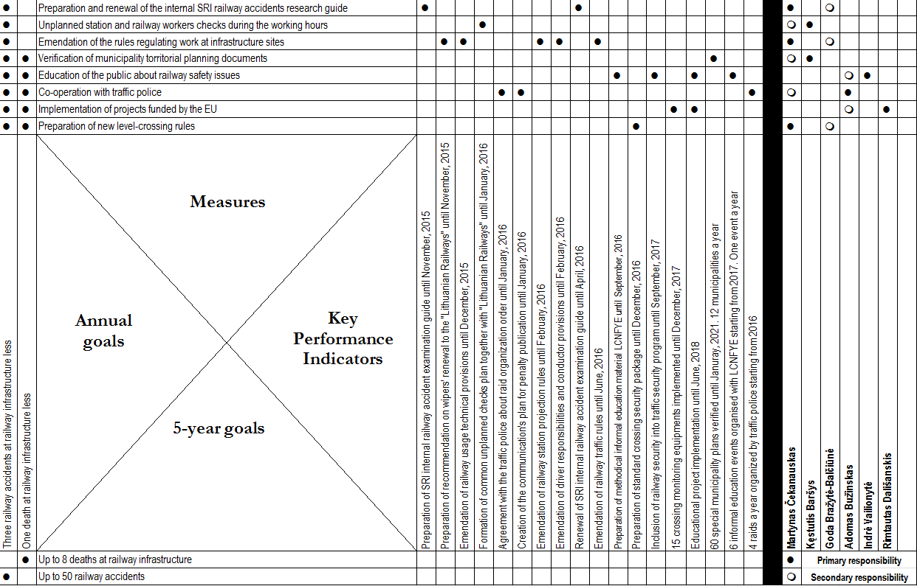
SRI X - Matrix

Slide 12
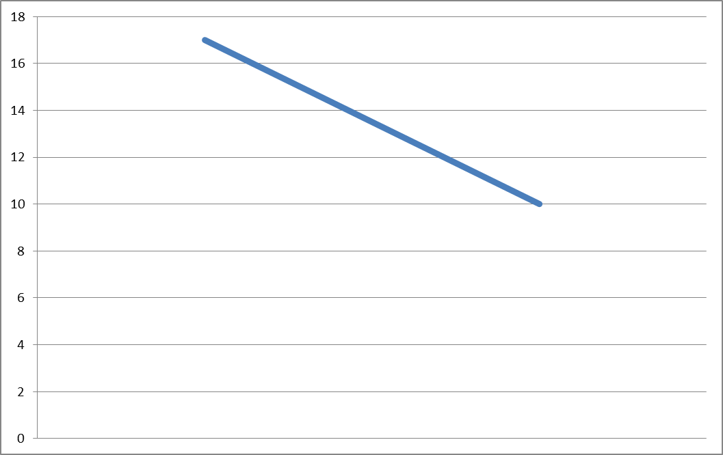
Zero Vision - for Safer Railway Transport!
Decreasing number of fatalities in Lithuanian Railway Premises
-41,2 %
2013
2014

Slide 13
Zero Vision - for Safer Railway Transport!

Slide 14
CONTACT
Thank You for Your Attention!
State Railway Inspectorate
under the Ministry of Transport and Communications
Adomas Bužinskas
vgi@vgi.lt / +370 5 243 0362 / www.vgi.lt
Notes:
Changer journal par report

Slide 15
In – depth Working Session:
Vision – based strategy of the State Railway Inspectorate under the Ministry of Transport and Communications

Slide 16
Outline
Concept of the Zero vision;
5 Whys methodology;
SRI IT tools;
Quality management methods;
Success factors and pitfalls;
Future plans.

Slide 17
Zero Vision as a Concept
Multi – national transport safety approach:
Swedish approach;
“No loss of life is acceptable”.

Slide 18
5 Whys (I)
Toyota Motor Corporation: Sakichi Toyoda’s iterative question asking technique;

Slide 19
5 Whys (II)
5W integration into:
SRI administrative processes;
Accident investigation;
Drafting of the long –term strategy.

Slide 20
SRI IT Solutions (I)
Main functions:
Railway traffic noise maps;
Inspection of economic entities;
Technical supervision of relevant constructions.
Railway transport risk management module.

Slide 21
SRI IT Solutions (II)

Slide 22
LEAN Government
Management methodology for providing government services in the most efficient way;
Good practice of the private sector;
Self – initiative of SRI.

Slide 23
Our experience
Success Factors
Pitfalls
Support from the SRI management;
Committed team of experts.
Thorough planning of every step necessary;
Long – term process of initiating change in the railway sector;
The scope of the project needs to be regularly reviewed;
Self – reliance.

Slide 24
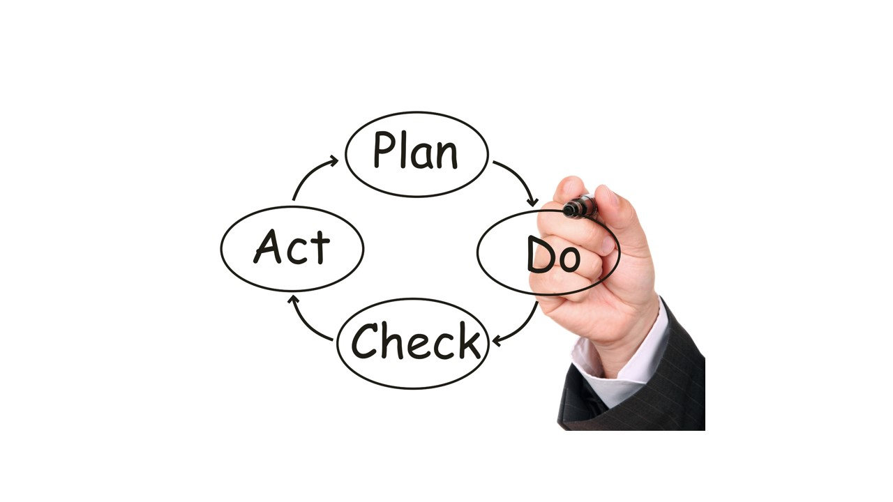
Future Plans

Slide 25
Transferability
Safety – oriented public institutions (Zero Vision);
Any public institution (Strategic planning; quality management).

Slide 26
CONTACT
Thank You for Your Attention!
State Railway Inspectorate
under the Ministry of Transport and Communications
Adomas Bužinskas
vgi@vgi.lt / +370 5 243 0362 / www.vgi.lt
Notes:
Changer journal par report

