Slide 1




Slide 2
Quality of Public Administration –
A Toolbox for Practitioners
8th European Quality Conference’, Esch-Belval, 1 October 2015
Florian HAUSER, European Commission, DG EMPL

Slide 3
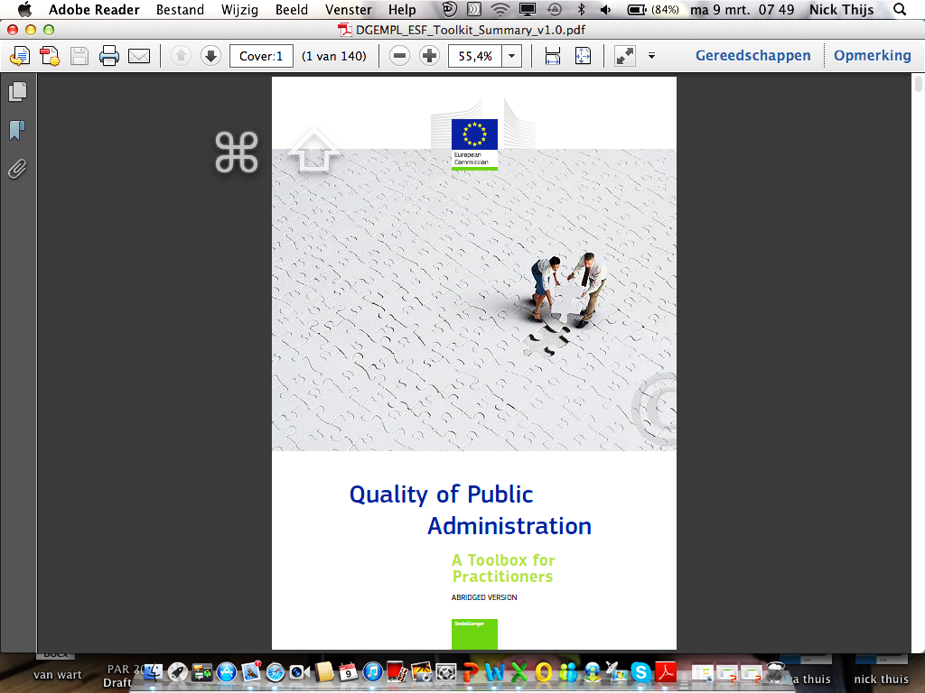
Here it is!
http://ec.europa.eu/esf/toolbox
Short version = print & online
Full version = online only

Slide 4

Key Messages
We need to achieve RESULTS with EU funding for public administration
(Conference EU Budget for Results, 22.09. 2015)
Results does not mean outputs and disbursement
Results means real improvements (innovation => outcomes) for citizens/business
Achieving this might require a culture change – the Toolbox might help you

Slide 5

Toolbox – Why? & What?
Why?
- Linking Policy and funding
- Knowledge Management (one voice)
- Need for Guidance (basis for dialogue)
What?
- Compendium
- Non-prescriptive (no new policy)
- Principles & Examples (170)

Slide 6

Toolbox success
Toolbox success (… so far)
"Non-threatening" (no new policy; non prescriptive)
Demand (Initial print run of more than 2000; more than 1600 downloads within a few weeks; requests for workshops in MS)
Positive feedback (one voice, inspiration, useful examples)

Slide 7
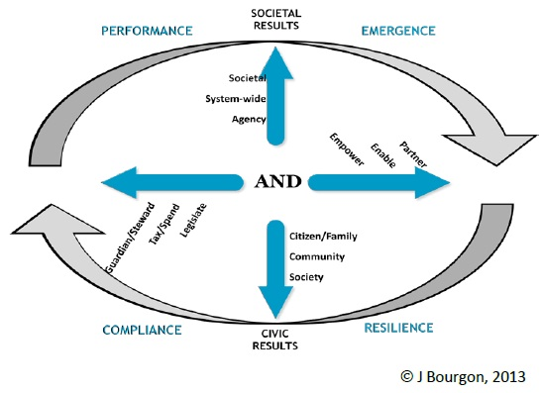
What is at stake?
New Synthesis for Public Administration
Innovative capacity
Organisational capacity
Adaptive capacity
Institutional capacity
http://www.pgionline.com/

Slide 8

    Linking "Policy" to Funding?
20 countries with country specific recommendations from European Semester
Ex-ante conditionalities
TO11 OPs
What policy?
Demand for Guidance
Notes:
Both PA and judiciary.

Slide 9
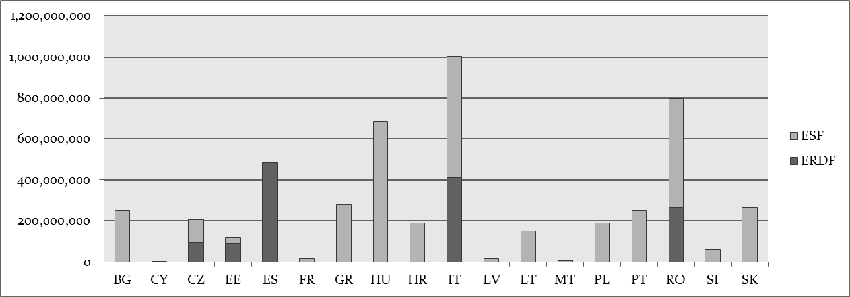
2014-2020 - TO11 Allocation – ESF & ERDF
IT
EUR 4.7 billion
Results?
EL
SK
BG

Slide 10

      Learning & Managing Knowledge
      12 commission directorates general involved
      Compendium of (existing) initiatives (public sector innovation, Small Business Act, Digital Agenda, etc.)
      Complement with international good practice (e.g. HR)
      Break down silos; speak as one voice
Notes:
Both PA and judiciary.

Slide 11

Process
Commission Inter-service Group – agree structure and develop content on basis of CSR and TO11 relevance
Presentation & discussion of drafts (EUPAN, ESF committee, TO11 practitioners, academia)
Verification of case studies (170; mainly member states, many on regional & local level)
May 2014 – March 2015

Slide 12

A Look inside…
Introduction
Principles & values of good governance
Seven thematic chapters:
  Better policy-making
  Embedding ethical & anti-corruption practices
  Professional and well-performing institutions
  Improving service delivery
  Enhancing the business environment
  Strengthening the judicial system
  Managing public funds effectively (including PP and ESIF, TO11)

Slide 13
Toolbox overview by theme and topic
Core functions
Major challenge
Mechanics of administration
Theme 1: Policy-making
1.1 Qualities of policy-making
1.2 Instruments of policy implementation
1.3 Continuous improvement and innovation
Theme 2: Embedding ethical & anti-corruption practices
2.1 Establishing the policy framework
2.2 Building public trust through transparency and accountability
2.3 Promoting integrity & reducing the scope for corruption
2.4 Detecting and acting on corruption
Theme 3: Professional & well-functioning institutions
3.1 Managing for results
3.2 Professional leadership
3.3 Modern human resources policy and management
3.4 Total quality management
Theme 4: Improving service delivery
4.1 Understanding user needs & expectations
4.2 Improving processes to benefit public service users
4.3 Meeting user expectations of easy access to services
4.4 Using e-Government to access faster, cheaper, better services
4.5 Committing to service standards and measuring satisfaction
Applications of good governance
Theme 5: Enhancing the business environment
5.1 Putting business first
5.2 Streamlining administration for businesses
Theme 6: Strengthening the quality of judicial systems
6.1 Assessing and enhancing performance
6.2 Improving access to justice
6.3 Modernising justice systems
6.4 Training and continuing professional development
Theme 7: Managing public funds effectively
7.1 Public financial management
7.2 Public procurement
7.3 Managing ESI Funds

Slide 14
Navigation
Compendium style (many sources, underlying messages, lessons, not a roadmap – context may limit transferability) +
Blue Boxes
Commission policy and initiatives
Orange Boxes
Key studies and speeches
Green Boxes
Case studies
Lighter Green
"Cited" from existing studies and guides
Darker Green
Checked with "original sources"

Slide 15

The Toolbox is more like a cookbook…
You choose what you like/what suits you…
You don't have to like or cook everything in the book!

Slide 16
Content Example – anti-corruption
Typical Operational Programme approach | Toolbox suggestions
Training Whistleblowing, persecution Invest in anti-corruption agencies | Systemic approach Risk based review Transparency http://anticorrp.eu/

Slide 17
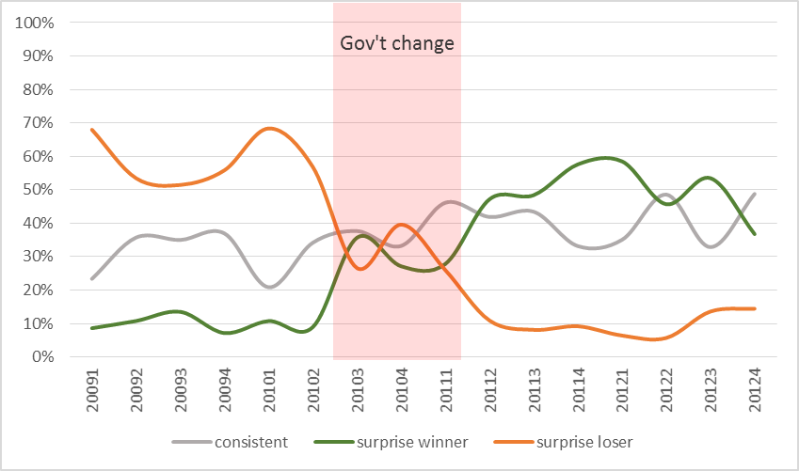
Companies lose/win surprisingly when government changes
http://anticorrp.eu/

Slide 18
Content Example – e-government
Typical Operational Programme approach | Toolbox suggestions
Focus on IT (buying stuff) Separate hardware and system design Risk to "digitise bureaucracy" | Integrated approach Streamline processes first Technology is not the problem (organisational, legal, procedural, inter-operability)

Slide 19
Putting it to Practice – Toolbox for Quality PAs
Interoperability & key enablers
(e-ID, single sign on, etc.)
Better policy-making
Embedding ethical & anti-corruption practices
Professional and well-performing institutions
Improving service delivery
Enhancing the business environment
Strengthening the quality of judicial systems
Managing public funds effectively
Policy labs
Financial Transparency System
‘Once only’ principle
of data registration
Digital by default
eProcurement
eJustice
Open by default

Slide 20
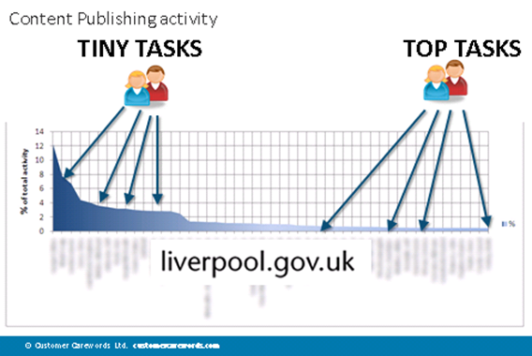
Good Practice
User centricity
Source: Gerry Mc Govern

Slide 21



Example -
"Once only" (data exchange among relevant authorities)
Staff motivation – creative solutions from bottom up
Customer Orientation (Service & simplification)
Focus on:
Learning, innovation and
continuous improvement (and continuity and stability)
Performance Monitoring
Benchmarking against "Toolbox" Principles

Slide 22
ELEKTRONIZÁCIA VEREJNÉHO OBSTARÁVANIA NA SLOVENSKU
ELECTRONIC PUBLIC PROCUREMENT IN SLOVAKIA
 |  |  | 2010 | 2011 | 2012 | 2013 | 2014 | 2015
Neelektronická forma Non-electronic form | Vyhlásené verejné obstarávanie Announced public procurements |  | * | * | * | 9 929 | 3 178 | *
Elektronická forma Electronic form | Počet zrealizovaných e-aukcií Number of executed e-auctions | EVO | 3 | 864 | 1 420 | 1 280 | 1 356 | *
 |  | PROe.biz* | * | * | * | 3 150 | 3 707 | 5 460
 | Počet začatých zákaziek Number of started order placements | EVO | 53 | 899 | 973 | 777 | 727 | *
 | Počet obchodov Number of contracts | EKS | * | * | * | * | 214 ⁽¹ | 22 433 ⁽²
 |  | 2010 | 2011 | 2012 | 2013 | 2014 | 2015
Počet zaregistrovaných organizácií / objednávateľov | EVO | 87 | 281 | 441 | 618 | 1 007 | *
Number of registered organisations / contractors | EKS | * | * | * | * | 1 915 ⁽¹ | 6 116 ⁽²
Počet používateľských prístupov / dodávateľov Number of user accesses / suppliers | EVO | 328 | 1 215 | 1 793 | 2 370 | 3 576 | *
 | EKS | * | * | * | * | 3 817 ⁽¹ | 10 291 ⁽²
*
Údaj nie je k dispozícii, je dostupný iba za ukončené kalendárne roky alebo systém neexistoval /
Information is not available, is available only for completed calendar years or system did not exist
Testovacia prevádzka / Testing phase
Od 02/2015 ostrá prevádzka, k dátumu 23. 09. 2015 / Since 02/2015 real phase, as of 23. 09. 2015
www.uvo.gov.sk, www.eks.sk, PROe.biz
(1
(2

Slide 23



















BENEFITS OF ELECTRONIC MARKET PLACE TO THE SOCIETY
ECONOMY
30 000 000
3,76
5,67
24 278 367 € / 17 707 zákaziek/order placements
z toho zákazky z EÚ fondov/from it order placements of EU funds:
8 428 007 € / 1 914 zákaziek/order placements
Úspory/Savings
25 000 000
20 000 000
15 000 000
10 000 000
5 000 000
0
Priemerný počet súťažiacich v jednej zákazke
Average number of contestants in single order placement
20 000 000
18 745 161 € / 10 199
zákaziek/order placements
z toho zákazky z EÚ fondov/
from it order placements of EU funds:
8 024 168 € / 943 zákaziek/
order placements
15 000 000
10 000 000
5 000 000
0
Február 2015
Marec 2015
Apríl 2015
Máj 2015
Jún 2015
Júl 2015
August 2015
September 2015*
Úspory dosiahnuté pri zákazkách s viac ako 3 ponúkajúcimi, vypočítané z rozdielu najnižšej a tretej najvyššej ponuky
Savings by order placements with more than 3 contestants,
* k dátumu 23.09.2015 / as of 23.09.2015
Celkové dosiahnuté úspory
All savings
calculated from the difference between lowest and third highest offer

Slide 24
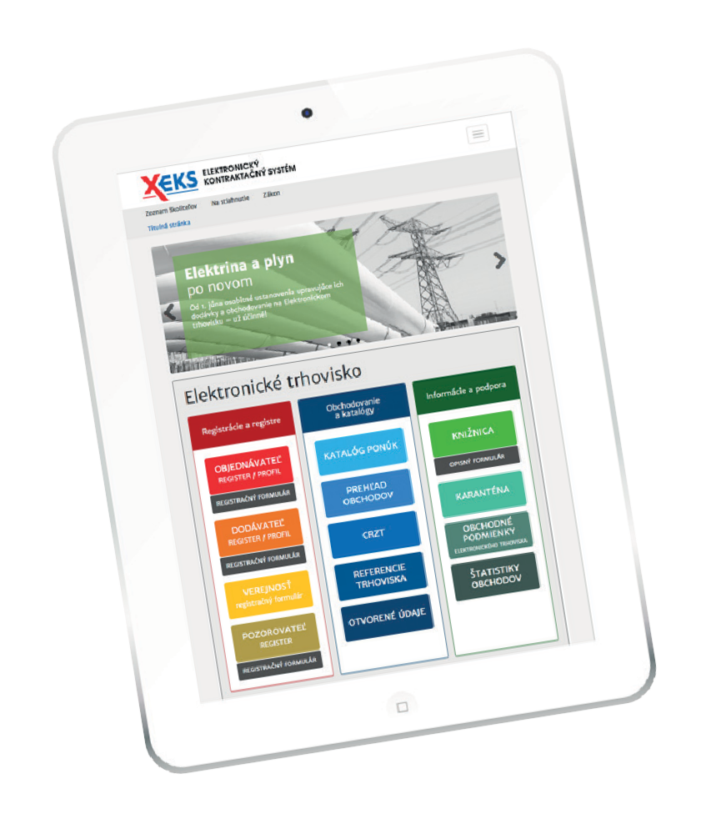

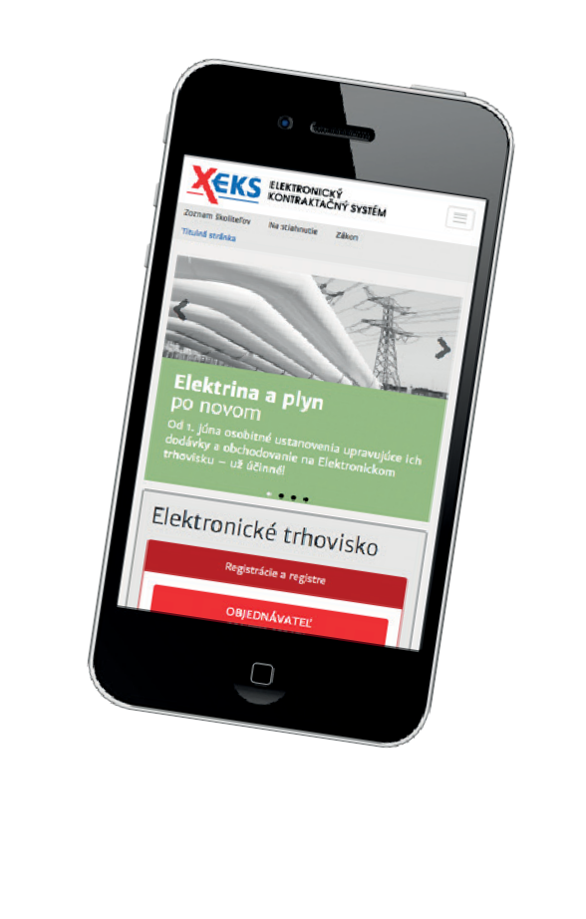


BENEFITS OF ELECTRONIC MARKET PLACE TO THE SOCIETY
EFEKTÍVNOSŤ
EFFICIENCY
ELIMINÁCIA KORUPČNÉHO SPRÁVANIA
ELIMINATION OF CORRUPTION BEHAVIOUR
čas súťaže v priemere 3 mesiace competition time
on average 3 months
competition time
Automatically generated contracts
Anonymous process of trade management and placement of offers
Online trading on the web
Minimization of personal interventions
on average 5 working days
Place and time flexibility
Odbúranie administratívnej záťaže
Removal of administrative burden

Slide 25
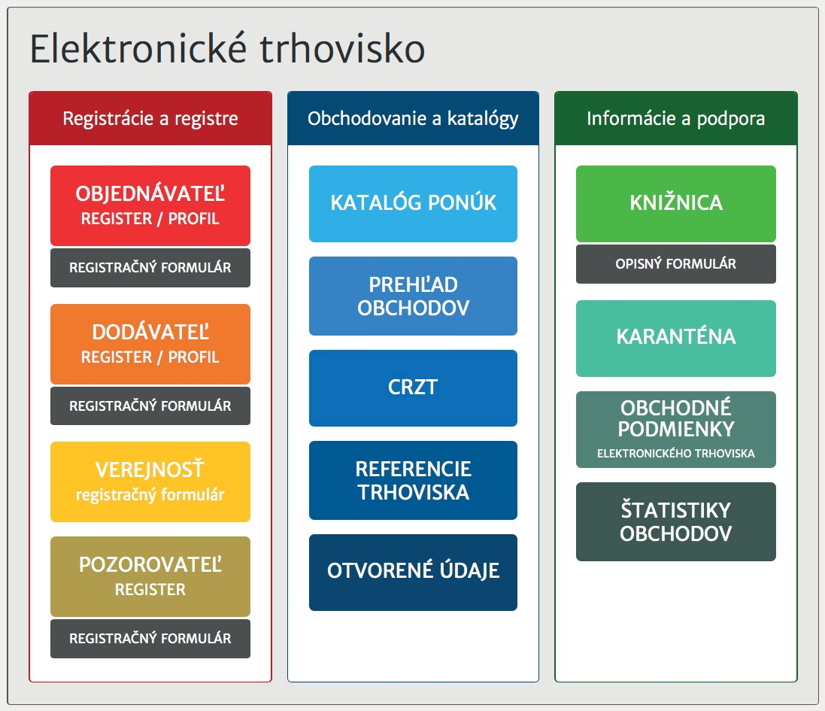
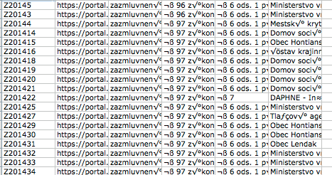
BENEFITS OF ELECTRONIC MARKET PLACE TO THE SOCIETY
TRANSPARENCY
PUBLICATION
through section of Open
data, which registered
6 949 visits until now
COMPREHENSIBILITY
in the form of spreading
the knowledge through direct unlimited web access:
31 654 Description forms,
which provide examples of good practices and information through:
FAQ
view of all executed contracts
direct contact through support centre of Electronic contracting system and trainings, where information was provided to over 8 000 contractors
and over 15 000 suppliers
It contributes to the support of economic competition together with systems of active notification in the form of automated inviting of all registered suppliers into competitions called in their respective field.

Slide 26

Toolbox
Dissemination
ToT approach via geo desks (speak as one voice)
Workshops on request (6 booked so far)
Via multipliers (e.g. EUPAN, ESIF committees, etc.)

Slide 27



Toolbox Evolution?
Collaboration with Member States
Format / content / management?
Basis for dialogues & exchange?
Your Ideas?

